Slide 1
Workshop 3: Improving Project Estimates and Communication
PA TechCon
May 4, 2017

Slide 2
Agenda
About Estimates
Estimation Methodologies
Best Practices
Team Exercise

Slide 3
Estimates v. Commitments
Requestors usually don’t know the difference…
The Problem with Estimating Too High
Could lose a bid
Project canceled for lack of overestimated funds
Rejection of a good solution
Long term loss of credibility
The Problem with Estimating Too Low
Missed deadlines
Lose money on bid
Setup for failure
Over budget
Long term loss of credibility

Slide 4
What Are We Estimating?
What will it take to complete a project? What are we estimating?
Requirements
Work Breakdown Structure
Implementation Process & Tasks
Effort
Duration
Resource
Costs
Microsoft Word
& Other WBS Tools
Material
Costs

Slide 5
Document All Assumptions
Document all assumption and their impact on the estimate.
Clarifies the thought processes (for yourself and others)
Provides a disclaimer for estimates that are not “perfect predictions”
May calm the fears of those providing an estimate
Deliver all the Assumptions in detail with the estimate.
Accept that you won’t have every detail – it’s not realistic or necessary.

Slide 6
Typical Assumptions
Scope of Work
Functionality
Performance & Capacity
Security
Available Staff & Skills
Tools & Technologies
SDLC Phases (Testing, Training, Documentation)
Availability and Quality of Data
Timing
Dependencies on Other Participants
Available Facilities
Procurement Timing
Work Hours
Turnaround on Review and Approval of Artifacts

Slide 7
Effort Does Not Equal Duration
Many factors impact a resource’s availability and effectiveness.
Other Project Commitments
Meetings
Personal Distractions
Vacations
Holidays
MS Project and other tools allow you to create calendars and adjust availability of resources.
The Toolkit includes an adjustable factor for Hours/Day. Default = 7.5

Slide 8
Communicate the Complete Estimate
Communicate the estimate as a complete package that documents and highlights all information.
Scope
Approach
Effort & Duration
Material Costs
Assumptions & Risks
Range of Results
Summarize on one page along with the details.

Slide 9
Estimation Methodologies

Slide 10
Expert Judgement
The most common approach to estimation can be incredibly accurate and can be substantially abused.
Find Real Experts – with Hands-on Experience
Make Sure Requirements are Clearly Understood

Slide 11
WBS Focused
Top-down
Bottom Up
Develop Level Of Effort from the top of the WBS. Example:
Estimate for the Infrastructure
Divide the Infrastructure into components and validate
Leverage work breakdown structure and data from previous projects
Pro: Good for First Pass
Con: Lacks Detailed Justification
Develop Level of Effort from the bottom of the WBS. Example:
Estimate for each Server
Roll up all the estimates
Pro: Detailed
Con: Requires additional time and detail, easy to get exaggerated results if not careful
When to use top down…
The early stages of a project to develop talking points for management
When you have similar projects for comparison
When time to develop an estimate is limited
When high level budgetary estimates are needed to obtain funding

Slide 12
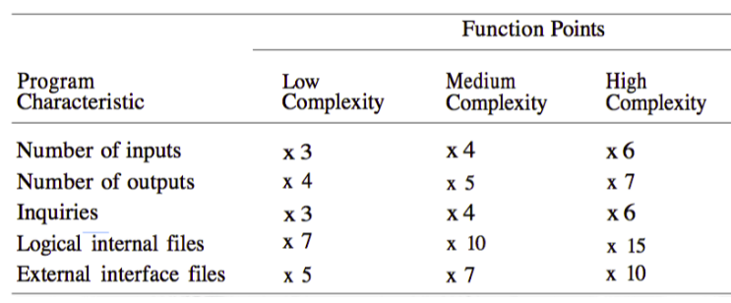
Parametric Model
Leverage comparative or analogous projects to create a model.
Extrapolate WBS components - Understand what may change
Resources skills
Complexity
Customer
Size
Based on repeatable projects and work packages
Uses scalable results to create new estimates
Pro: fairly accurate if refined carefully over time, variations can be measured
Con: takes time to build up model, many variations/parameters

Slide 13
Delphi
Delphi is a consensus building exercise where experts provide estimates and the results are shared anonymously as input to another round of estimates.
Feedback
1st Round
Analysis of Results
2nd Round
Analysis of Results
3rd Round
Analysis of Results
Feedback
Feedback

Slide 14
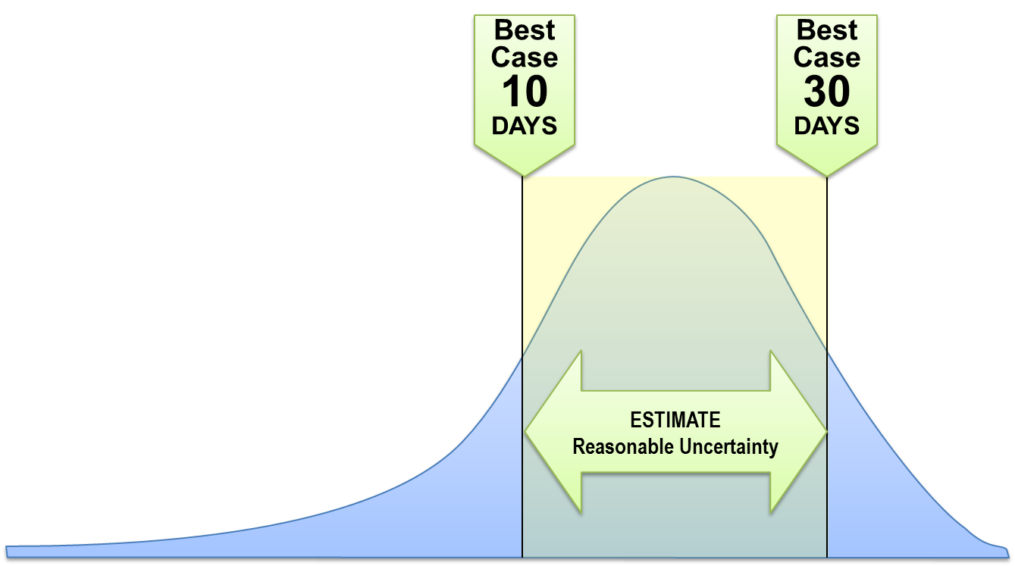
PERT (Program Evaluation and Review Technique)
The Beta Distribution analysis allows estimators to consider a range of outcomes.
Estimate = (Optimistic + 4 * Expected + Pessimistic)/6
Consider multiple estimators
Allows for the analysis of total optimistic and pessimistic scenarios
The beta distribution estimation technique is used when there is a degree of uncertainty around expected durations of a work breakdown structure element.

Slide 15
Best Practices
Document Assumptions
Create a WBS
Get Broad Participation
Learn From History
Compare Estimates
Effort Does Not Equal Duration
Follow a Process
Communicate the Whole Estimate

Slide 16
Team Exercise

Slide 17
What Will it Take to Build a Shed in Steve’s Backyard
Shed Requirements
Dimensions 12 ft. x 12 ft.
Door – 6’ entry
Window
Vents
Lock
Ramp
No electricity
Your Table is Your Team.
What Questions Do You Have About The Scope?

Slide 18
Exercise
Clarifying Scope
What Questions Might We Ask?
Class Discussion – 5 Minutes
Developing WBS
Team Collaboration – 5 Minutes
Class Discussion – 5 Minutes
Developing & Estimating Tasks
Team Collaboration Complete Worksheet – 15 Minutes
Class Discussion – 10 Minutes

Slide 19
Realistic Scope Questions…
Scope
Approach
Need Permits?
Concrete Pad or Wooden Floor?
Height? Includes Loft?
Framing Spacing?
Weight Capacity?
Exterior Finish?
Gutters?
Trim work and Decorations?
DIY, Contractor, Kit, Pre-Built?
Accounting for waste/scrap?
Cleanup and disposal?
What’s the weather/season?

Slide 20
Create a Work Breakdown Structure
Site Plans & Building Design
Permit
Concrete Pad (or footings)
Frame
Siding/Sheathing
Roof
Window
Door
Finished/Painted Exterior
Inspection Certificate

Slide 21
Implementation Tasks
Develop Plans
Obtain Permit
Buy Materials
Build Foundation
Build Frame
Attach Siding/Sheathing
Build Roof
Install Window
Install Door
Finish Exterior (Paint, Trim, etc.)
Inspection

Slide 22
Contact Information
For more information regarding this presentation please contact:
Steven E. Young, PMP, Vice President
syoung@mathtechinc.com
Frank Nestore, PMP, Director
syoung@mathtechinc.com
Mathtech, Inc.
Mathtech, Inc.
2465 Kuser Road
Suite 200
Hamilton, NJ 08690
Phone: 609-689-8520
www.mathtechinc.com

