Slide 1
IBM SECURITY SERVICES
Data Protection: It’s more than encryption
Notes:
This file was created in Microsoft PowerPoint 365 Pro Plus 2016
To ensure ideal readability and slide effects, view using the latest version of PowerPoint
which is free for IBMers to download on any IBM-managed device from the
Microsoft Office at IBM Community: https://w3-connections.ibm.com/communities/service/html/communitystart?communityUuid=5b88000f-d3c4-4e5a-b2be-4acd9e3a0c6a

Slide 2



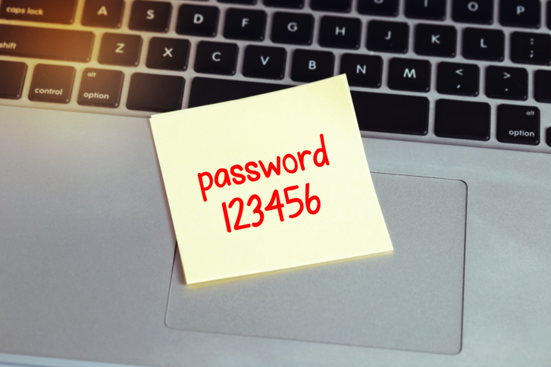

Today’s Agenda
Threat / Risk
Landscape
Database Activity Monitoring
Case Studies
Data Protection
Framework
Encryption Solutions
Notes:
Advanced Attacks – more advanced than ever, >80% in cyber gangs, global business that accounts for $400B+ a year.
Source: http://www.mcafee.com/us/resources/reports/rp-economic-impact-cybercrime2.pdf
Human error – More than half of data breaches are caused by insiders, including employees, third-party contractors and partners.
Source: http://www-03.ibm.com/security/data-breach/2015-cyber-security-index.html?ce=ISM0484&ct=SWG&cmp=IBMSocial&cm=h&cr=Security&ccy=US
Innovation – cloud, mobile, and IOT create unprecedented risks to organizations. 44% of security leaders expect a major cloud provider to suffer a significant security breach in the future. 33% of organizations don’t even test their mobile apps. CISCO estimates that by 2020, there’ll be 50 billion devices connected.
Sources: https://www-03.ibm.com/press/us/en/pressrelease/45326.wss; https://securityintelligence.com/mobile-insecurity/; http://blogs.cisco.com/diversity/the-internet-of-things-infographic
Compliance – adapting to a threat-aware, risk based approach vs. compliance based, box checking approach. In August 2015 a federal court ruled that the Federal Trade Commission (FTC) has the authority to take action against organizations that fail to protect consumer information against cyber attacks. The court’s ruling should lead to greater scrutiny of corporate cyber security following a breach of personal privileged information.
Source: http://www.pcworld.com/article/2974771/appeals-court-denies-challenge-to-ftcs-cybersecurity-enforcement.html
The Federal Communications Commission (FCC) reached a $25 million settlement with AT&T Services over allegations the phone carrier failed to protect the personal data of hundreds of thousands of customers whose personal information was compromised in a data breach that occurred between November 2013 and April 2014.
Source: http://topclassactions.com/lawsuit-settlements/lawsuit-news/53582-att-to-pay-25m-in-data-breach-settlement-with-fcc/
Skills gap - experts predict a shortage of 1.5 million open and unfilled security positions by 2020.
Source: Frost & Sullivan Report, 2015
More than 209,000 cybersecurity jobs in the U.S. are unfilled, and postings are up 74% over the past five years, according to a 2015 analysis of numbers from the Bureau of Labor Statistics by Peninsula Press, a project of the Stanford University Journalism Program.
Source: http://www.forbes.com/sites/stevemorgan/2016/01/02/one-million-cybersecurity-job-openings-in-2016/#683b25157d27

Slide 3
Threat / Risk Landscape
Threat / Risk
Landscape
Database Activity Monitoring
Case Studies
Data Protection
Framework
Encryption Solutions
Notes:
Advanced Attacks – more advanced than ever, >80% in cyber gangs, global business that accounts for $400B+ a year.
Source: http://www.mcafee.com/us/resources/reports/rp-economic-impact-cybercrime2.pdf
Human error – More than half of data breaches are caused by insiders, including employees, third-party contractors and partners.
Source: http://www-03.ibm.com/security/data-breach/2015-cyber-security-index.html?ce=ISM0484&ct=SWG&cmp=IBMSocial&cm=h&cr=Security&ccy=US
Innovation – cloud, mobile, and IOT create unprecedented risks to organizations. 44% of security leaders expect a major cloud provider to suffer a significant security breach in the future. 33% of organizations don’t even test their mobile apps. CISCO estimates that by 2020, there’ll be 50 billion devices connected.
Sources: https://www-03.ibm.com/press/us/en/pressrelease/45326.wss; https://securityintelligence.com/mobile-insecurity/; http://blogs.cisco.com/diversity/the-internet-of-things-infographic
Compliance – adapting to a threat-aware, risk based approach vs. compliance based, box checking approach. In August 2015 a federal court ruled that the Federal Trade Commission (FTC) has the authority to take action against organizations that fail to protect consumer information against cyber attacks. The court’s ruling should lead to greater scrutiny of corporate cyber security following a breach of personal privileged information.
Source: http://www.pcworld.com/article/2974771/appeals-court-denies-challenge-to-ftcs-cybersecurity-enforcement.html
The Federal Communications Commission (FCC) reached a $25 million settlement with AT&T Services over allegations the phone carrier failed to protect the personal data of hundreds of thousands of customers whose personal information was compromised in a data breach that occurred between November 2013 and April 2014.
Source: http://topclassactions.com/lawsuit-settlements/lawsuit-news/53582-att-to-pay-25m-in-data-breach-settlement-with-fcc/
Skills gap - experts predict a shortage of 1.5 million open and unfilled security positions by 2020.
Source: Frost & Sullivan Report, 2015
More than 209,000 cybersecurity jobs in the U.S. are unfilled, and postings are up 74% over the past five years, according to a 2015 analysis of numbers from the Bureau of Labor Statistics by Peninsula Press, a project of the Stanford University Journalism Program.
Source: http://www.forbes.com/sites/stevemorgan/2016/01/02/one-million-cybersecurity-job-openings-in-2016/#683b25157d27

Slide 4
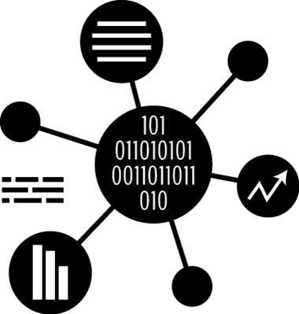








Securing data is challenging….
DYNAMIC
Data multiplies continuously and
moves quickly
DISTRIBUTED
Data is everywhere,
across applications
and infrastructure
IN DEMAND
Users need to constantly access
and share data to do their jobs

Slide 5
When considering databases, the current threat landscape presents significant challenges for maintaining data confidentiality and integrity
  Threat / Risk Categories
  Description
1
Physical Theft
  Stealing hard drives and / or where sensitive data resides
2
Database Administrator (Compromised / Insider)
  Accessing system data directly using provisioned DBA privileges
3
Privileged User Account (Compromised / Insider)
  Accessing system data directly using compromised privileged account(s)
Sensitive Data Exposure / Compromise
4
SQL Injection
  Using malicious code to directly bypass authentication methods
5
Malware Infection
  Malicious code (e.g., Ransomware) designed to allow remote access or exfiltrate sensitive data
6
Zero-Day Attacks
  Exploitation of new vulnerability to bypass authentication or install malware
7
Non-Production Systems
  Extending sensitive data into non-production systems where: (i) controls may not be as mature; and (ii) non-essential personnel may have access

Slide 6
Data Protection Framework
Threat / Risk
Landscape
Database Activity Monitoring
Case Studies
Data Protection
Framework
Encryption Solutions
Notes:
Advanced Attacks – more advanced than ever, >80% in cyber gangs, global business that accounts for $400B+ a year.
Source: http://www.mcafee.com/us/resources/reports/rp-economic-impact-cybercrime2.pdf
Human error – More than half of data breaches are caused by insiders, including employees, third-party contractors and partners.
Source: http://www-03.ibm.com/security/data-breach/2015-cyber-security-index.html?ce=ISM0484&ct=SWG&cmp=IBMSocial&cm=h&cr=Security&ccy=US
Innovation – cloud, mobile, and IOT create unprecedented risks to organizations. 44% of security leaders expect a major cloud provider to suffer a significant security breach in the future. 33% of organizations don’t even test their mobile apps. CISCO estimates that by 2020, there’ll be 50 billion devices connected.
Sources: https://www-03.ibm.com/press/us/en/pressrelease/45326.wss; https://securityintelligence.com/mobile-insecurity/; http://blogs.cisco.com/diversity/the-internet-of-things-infographic
Compliance – adapting to a threat-aware, risk based approach vs. compliance based, box checking approach. In August 2015 a federal court ruled that the Federal Trade Commission (FTC) has the authority to take action against organizations that fail to protect consumer information against cyber attacks. The court’s ruling should lead to greater scrutiny of corporate cyber security following a breach of personal privileged information.
Source: http://www.pcworld.com/article/2974771/appeals-court-denies-challenge-to-ftcs-cybersecurity-enforcement.html
The Federal Communications Commission (FCC) reached a $25 million settlement with AT&T Services over allegations the phone carrier failed to protect the personal data of hundreds of thousands of customers whose personal information was compromised in a data breach that occurred between November 2013 and April 2014.
Source: http://topclassactions.com/lawsuit-settlements/lawsuit-news/53582-att-to-pay-25m-in-data-breach-settlement-with-fcc/
Skills gap - experts predict a shortage of 1.5 million open and unfilled security positions by 2020.
Source: Frost & Sullivan Report, 2015
More than 209,000 cybersecurity jobs in the U.S. are unfilled, and postings are up 74% over the past five years, according to a 2015 analysis of numbers from the Bureau of Labor Statistics by Peninsula Press, a project of the Stanford University Journalism Program.
Source: http://www.forbes.com/sites/stevemorgan/2016/01/02/one-million-cybersecurity-job-openings-in-2016/#683b25157d27

Slide 7
Protecting data now requires designing a comprehensive data protection program where multiple elements are integrated across the enterprise

Slide 8
A mature data protection program will integrate with and influence other traditionally stove-piped cybersecurity capabilities

Slide 9












To develop a mature program, critical data must be identified, protected, and monitored
What are the “crown jewels”?
Where are they? How are they used?
What is required to protect critical data?
How to plan, design, and implement?
What to consider operationally?
Determine data protection objectives
Define “crown jewels”
Develop organizational data model / taxonomy
Obtain stakeholder consensus
Understand data lifecycle and environment
Perform iterative discovery, analysis and classification
Establish baseline requirements
Assess current data security processes and controls
Determine gaps and identify solutions
Plan and prioritize technical and business process transformations
Design and implement solutions that protect critical data, enable access and align to business growth objectives
Determine metrics and process for monitoring, response, and communications
Continue to evolve and adapt to changes
Revalidate and improve program effectiveness
Supported by:
Robust Consulting Methods | Industry-specific Data Models | Global Consulting Expertise | IBM Data Security Research
Leading Data Protection Technologies

Slide 10
Database Activity Monitoring
Threat / Risk
Landscape
Database Activity Monitoring
Case Studies
Data Protection
Framework
Encryption Solutions
Notes:
Advanced Attacks – more advanced than ever, >80% in cyber gangs, global business that accounts for $400B+ a year.
Source: http://www.mcafee.com/us/resources/reports/rp-economic-impact-cybercrime2.pdf
Human error – More than half of data breaches are caused by insiders, including employees, third-party contractors and partners.
Source: http://www-03.ibm.com/security/data-breach/2015-cyber-security-index.html?ce=ISM0484&ct=SWG&cmp=IBMSocial&cm=h&cr=Security&ccy=US
Innovation – cloud, mobile, and IOT create unprecedented risks to organizations. 44% of security leaders expect a major cloud provider to suffer a significant security breach in the future. 33% of organizations don’t even test their mobile apps. CISCO estimates that by 2020, there’ll be 50 billion devices connected.
Sources: https://www-03.ibm.com/press/us/en/pressrelease/45326.wss; https://securityintelligence.com/mobile-insecurity/; http://blogs.cisco.com/diversity/the-internet-of-things-infographic
Compliance – adapting to a threat-aware, risk based approach vs. compliance based, box checking approach. In August 2015 a federal court ruled that the Federal Trade Commission (FTC) has the authority to take action against organizations that fail to protect consumer information against cyber attacks. The court’s ruling should lead to greater scrutiny of corporate cyber security following a breach of personal privileged information.
Source: http://www.pcworld.com/article/2974771/appeals-court-denies-challenge-to-ftcs-cybersecurity-enforcement.html
The Federal Communications Commission (FCC) reached a $25 million settlement with AT&T Services over allegations the phone carrier failed to protect the personal data of hundreds of thousands of customers whose personal information was compromised in a data breach that occurred between November 2013 and April 2014.
Source: http://topclassactions.com/lawsuit-settlements/lawsuit-news/53582-att-to-pay-25m-in-data-breach-settlement-with-fcc/
Skills gap - experts predict a shortage of 1.5 million open and unfilled security positions by 2020.
Source: Frost & Sullivan Report, 2015
More than 209,000 cybersecurity jobs in the U.S. are unfilled, and postings are up 74% over the past five years, according to a 2015 analysis of numbers from the Bureau of Labor Statistics by Peninsula Press, a project of the Stanford University Journalism Program.
Source: http://www.forbes.com/sites/stevemorgan/2016/01/02/one-million-cybersecurity-job-openings-in-2016/#683b25157d27

Slide 11
Database Activity Monitoring (DAM) can help address certain threats and programmatic concerns
Data Discovery & Classification
Without understanding the location and classification of sensitive data, proper protections can not be put into place
Continuous Monitoring
Monitoring traffic to and from databases for security and compliance violations
Policy Deployment & Enforcement
Configuring enterprise wide policies for security and compliance, and enforcing them across all databases from a central location
Compliance Reporting
Most tools contain pre-defined reports to address most needs, and the ability to develop custom reports for the one-off cases
SQLi Identification & Blocking
Alerting, quarantining, or stopping attacks when the happen without disrupting business activities
User Rights Management
Evaluating user rights across data stores to help organizations review and eliminate excessive user rights
Sources
Imperva – DS_SecureSphere_Data_Security.pdf
IBM Guardium - http://www-03.ibm.com/software/products/en/ibm-security-guardium-data-activity-monitor

Slide 12
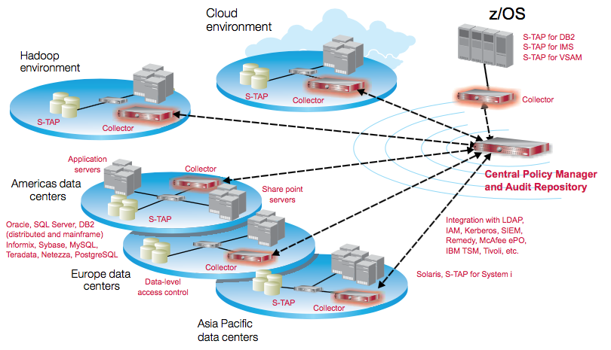
DAM can be configured across multiple storage environments with different audit levels
Infrastructure
Audit Levels
Privileged
Audit only specific users and ignore all other connections
Selective
Audit specific DB activity (sensitive objects or SQL commands)
Comprehensive
Audit / Log everything across DB
Most organizations spread their architecture across different data centers due to DR / HA requirements, with a combination of privileged and selective auditing enabled
Source: IBM Guardium - IBMSecurity-PPS-Guardium partner knowledge share - Volume 1 - August 2016.pdf

Slide 13
Establishing a DAM program requires more than just installing the technology and leaving it be
Role Descriptions and RACI Charts
Process Diagrams and Descriptions
Roles required to operate, configure, govern client’s DAM program
Mapping roles to specific responsibilities across each DAM process
DAM processes are illustrated with decision trees and responsible parties
Allows for quick customization to integrate with client’s current procedures
Operating Model and Governance Program
Project Charters and Roadmap
Organizational documentation outlining the integration points between the DAM program and the cybersecurity organization
Formalized metrics and reporting templates to measure the effectiveness of the DAM program
Project specific tasks and activities designed to increase the maturity of client’s DAM program
Consolidated tactical and strategic recommendations into time-sequenced events

Slide 14
DAM can overload your resources if not tailored and configured properly according to best practices
Classification
Performing the initial identification and classification of sensitive data is critical to placing DAM in the correct locations
Alignment
The use cases developed should be aligned with specific business / compliance / security needs.
Use Cases
Use cases need to be targeted – collecting ALL activity typically results in difficulty identifying the anomalous activity
Governance
Robust governance and operating model is essential to outline the procedures, roles and responsibilities, and resources needed to manage the tool
Refinement
Continual refinement of policies is necessary to account for new activity and data sets

Slide 15
Encryption Solutions
Threat / Risk
Landscape
Database Activity Monitoring
Case Studies
Data Protection
Framework
Encryption Solutions
Notes:
Advanced Attacks – more advanced than ever, >80% in cyber gangs, global business that accounts for $400B+ a year.
Source: http://www.mcafee.com/us/resources/reports/rp-economic-impact-cybercrime2.pdf
Human error – More than half of data breaches are caused by insiders, including employees, third-party contractors and partners.
Source: http://www-03.ibm.com/security/data-breach/2015-cyber-security-index.html?ce=ISM0484&ct=SWG&cmp=IBMSocial&cm=h&cr=Security&ccy=US
Innovation – cloud, mobile, and IOT create unprecedented risks to organizations. 44% of security leaders expect a major cloud provider to suffer a significant security breach in the future. 33% of organizations don’t even test their mobile apps. CISCO estimates that by 2020, there’ll be 50 billion devices connected.
Sources: https://www-03.ibm.com/press/us/en/pressrelease/45326.wss; https://securityintelligence.com/mobile-insecurity/; http://blogs.cisco.com/diversity/the-internet-of-things-infographic
Compliance – adapting to a threat-aware, risk based approach vs. compliance based, box checking approach. In August 2015 a federal court ruled that the Federal Trade Commission (FTC) has the authority to take action against organizations that fail to protect consumer information against cyber attacks. The court’s ruling should lead to greater scrutiny of corporate cyber security following a breach of personal privileged information.
Source: http://www.pcworld.com/article/2974771/appeals-court-denies-challenge-to-ftcs-cybersecurity-enforcement.html
The Federal Communications Commission (FCC) reached a $25 million settlement with AT&T Services over allegations the phone carrier failed to protect the personal data of hundreds of thousands of customers whose personal information was compromised in a data breach that occurred between November 2013 and April 2014.
Source: http://topclassactions.com/lawsuit-settlements/lawsuit-news/53582-att-to-pay-25m-in-data-breach-settlement-with-fcc/
Skills gap - experts predict a shortage of 1.5 million open and unfilled security positions by 2020.
Source: Frost & Sullivan Report, 2015
More than 209,000 cybersecurity jobs in the U.S. are unfilled, and postings are up 74% over the past five years, according to a 2015 analysis of numbers from the Bureau of Labor Statistics by Peninsula Press, a project of the Stanford University Journalism Program.
Source: http://www.forbes.com/sites/stevemorgan/2016/01/02/one-million-cybersecurity-job-openings-in-2016/#683b25157d27

Slide 16
Multiple database encryption options exist with varying risk reduction
Type
Description
Protects Against
Examples
Security
Application
Performs encryption at the individual data element level (e.g., Social Security Number or Account Number)
Occurs at the application layer, prior to entering data into a specific database
Depending on type of encryption selected (e.g. tokenization, FPE, or AES) could require schema changes
HP Voltage SecureData
Vormetric Application Encryption
Dataguise
Gemalto Safenet ProtectApp
Complexity
Table / Column Level
Encrypt subset of data in the DB e.g. tablespace, row, or column encryption
Typically transparent to users and applications
Oracle / SQL TDE
Gemalto Safenet ProtectDB
File
Performs encryption on the actual file (e.g., database) to effectively encrypt the entire container
Agent encrypts/decrypts reads/writes to disk
Transparent to users and applications
Vormetric Transparent Encrypt
Oracle ZFS Encryption
IBM Guardium
Gemalto Safenet ProtectFile
Rocket Systems
Hardware
Uses hardware on the device to perform encryption of the physical hard disk
Transparent to applications, databases, and users
BitLocker
Sophos
Native hardware
  Encryption Best Practices
Publically vetted ciphers
Periodic key rotation
Separation of duties
Centralized key management

Slide 17
Certain questions need to be answered before the proper encryption solution can be selected and implemented
What threats and risks need to be protected against?
What type of data needs to be encrypted?
Where is the data located?
What is the current configuration of the environment (e.g., Database types, non-relational structured data, compression, high i/o, appliances, etc.)?
What is the current budget allocation for data protection and encryption?
What performance impact can be tolerated?
…

Slide 18
For example, enabling encryption with storage level compression can cause problems with the enterprise storage design

Slide 19
Case Studies
Threat / Risk
Landscape
Database Activity Monitoring
Case Studies
Data Protection
Framework
Encryption Solutions
Notes:
Advanced Attacks – more advanced than ever, >80% in cyber gangs, global business that accounts for $400B+ a year.
Source: http://www.mcafee.com/us/resources/reports/rp-economic-impact-cybercrime2.pdf
Human error – More than half of data breaches are caused by insiders, including employees, third-party contractors and partners.
Source: http://www-03.ibm.com/security/data-breach/2015-cyber-security-index.html?ce=ISM0484&ct=SWG&cmp=IBMSocial&cm=h&cr=Security&ccy=US
Innovation – cloud, mobile, and IOT create unprecedented risks to organizations. 44% of security leaders expect a major cloud provider to suffer a significant security breach in the future. 33% of organizations don’t even test their mobile apps. CISCO estimates that by 2020, there’ll be 50 billion devices connected.
Sources: https://www-03.ibm.com/press/us/en/pressrelease/45326.wss; https://securityintelligence.com/mobile-insecurity/; http://blogs.cisco.com/diversity/the-internet-of-things-infographic
Compliance – adapting to a threat-aware, risk based approach vs. compliance based, box checking approach. In August 2015 a federal court ruled that the Federal Trade Commission (FTC) has the authority to take action against organizations that fail to protect consumer information against cyber attacks. The court’s ruling should lead to greater scrutiny of corporate cyber security following a breach of personal privileged information.
Source: http://www.pcworld.com/article/2974771/appeals-court-denies-challenge-to-ftcs-cybersecurity-enforcement.html
The Federal Communications Commission (FCC) reached a $25 million settlement with AT&T Services over allegations the phone carrier failed to protect the personal data of hundreds of thousands of customers whose personal information was compromised in a data breach that occurred between November 2013 and April 2014.
Source: http://topclassactions.com/lawsuit-settlements/lawsuit-news/53582-att-to-pay-25m-in-data-breach-settlement-with-fcc/
Skills gap - experts predict a shortage of 1.5 million open and unfilled security positions by 2020.
Source: Frost & Sullivan Report, 2015
More than 209,000 cybersecurity jobs in the U.S. are unfilled, and postings are up 74% over the past five years, according to a 2015 analysis of numbers from the Bureau of Labor Statistics by Peninsula Press, a project of the Stanford University Journalism Program.
Source: http://www.forbes.com/sites/stevemorgan/2016/01/02/one-million-cybersecurity-job-openings-in-2016/#683b25157d27

Slide 20
Case Study: Large government entity implements Database Activity Monitoring, Vulnerability Assessment, and Encryption
Client Situation:
Government entity processing large volumes of tax records containing sensitive data needed to comply with Publication 1075 and FISMA that requires continuous monitoring of access to sensitive data, protection of sensitive data at rest, and vulnerability management pf CVEs. Additionally, there was a growing concern among leadership regarding the level of access privileged users had to sensitive data. This entity turned to IBM to help implement a solution to cover these aspects and address the compliance and security concerns.
Solution:
The IBM team utilized Guardium to scan over 1800 databases for sensitive data across a heterogeneous environment, including SQL Server, DB2, Oracle Hadoop, Z, and Informix databases.
Performed strategy assessment to stage technologies (Vulnerability Assessment, DAM, Encryption) over the next 2-3 years, with a clearly defined roadmap outlining the process for implementing each (e.g., Design, ATO, Use Case Development, etc.)
Implemented Guardium Vulnerability Assessment within 90 days to scan for database vulnerabilities, patch levels, buffer settings, default accounts, etc.
Phased Database Activity Monitoring to the databases over the next 1.5 years, with use cases focused around privileged user access, sensitive object access, and VIP record access
Currently in the process of deploying file level encryption w/ Guardium Data Encryption across the environment with 500/1800 DBs in the first 3 months.
Client Benefits:
Compliance with FISMA regulations regarding continuous monitoring and encryption of sensitive data
Continual scanning of databases to verify patch levels and uncover vulnerabilities
Quick detection and response to anomalous activity

Slide 21
Case Study: Implementing Transparent Data Encryption (TDE) across Oracle appliances
Client Situation:
The client had multiple Oracle Database Appliances (ODAs) in service to store PII data. Due to regulatory concerns, sensitive data across the ODAs needed to be encrypted quickly. Additionally, the client was in the process of refreshing their ODA hardware, but the migration completion date was too far in the future. The client looked to IBM to help design a solution to encrypt data stored in the ODAs while allowing for the solution to roll into the new hardware.
Solution:
The IBM Team scanned the ODAs to determine the location of sensitive data, and found the data to be on every single ODA through the environment, and within multiple tables across the database.
Due to the breadth of encrypted data, the team decided to implement TDE at the tablespace level, which allows the database to utilize the AES-NI encryption instruction set that accelerates encryption and decryption across the devices.
The team conducted a performance test by simulating calls from applications to unencrypted and encrypted data. The test showed minimal impact to performance (<5%) when comparing the two configurations
Tablespace encryption was deemed acceptable, and subsequently implemented across the current ODAs with a centralized key management solution to manage the ODA keys, as well as prepare the client for any future key management needs.
Client Benefits:
Sensitive data across ODAs were encrypted with minimal performance impact to the appliances
The legacy ODAs test results provided a level of confidence that the same encryption solution (tablespace TDE) would work on the ODA hardware refresh

Slide 22
Case Study: Major healthcare player designed solution to encrypt data at rest
Client Situation:
The client had an audit finding to begin encrypting it’s data at rest across the entirety of its structured relational databases, throughout all environments (e.g., Production, Staging, Testing). At the same time, the client was the process of migrating its data to two large systems (replicated across data centers) and was looking to IBM to provide a cost-effective and efficient solution to not only adhere it the compliance requirements, but simultaneously increase its overall security posture.
Solution:
The IBM Team reviewed existing security controls and performed a quick look assessment through targeted interview with key technical stakeholders.
Several different data-at-rest encryption strategies were compiled, based on the client’s unique environment, to be presented and discussed with the client sponsor.
The IBM Team conducted a threat / risk workshop where the current threat trends were discussed in relation to the different encryption strategies in order to determine the client’s preferred path forward.
Due to the constraints of the client environment (e.g., legacy file structures, storage compression, multiple applications), the most prudent path forward was hardware level encryption to cover all data within the environment.
In addition to hardware level encryption, the team recommended implementing Database Activity Monitoring to watch certain privileged use cases
Client Benefits:
IBM was able to develop a data-at-rest encryption design to address data comprehensively across the environment.
Resources were shifted to cover another area of need: Database Activity Monitoring

Slide 23
Case Study: Leading bank discovers sensitive data utilizing DAM tool
Client Situation:
The client had embarked on a journey to identify and protect sensitive data in its environment. The bank has implemented a database security solution (Guardium DAM) on a pilot set of databases and wanted to engage with a partner that could help them discover their crown jewels and then plan & prioritize Data Loss Prevention (DLP) protection measures on their databases that could reduce their risk and strengthen their security posture as well as meet the MAS (Monetary Authority of Singapore) –TRM guidelines
Solution:
IBM participated in an information gathering exercise which included reviewing the risk scores, conducting interviews and reviewing classification documents
The Guardium DAM product was configured with the appropriate data discovery & classification policies & rules to search for sensitive data using regular expressions and keywords as applicable for the banking industry and in the regulatory context
The scanning results were compiled into a Sensitive Data Dictionary with a summary heat map
IBM also defined the DLP enforcement rules necessary to configure Guardium with alerting & blocking policies to prevent data leakage
Client Benefits:
The project provided the client the required visibility of their sensitive data & location within their environment
The client was better placed with prioritized databases which had sensitive data and devise protection strategy to prevent data leakage & fraud

Slide 24


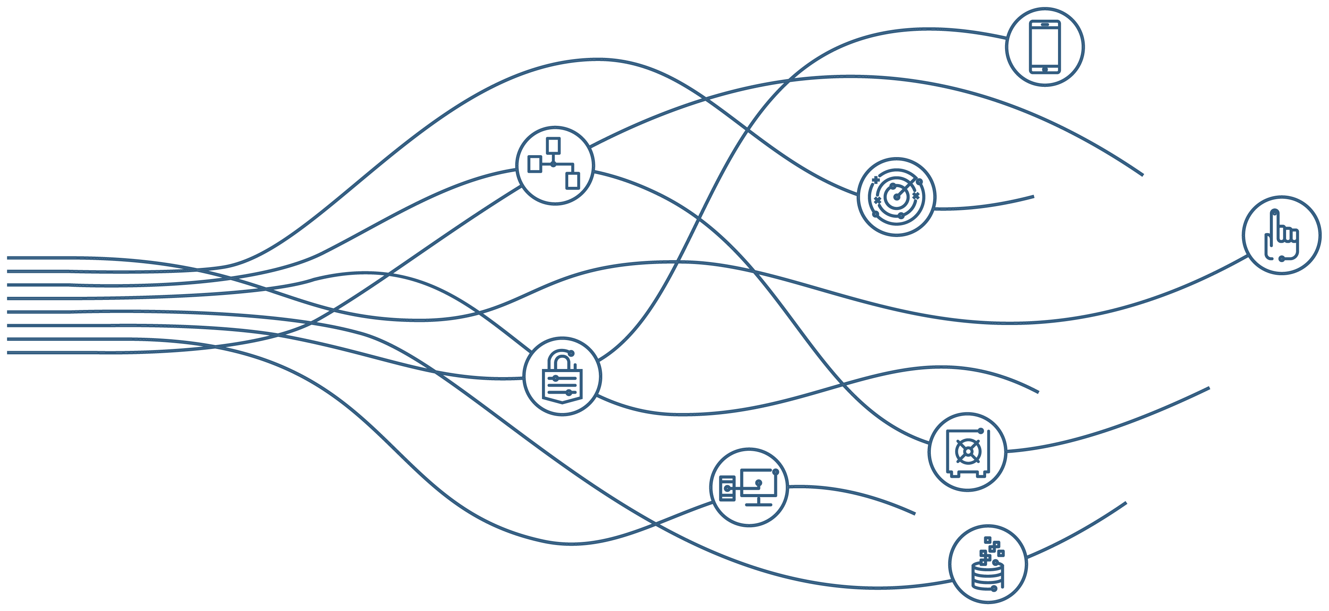
A Global Leader in Enterprise Security
#1 in enterprise security software and services*
7,500+ people
12,000+ customers
133 countries
3,500+ security patents
19 acquisitions since 2002
*According to Technology Business Research, Inc. (TBR) 2016

