Slide 1
The Vendor Client Relationship
Maintaining Harmony Towards Success in the State Government Client Vendor Relationship

Slide 2
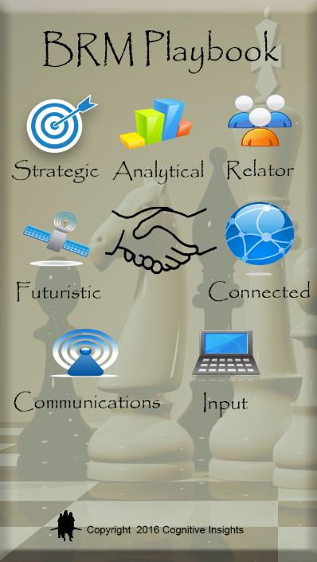

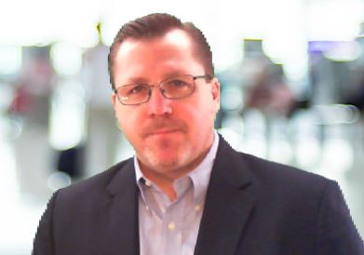

About Gerry Robinson, PMP, Professional Scrum Master
BIOGRAPHY
Gerry Robinson is an information technology professional with diverse experience in almost every facet of IT. He is currently a leader at Verizon. He has been a certified project manager for ten years, has led teams in application development, cloud, and infrastructure projects.
15 years State and Local Experience
Corporate Faculty at Harrisburg University.
Executive Council at BRM Institute.
Author of three books on technology, IT leadership, and business and IT convergence.
Creator of the mobile app “The BRM Playbook.”
https://www.linkedin.com/in/techbuzzkillgr
2016
2015
2014

Slide 3
Objectives of today’s workshop
Discuss the vendor client relationship
Outline common stress points
Best practices to optimize relationship
Understanding the other party
Workshop scenarios

Slide 4
Top Ten Reasons for Project Failure*
Scope Creep
Overallocated Resources
Poor Communications
Bad Stakeholder Management
Unreliable Estimates
No Risk Management
Unsupported Project Culture
Defacto Project Manager
Lack of Planning
Poor Monitoring and Controlling
Scope Management
Resource Management
Communication Management
Stakeholder Management
Estimate Refinement
Risk Management
Joint Planning
Joint Monitoring and Controlling
*Based on Project-Management.com

Slide 5
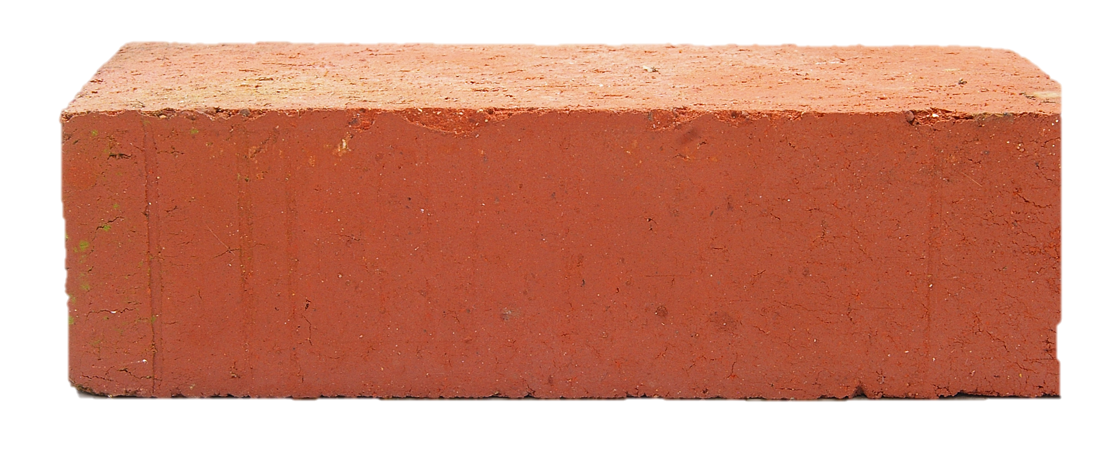
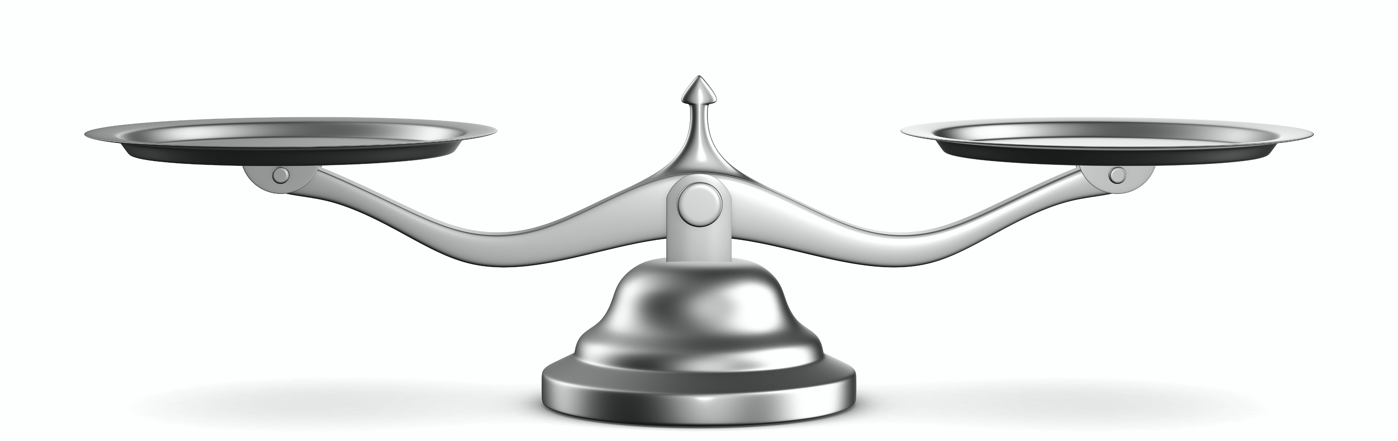
Government and Vendor Relationship Balance
State
Vendor
Cost Pressure
versus
Profit
Slower Adoption
versus
Micro-Innovation
Bureaucracy
versus
Speed
versus
Team Fluidity
Team Stability

Slide 6
Anticipation Buildup through the procurement cycle
Notes:
Mark, I will express the dynamic of what I call anticipation build up. This is the dynamic of a long runway to the project, which then builds in stakeholders the desire to get everything possible out of a contract, given that they do not want to jump through additional procurement hoops. This is something that has to be managed by both vendor and state leaders. The timeline above shows how long it can take to get an RFP award.

Slide 7
Vendor Timeline
Project Timeline
Notes:
This will show the dynamic of phase and timeline alignment needed when a vendor is brought on board. Initiation and planning phases for the state are during the leadup to choosing a vendor. The vendor then goes through their initiation phase after planning (as they have to do their plan for the RFP). This dynamic can create stress and incongruency.

Slide 8
Keys to Relationship
Limit contractual tone
Understand the other’s situation and pressures
Look for opportunities to build relationship
Give more than you expect to get (in other words, don’t get transactional)
Communicate
Know the scope inside and out
Perform analysis upfront to anticipate the other’s challenges in project
The Vendor/Client Relationship is two organizations coming together to work as one, while remaining two organizations.

Slide 9
Workshop

Slide 10
Scenario Review
Large Application Development Project

Slide 11
Workshop
You will be given scenarios
Work through as a group different techniques to address these
Prioritize these techniques
Each table has a different scenario
15 minutes to work through the scenarios
We will then review each teams’ answers as a group

Slide 12
Breakout
Groups 1 and 2
Personnel that typically run the project
Group 1
Group 2
Group 3
Personnel that are stakeholders, users or are on the business side
Group 3
Group 4
Personnel that are typically on evaluation committee and initiation
Group 4

Slide 13
Questions

