Slide 1
DevOps in Azure
Kevin Mack (ADM)

Slide 2
Agenda
What is DevOps?
Implementing DevOps with MSFT Tools
Automated Builds
Automated Testing
Automated Deployments
Telemetry / Monitoring

Slide 3

What is DevOps?

Slide 4

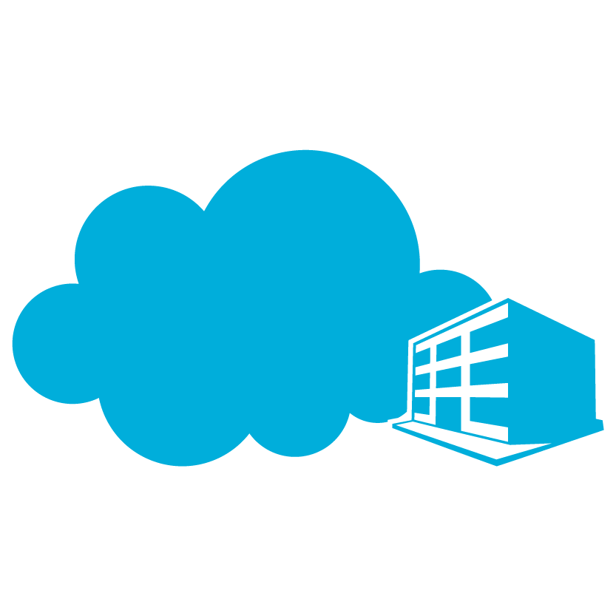

Industry trends
Technology
Multi-platform
Multi-device
Cloud services
User-centric
Social
People & Processes
Continuous feedback
Continuous quality
Continuous delivery
Heterogeneous
development teams
Notes:
Trends
We’re seeing the modernization of IT happen along two major lines: trends and advances in technology and emerging methods of collaborating to deliver value to customers.
Applications, and the associated set of user expectations, have evolved significantly over the past few years. Applications are expected to run on many different platforms, data is expected to be readily available, and with social tools seamlessly built in. Their apps should be always on, always available and constantly updated.
To take advantage of this new marketplace, organizations have begun drastically evolving their practices and processes.
To ensure that their product maintains it’s competitive advantage, customer feedback is constantly requested, collected, tracked and incorporated into new iterations of the product.
Because customers don’t want to wait, continuous delivery models that let you push updates daily or weekly rather than monthly or yearly are the new normal.
Pushing updates that often means you can’t just test for quality at the end of the development process; you have to build it in from day 1. Modern development processes recognize that quality doesn’t happen unless everyone in the process is equally responsible for making it happen
And all of this needs to be accomplished in a heterogeneous development environment with diverse teams, distributed team members, and multi-platform and multi-device applications.
Quotes to look for:
“Their apps should be always on, always available and constantly updated.”
“Pushing updates that often means you can’t just test for quality at the end of the development process”
“And all of this needs to be accomplished in a heterogeneous development environment with diverse teams, distributed team members, and multi-platform and multi-device applications.”
Narrative guidance:
We’re seeing the modernization of IT happen along two major lines: trends and advances in technology and emerging methods of collaborating to deliver value to customers. Applications, and the associated set of user expectations, have evolved significantly over the past few years. Applications are expected to run on many different platforms, data is expected to be readily available, and with social tools seamlessly built in. Their apps should be always on, always available and constantly updated.
To take advantage of this new marketplace, organizations have begun drastically evolving their practices and processes.
To ensure that their product maintains it’s competitive advantage, customer feedback is constantly requested, collected, tracked and incorporated into new iterations of the product.
Because customers don’t want to wait, continuous delivery models that let you push updates daily or weekly rather than monthly or yearly are the new normal.
Pushing updates that often means you can’t just test for quality at the end of the development process; you have to build it in from day 1. Modern development processes recognize that quality doesn’t happen unless everyone in the process is equally responsible for making it happen
And all of this needs to be accomplished in a heterogeneous development environment with diverse teams, distributed team members, and multi-platform and multi-device applications.

Slide 5

Testimonial 1: Industry changes

Slide 6


Traditional Development and Operations
DEV
OPS
DEV
+
TEST
OPS

Slide 7
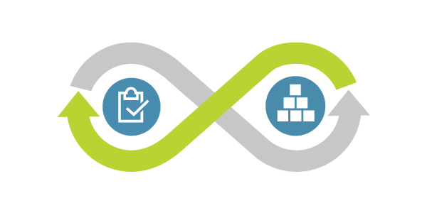
What is DevOps
DevOps is the union of people, process, and products to enable continuous delivery of value to your end users.

Slide 8
What is DevOps
The contraction of “Dev” and “Ops” refers to replacing siloed Development and Operations to create multidisciplinary teams that work together with shared and efficient practices and tools.

Slide 9
What is DevOps – Deliver Faster, Smarter and Continuously
REQUIREMENTS
BACKLOG
Plan
Monitor + Learn
O
Development
Production
Collaboration
Develop + Test
Release
Notes:
So what are the solutions to these challenges?
Applying agile practices to develop ‘Modern Apps’ holds great promise when executed properly:
Faster and more frequent delivery
Higher Quality
Increased Stakeholder satisfaction
Higher ROI – continuous delivery of value
Note the roles engaged in each of the phases – and notice that at the heart of all this is ‘Connect’. The whole team is aligned and collaborates throughout the lifecycle.

Slide 10
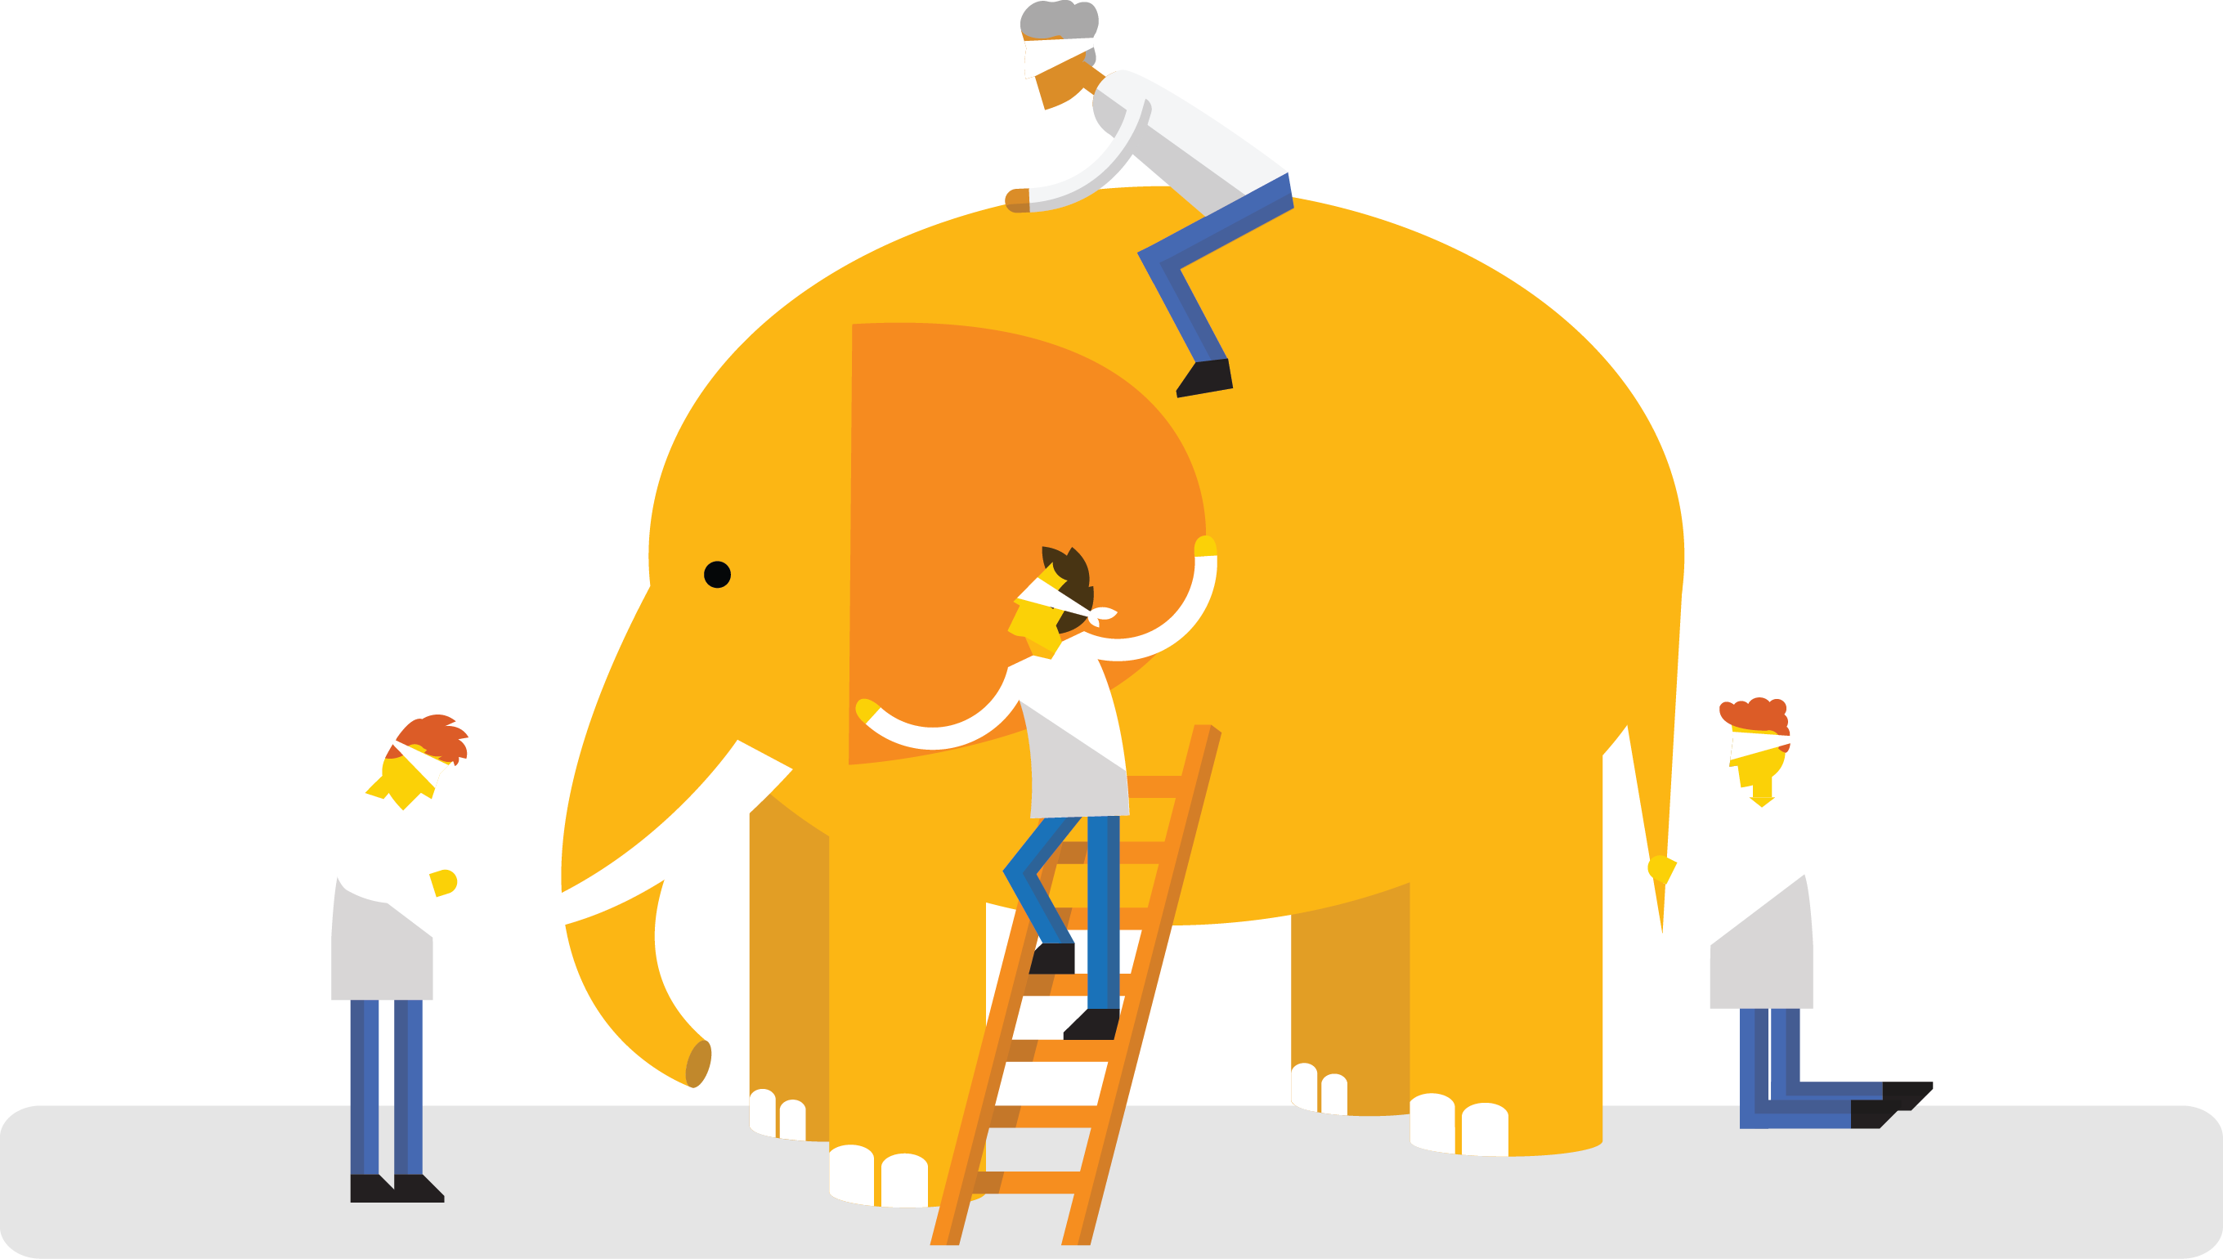
What’s DevOps
“DevOps is treating your infrastructure as code”
“DevOps is using Agile Planning”
“DevOps is feature switches”
It’s DevOps!
“DevOps is Testing in production”
“DevOps is development and operations working together as a unified team”
It’s DevOps!
It’s DevOps!
“DevOps is A/B Testing”
It’s DevOps!
“DevOps is using automation”
“Microservices?”
“DevOps is small deployments”

Slide 11
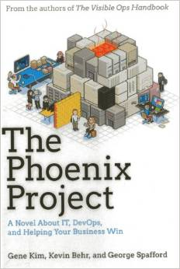
The Phoenix Project by Gene Kim, Kevin Behr and George Spafford
The Phoenix Project frames in the impact of chronic friction between Dev and IT Ops.
This is a fantastic illustration of relatable
scenarios that we all have experienced.
The Three Ways
Maximize Flow
Amplify Feedback loops
Continual improvement
Four Types of Work
Business Projects
Internal IT Projects
Changes
Unplanned / Recovery work

Slide 12
The Phoenix Project
Why do DevOps?.
Competitive Advantage – Productivity
How much high performance DevOps organizations are outperforming the traditional enterprise counter parts.
*Note - from The Phoenix Project
Company | Deploy Freq. | Lead Time | Reliability | Cust. Responsiveness
Amazon | 23,000/ day | Minutes | High | High
Google | 5,500/ day | Minutes | High | High
Netflix | 500/ day | Minutes | High | High
Facebook | 1/ day | Hours | High | High
Twitter | 3/ wk | Hours | High | High
Traditional Enterprise | 1/ 9 months | Months or Quarters | Low/ Med | Low/ Med

Slide 13
Testimonial 2– Why do DevOps

Slide 14
Implement DevOps using the Microsoft ALM & DevOps Tools

Slide 15

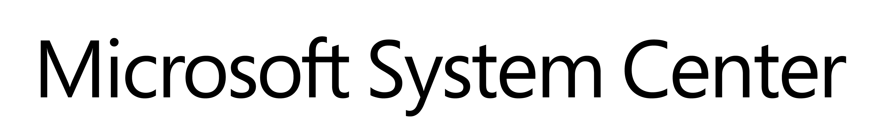
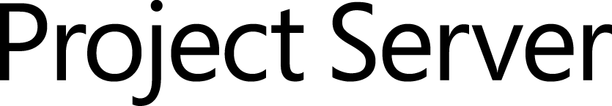


Microsoft ALM & DevOps Tools
Source control
Team Foundation
Server
Visual Studio
Team Services
Agile planning
Test case management
Build automation
Continuous deployment
Release management
Load testing
Feedback management
Team collaboration
Application telemetry
Lab management

Slide 16
Agile Manifesto
We are uncovering better ways of developing software by doing it and helping others do it. Through this work we have come to value:
Individuals and interactions over processes and tools
Working software over comprehensive documentation
Customer collaboration over contract negotiation
Responding to change over following a plan
That is, while there is value in the items on the right, we value the items on the left more.

Slide 17

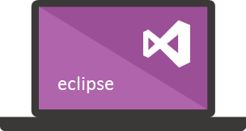




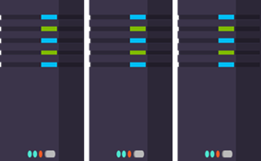
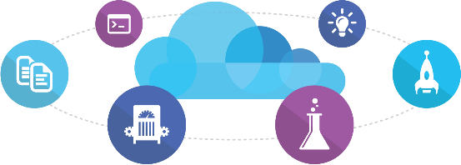
Microsoft Ecosystem
People | Process | Products
01
02
03
Developer Workstation
Build/CI
04
Release
Develop
Monitor
Build & Test
TFS / VSTS
Deploy
Release Management for Visual Studio
Release Management for Visual Studio
Team Collaboration
Monitor & Learn
Test
Automation Service
VSTS
TFS / VSTS
PowerShell | WAML
Application Insights
TFS / VSTS
Azure Resource Management
Microsoft Test Manager
xPlat Command Line
TFS
DEV
TEST
QA
Workstations - On-Premises | Hybrid | Cloud
ALM Services - On-Premises | Hybrid | Cloud
Environments - On-Premises | Hybrid | Cloud
Monitoring - On-Premises | Hybrid | Cloud

Slide 18
Automated Builds

Slide 19
Why do Automated Builds?
Increased Consistency
Increased Quality
Increased Consistency
Can be coupled with Code Analysis to enforce organization standards.
Increased Quality
Can be integrated with automated testing to ensure code meets organization quality standards.
Repeatable / Controlled
Removes the “Worked on my machine” problem.
Increased Stability
Ensures the application is built the same way each time.
Increased Productivity
Removes it from a person’s workload to a machines
Repeatable / Controlled
Increased Stability
Increased Productivity

Slide 20
Key Areas of Discussion
Are you leveraging nuget for dependencies?
Are dependencies within the app mapped properly?
Is your app architected for builds?
Do you enforce check-in policies?
How do you manage configuration of apps?
What are the benefits to policies?
What about Automated testing?
Are you doing any kind of static code analysis?
How are the results handled?
How are you monitoring technical debt?
Code Analysis
How are you managing your build server?
Are you using XAML Builds?
Are you ready for continuous integration?
Build Server

Slide 21
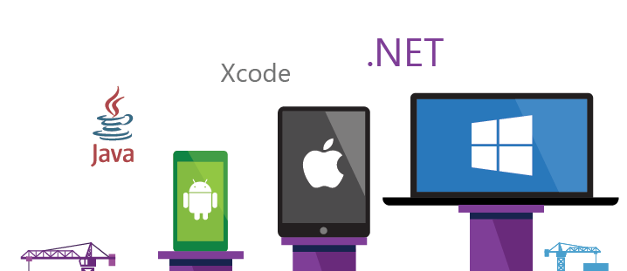
TFS Build – Any Platform, Any Developer

Slide 22
Options for Automated Builds
TFS (On-Premise)
Can create a maintain a collection of Build Servers (Pool) in your environment
Supports a variety of technologies (.net, Java, xcode, etc)
VSTS (On-Premise / Cloud)
Can create a maintain a collection of Build Servers (Pool) in your environment
Supports a variety of technologies (.net, Java, xcode, etc)
Can support a “Hosted” build server, which is a “vanilla” build server that is created on-demand, for lower maintenance.

Slide 23
Automated Testing

Slide 24
How good is your testing?
How much of the previous matrix have you implemented?
Is your testing affective?
How much testing are you doing?
Are you implementing inversion of control?
Are you structuring classes with SOLID?
Are you taking time to implement testing?
Are you architected for unit testing?
How are you tracking what elements are tested?
How do you manage test cases?
How are your users testing?
How much of your testing is a manual process?
Do you have the hardware?
Can you support
automating testing?

Slide 25
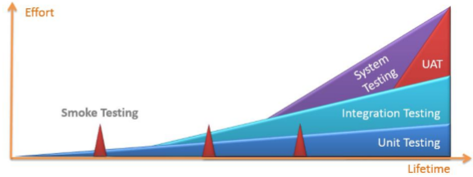
Testing types

Slide 26
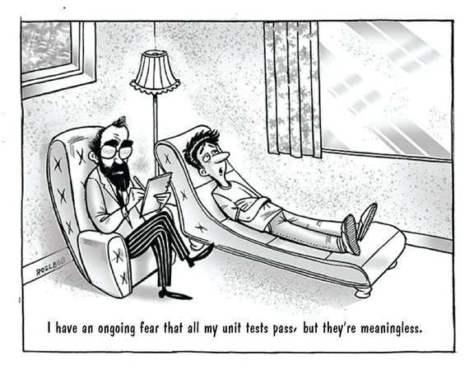
To Unit Test or Not to Unit Test?
Source: www.devops.com

Slide 27

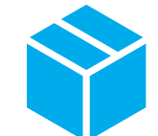

Unit Testing
Value
Understanding Requirements
Faster time to market
Higher Code quality
Accept changes with Confidence
Measure
Deployment Lead Time
MTTR
MTTD
DEV
OPS

Slide 28


Automated Testing
Testing Software
Value
Accelerate Delivery
Repeatability
Optimized Resources
X
Measure
Deployment Lead Time
MTTR
MTTD
DEV
OPS

Slide 29

Load Testing
Application Environment
Value
Improve deployment quality
Find performance bottlenecks
Cater for demand
Maintain application quality
X
Measure
Availability
MTTD
MTTR
DEV
OPS
Auto Scale

Slide 30
How can the cloud help with testing?
Minimize Infrastructure Requirements
Increased Speed
Minimize Infrastructure Requirements
Automated Testing (Coded UI / Load Testing) are very infrastructure intensive and require significant maintenance. Cloud provides a “Spin up when needed” option.
Increased Speed
By creating infrastructure on an as needed basis, and automating with scripts the time to execute tests can be lower given the resources at your disposal.
Process Integration
Included as part of an automated build / deployment pipeline, ensures that is executed early in the process.
Increased Reliability
Ensures that test are run and pass EVERY TIME
Increased Productivity
Removes it from a person’s workload to a machines
Process Integration
Increased Reliability
Increased Productivity

Slide 31
Automated Deployments

Slide 32
What do Automated Deployments?
Do deployments consistently succeed the first time?
Do you have safety controls to ensure bad code doesn’t make it to prod?
Do you have consistent quality
in your deployments?
Do your deployments take a long time or lot of people?
Do they require people to be available more off hours?
Are deployments time prohibitive?
Does the business have to “deal with” serious downtime?
What controls do you have in place for rollback?
What does your user’s downtime
experience look like?
How many people are involved?
How many lower environments do you maintain?
How much are deployments
costing you?

Slide 33
How can the cloud help with Deployments?
Minimize Infrastructure Requirements for Lower Environments
Minimize Costs
Minimize Infrastructure Requirements for Lower Environments
With the cloud you can spin up environments on demand, and manage when they are available to minimize how much they cost the organization.
Minimize Costs
Does your Dev environment need to be available at 2:00 AM? Does your test environment have to be available when you don’t have UAT testing going on?
Less Resource Intensive
With an automated agent doing your build, do you need to have as many people involved?
Increased Security / Accountability
Having tool based controls to ensure that approval processes are always followed without exception.
Increased Consistency
Removes the human element and makes it repeatable and CONTROLLABLE.
Less Resource Intensive
Increased Security / Accountability
Increased Consistency

Slide 34
Application Performance and Availability Monitoring

Slide 35
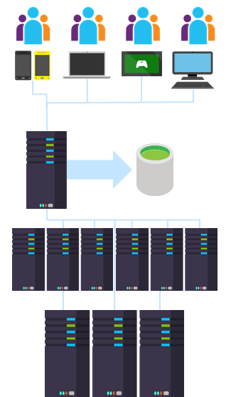
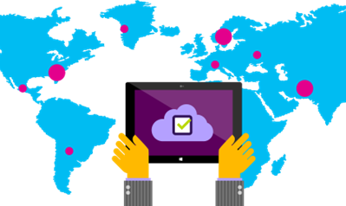
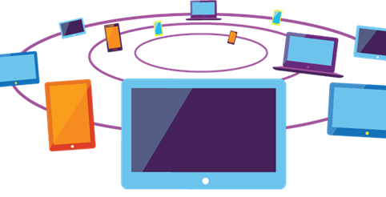
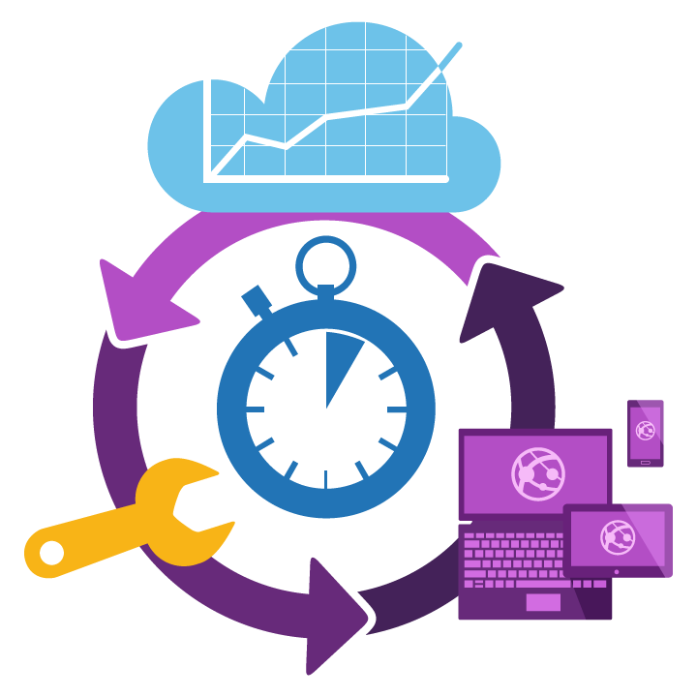
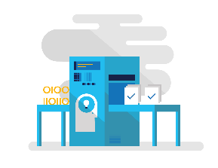
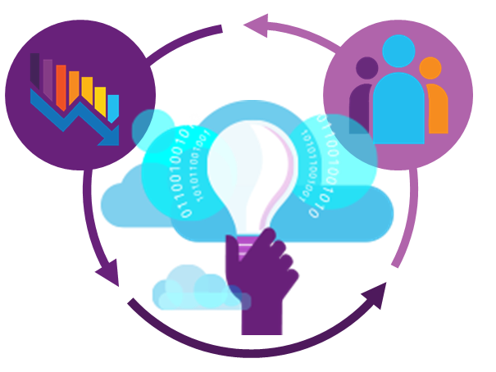
Diagnostics for modern applications
Multiple tiers and components
Multiple data centers
Different clients
and browsers
Feature churn
Continuous Delivery
Quickly find and fix

Slide 36
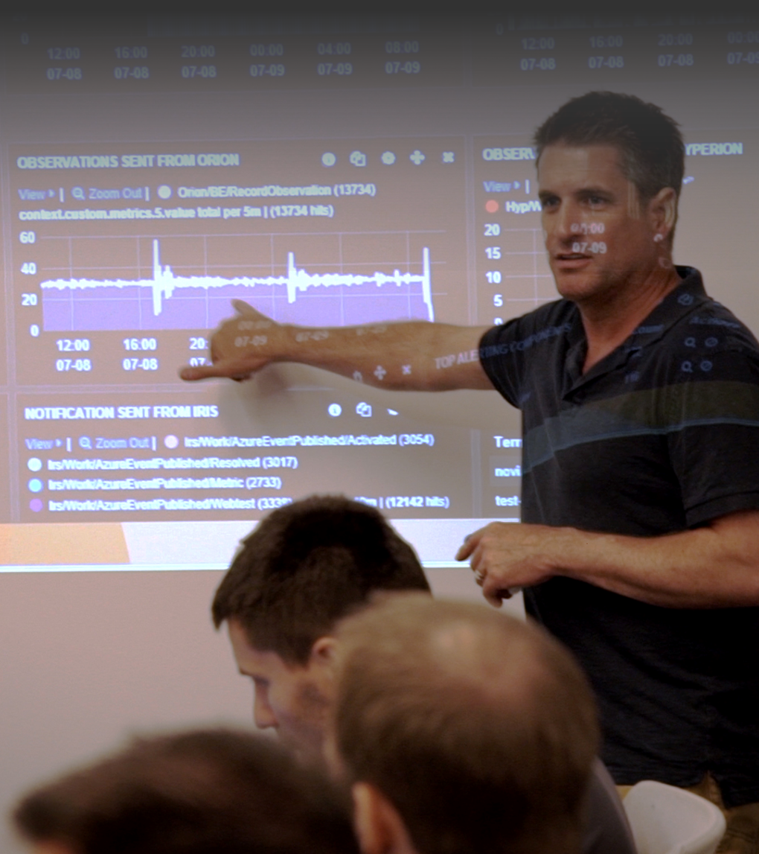
Answer questions like …
Is my application crashing?
What exactly happened?
Is my application fast enough?
Is my server able to handle the load?
How responsive are my dependencies?
Is my application UP or DOWN?
What is the root cause?
How many people are impacted?

Slide 37
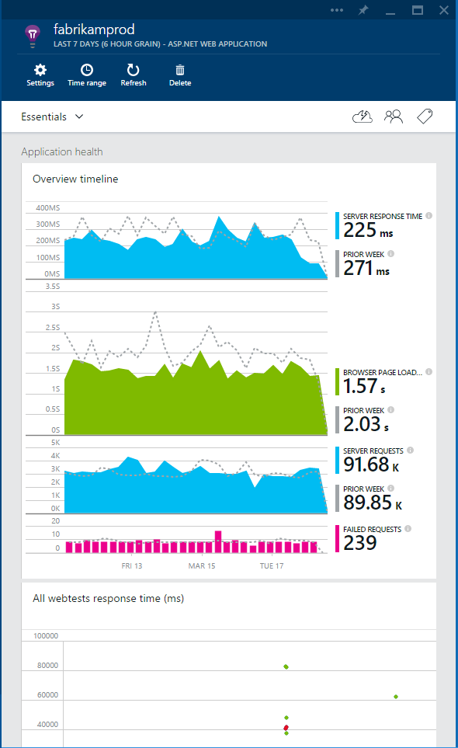
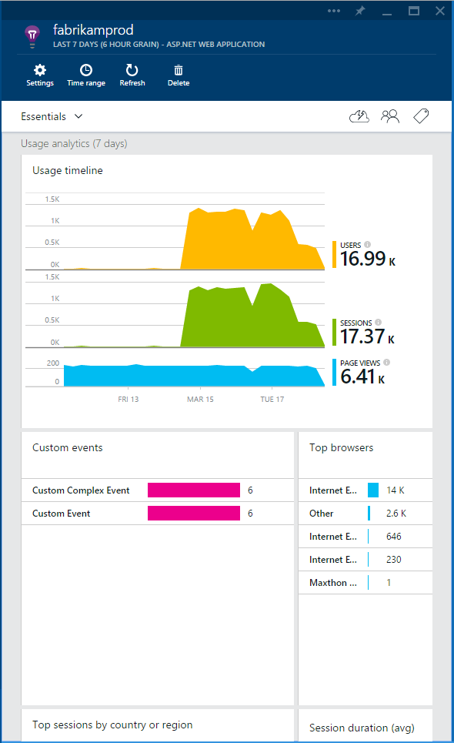
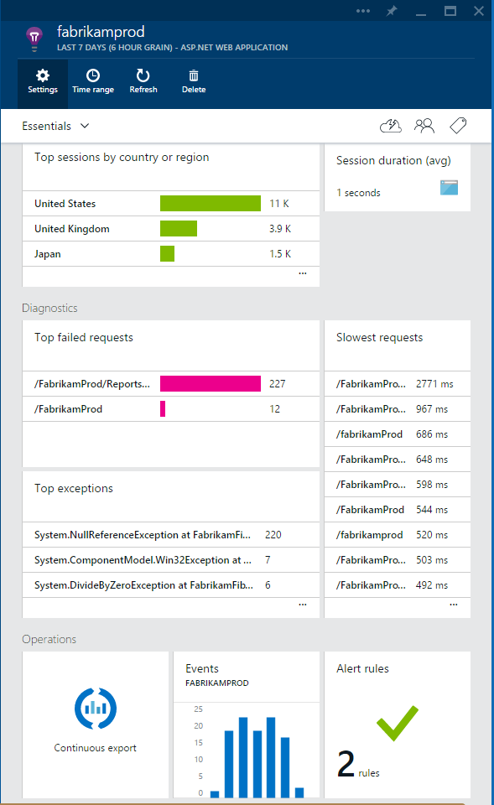


What is Application Insights?
3
Identify, understand and resolve issues with powerful out-of-the-box and custom telemetry
1
Telemetry is collected at each tier: server backend, middleware, web service & browser
2
Telemetry arrives in the cloud where it is stored & processed

Slide 38

New capabilities
Intelligent APM: Proactively Detect, Triage and Diagnose
Analytics: Instant Answers with Ad-hoc Queries
DevOps: Integration
and Extensibility

Slide 40
For More Information:
ALM Rangers:
https://blogs.msdn.microsoft.com/visualstudioalmrangers/
DevOps Hub on Microsoft.com
https://www.microsoft.com/en-us/cloud-platform/development-operations
Channel 9 videos:
https://channel9.msdn.com/DevOps
FBI “Sentinel” case management
http://www.cio.com/article/2392970/agile-development/how-the-fbi-proves-agile-works-for-government-agencies.html
http://www.agileconference.org/wp-content/uploads/2012/10/Agile-Success-at-the-FBI-Brian-Wernham.pdf
The Phoenix Project
https://www.amazon.com/Phoenix-Project-DevOps-Helping-Business-ebook/dp/B00AZRBLHO

