Slide 1
PA Techcon: Project management
Session 1: Project health and status in agile projects
Presented by:
Nick Lopez
Director, Project Management Solutions and Delivery
Ciber, Inc

Slide 2
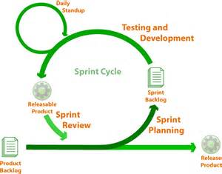
Agile projects
Key Components
Business Drivers
Story Points
Velocity
Capacity
Product Backlog
Release Plan
Release Backlog
Sprint Backlog
Improve Efficiency
Improve Quality
Embrace Change
Improve Customer Satisfaction
Mitigate Risk
Increase Value

Slide 3
Project and Portfolio Metrics and KPI’s
On Track
Percent Complete:
On Budget:
On Schedule:
On Scope:
What percent of actual scope has been completed?
What have we spent for the amount of work completed?
Was the work completed on or ahead of schedule?
Requirements, Value, quality, and customer satisfaction

Slide 4
Bridging the Gap Reporting agile project performance
Portfolio reporting across various project methodologies can be likened to an integration between disparate systems.
Portfolio Reporting
Agile Projects
Traditional
Custom
Deployment
Infrastructure

Slide 5
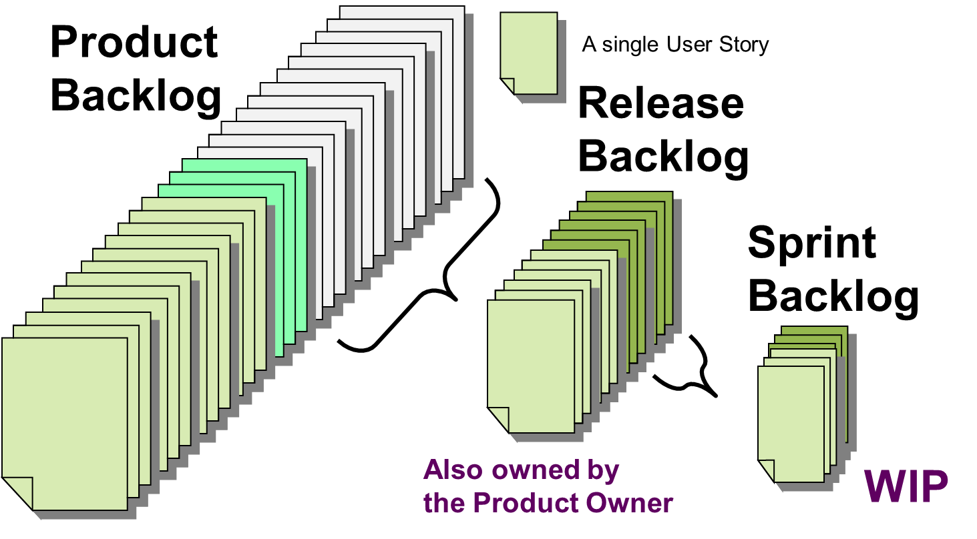
Percent Complete Portfolio Performance indicators
Project percent complete is typically the percentage of total work required to complete the project.
Does not include percent of time that has past or percent of budget that has been used.
Agile projects estimate work (size stories), plan work for each sprint, and measure performance (velocity).
Challenges:
The backlog is continuously updated
Not all backlog items will be delivered
Not all stories are sized
Not all “epics” are decomposed to stories

Slide 6
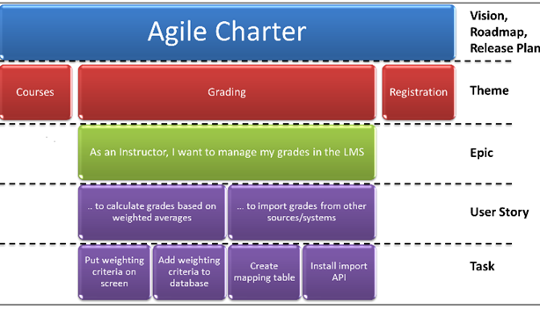
On Budget Portfolio Performance indicators
Project budget performance is typically based on actual cost of work performed, measured against planned cost for the same work.
In an Agile project, work is divided into iterations. With a dedicated team, the project budget is tied to a specific number of iterations.
Project Charter
Software development projects are typically chartered to deliver specific high-level requirements.
Themes (or features) provide high-level requirements for projects and can be mapped to stories and tasks.

Slide 7
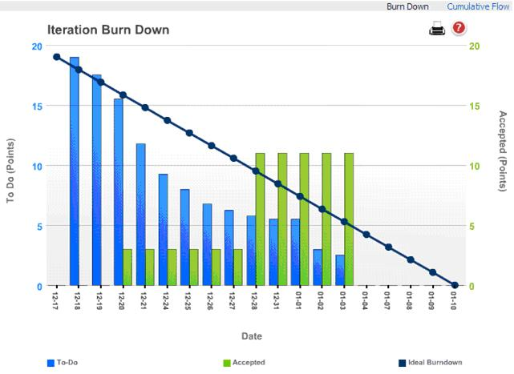
On Schedule Portfolio Performance indicators
Project schedule performance it typically the amount of work performed, measured against planned work as of a point in time.
In Agile projects, burndown charts, velocity and, estimates are leveraged to establish and measure productivity.
Challenges:
Not all stories in backlog will be delivered
Velocity is relative to each team
Sizing varies from team to team
Not all backlog items have been estimated

Slide 8
Exercise: Project health and status reporting
Handouts: Project data has been provided for an Agile project - as of a specific point in time:
Project Charter
Backlog statistics
Team performance data
Current taskboard
Review project data within your group and determine project status:
Percent Complete
On budget?
On Schedule?
On Scope?
Is this project on track?

