Slide 1

Modern Experiences for the Agile and
Mobile-First Enterprise
Catalina Kowal
Product Sales Specialist - Collaboration
@catalinakowal

Slide 2
Agenda
1
Trends in Collaboration
2
Transforming the Collaboration Experience
3
Digitize Your Business
4
Demo

Slide 3

Mobility
Teams
User Experience
Anytime, anywhere
learning
Interactive video

Slide 4

the demand for mobile devices to be integrated into work processes is exploding

Slide 5


How Has Collaboration Changed?
Past
Individual work
Fixed, long-term teams
Teams in office
Work mostly with
colleagues
Today
Interdependent work
Flexible, self-regulated
Agile teams
Team from anywhere
Work with colleagues,
partners, consultants, subject matter experts, etc.
Notes:
How has collaboration changed over the past few years? “Work from home” hasn’t always been a thing – and meetings were always held in a conference room. We weren’t agile and our organization was based on individual work and fixed deadlines.
But today, we’re much more agile, we’re flexible. While email and instant message systems like Jabber are still around and still heavily used, Spark takes collaboration to a whole new level.

Slide 6

work is shifting from being done by individuals to being done by teams

Slide 7
teams need to work together or apart

Slide 8
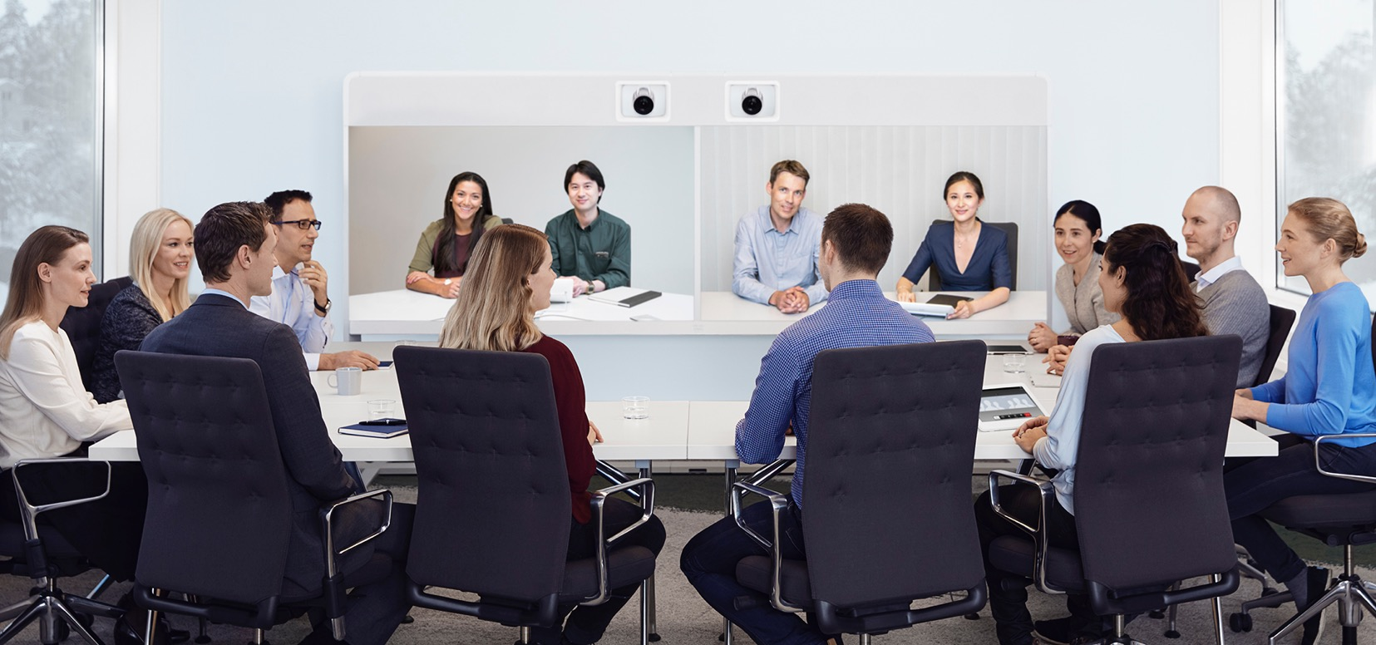
expectation that video experience is consistent, high quality, pervasive, secure, and interoperable

Slide 9
Day in the Life of a Team
Notes:
But even with all those disparate tools, let’s see what the day in the life of a team looks like.

Slide 10
ENGAGEMENT
TIME
Notes:
Lets consider a team that works together, and lets think about how they are working throughout the day. So, we can plot on the X axis here the time, from beginning of the day to the end. And we can think about intensity on the Y axis.

Slide 11
Scheduled
Meetings
Ad Hoc
Meetings
ENGAGEMENT
Furious
Chat
REALTIME
Occasional
Messaging
TIME
Notes:
This intensity various from occasional messaging, where I just send a few messages here and there, to something I call furious chat, where everyone is sending messages at once. In fact, if they had just spoken those messages it would have been a meeting. And in fact the next level of intensity is an ad-hoc meeting, and perhaps the most intense is a scheduled, more formal meeting. The line for real-time is around here – at furious chat – when things are happening at that very moment together.

Slide 12
Meetings Tool
Scheduled
Meetings
Ad Hoc
Meetings
ENGAGEMENT
Furious
Chat
REALTIME
Occasional
Messaging
TIME
Notes:
But, the tools they need to use are broken by their different engagement. We’ve got the traditional meeting tool, it only covers the scheduled and ad-hoc meetings.

Slide 13
Chat Tool
Scheduled
Meetings
Ad Hoc
Meetings
ENGAGEMENT
Furious
Chat
REALTIME
Occasional
Messaging
TIME
Notes:
And then we have chat tools, which are used for some of the messaging – including the real-time furious chat.

Slide 14
Email Tool
Scheduled
Meetings
Ad Hoc
Meetings
ENGAGEMENT
Furious
Chat
Furious
Chat
REALTIME
Occasional
Messaging
Occasional
Messaging
TIME
Notes:
And of course email which is also used for occasional messaging.

Slide 15
Pain in the Transitions
We’re on a roll in this meeting, if only I
had a little more time to finish my thoughts.
Scheduled
Meetings
How do I escalate from chat
to a live meeting without killing our momentum?
Ad Hoc
Meetings
I need a few more answers before I can assign the action items
ENGAGEMENT
Furious
Chat
Where did that list of important reference articles end up?
REALTIME
Occasional
Messaging
TIME
How do I add a new collaborator to this discussion?
Notes:
All of the pain points are on the transitions.
First pain point – escalating from furious chat into the meeting itself. Requires all of this coordination to figure out how to do that – whose bridge to use? Are you in a video room and how do we get you in?
Second pain point – sharing information during a meeting- the chat in the meeting isn’t the same chat. You can email it after the meeting…
Third paint point- how do I know when to switch meetings when I have all of these back to back meetings?
Forth pain point- work doesn’t stop when the meeting ends, if anything that’s when it starts and tracking actions requires connecting with people

Slide 16
Work is a continuous flow
Scheduled
Meetings
Ad Hoc
Meetings
ENGAGEMENT
Furious
Chat
REALTIME
Occasional
Messaging
TIME
Notes:
It’s pretty evident that smoothing over those transitions is critical to icnreasing productivity

Slide 17
Transforming the
Collaboration Experience

Slide 18
Video and Meetings
Notes:
Video and Meetings GOALS for Maximum Mobile Engagement

Slide 19




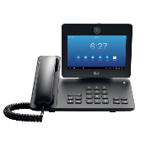
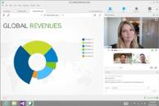




Meet Your Way
Desktop and Mobile Clients
Desktop
Collaboration
WebRTC Compliant Web Browsers
Standards-Based
Telepresence Endpoints
Skype for Business
Notes:
Leverage Meeting tools that are INCLUSIVE and provide seamless INTEROPERABILITY

Slide 20
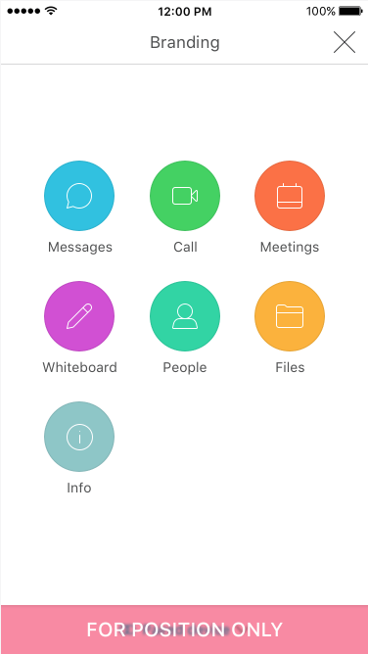
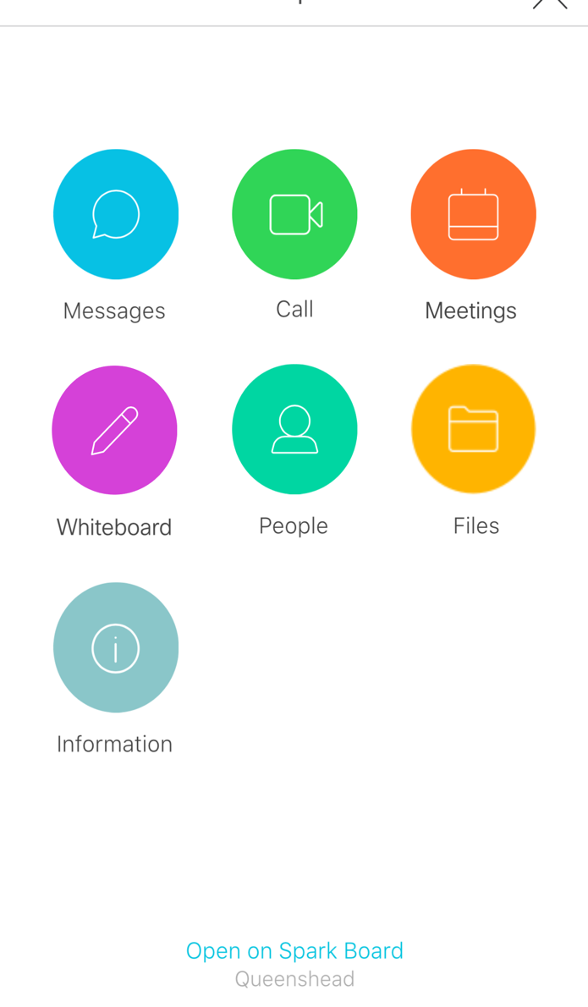
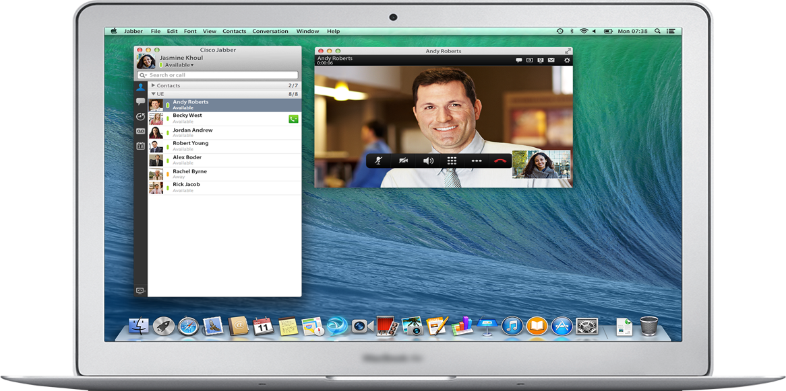

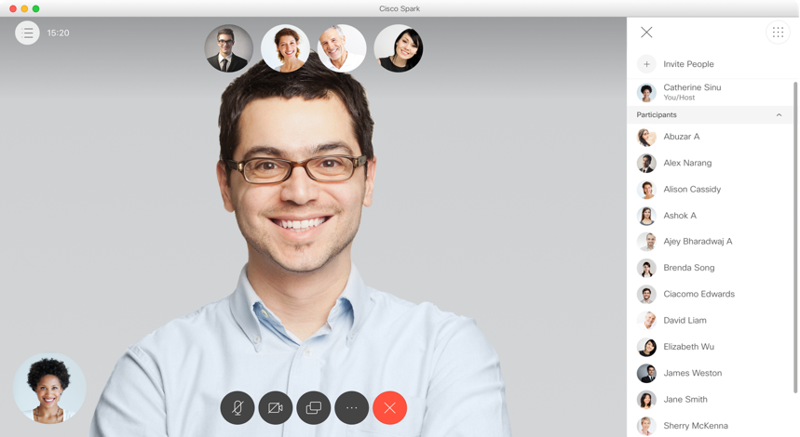
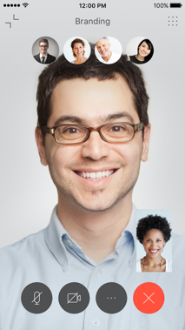
Always turn on Video
Notes:
Enable Video EVERYWHERE – it leads to maximum engagement

Slide 21
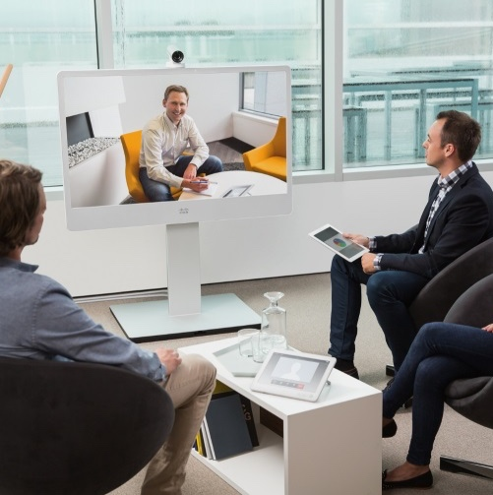
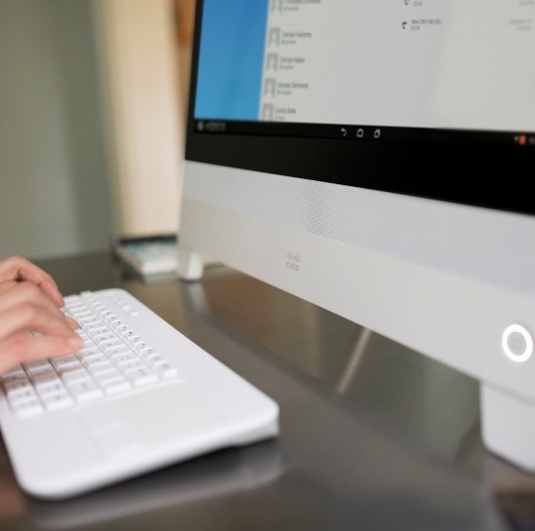
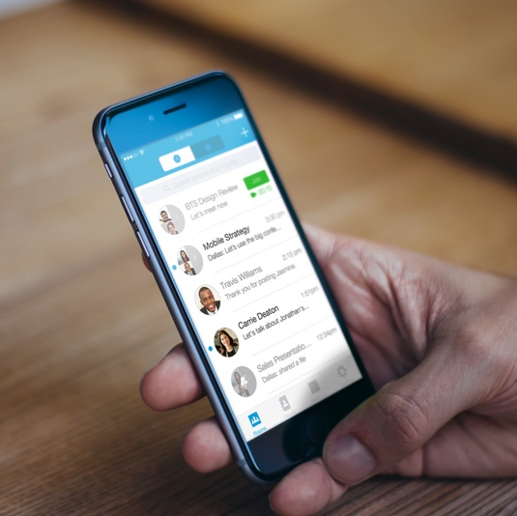
Enable “No-Compromise” Collaboration in:
Every Room
Every Desk
Every Pocket
Notes:
No EXCUSES as to why EVERY EXPERIENCE can’t be fully immersive.

Slide 22

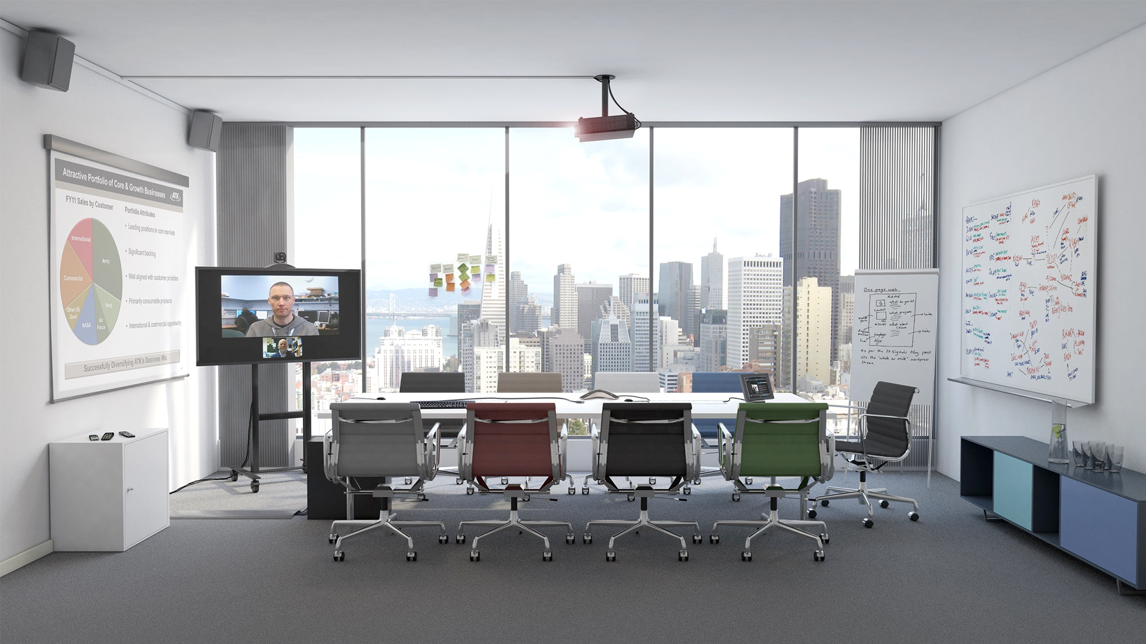
Today’s Collaboration Space
Notes:
To collaborate effectively in a physical room, users need local resources like a good presentation screen. They need whiteboards and a place to take notes. They also need the audio/video technology for remote participants. And they need it to be intuitive to use.
Content-centric collaboration rooms today are a complex combination of technical and analogue tools that don’t work together. This creates critical challenges because what is available to customers, today, are:
Complex layout of systems fighting for real estate
Complex UX due to multiple UI devices
Complex and costly deployment
We need a simple presentation solution, wired or wireless.
We need a simple white board
We need a simple audio/video connection
We need a simple solution that’s applicable to every room, not just for specialized rooms
We need it integrated with our collaboration tools

Slide 23
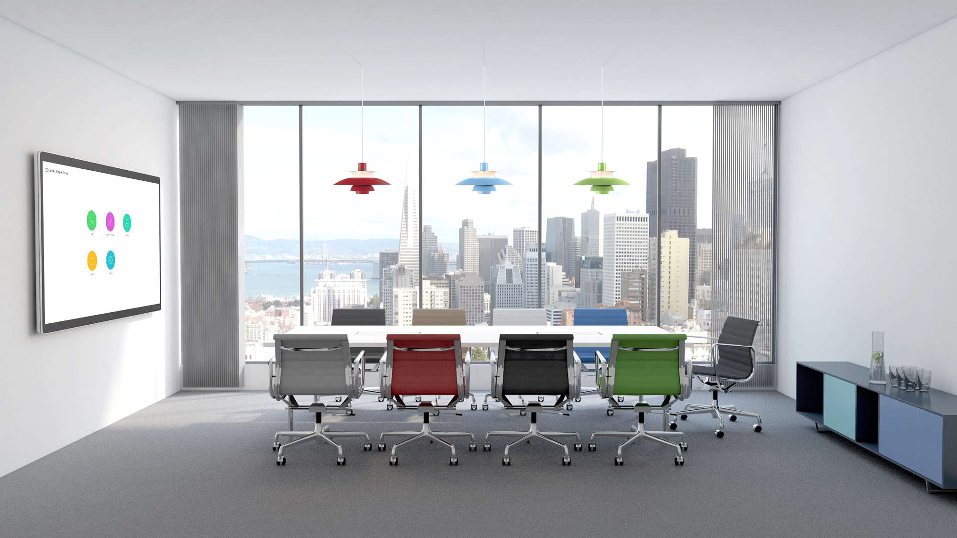

Slide 24
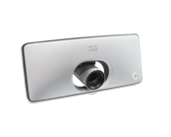







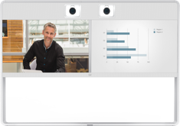
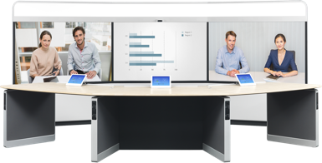



Enable Every Room with Video, Touch and Wireless Sharing
Huddle Room
Small to Medium Rooms
Medium to Large Rooms
Immersive

Slide 25
Invest in video endpoints with an innovative roadmap that incorporates analytics, AI, voice recognition, and beyond.

Slide 26
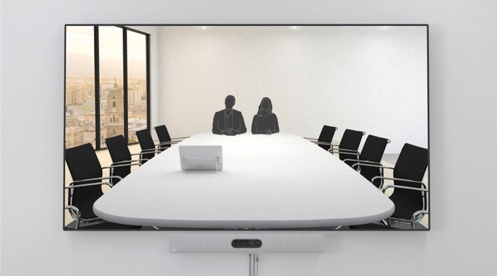
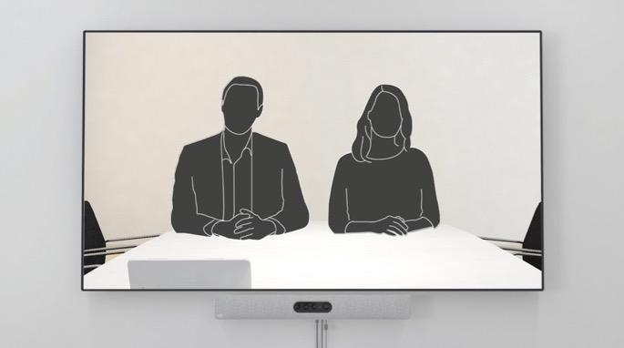


Intelligent Framing of Meeting Room Participants
Best OverView
1. Auto-detects people in room
2. Selects best framing

Slide 27
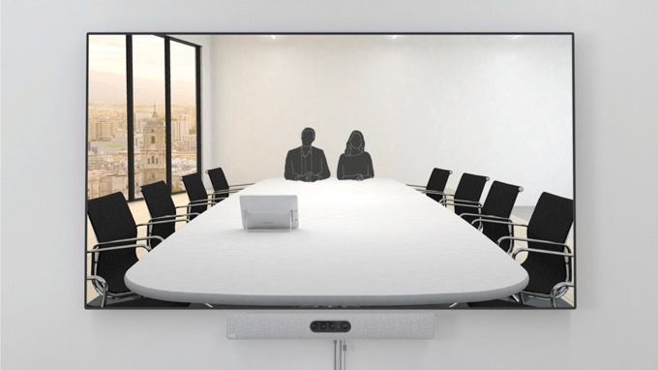
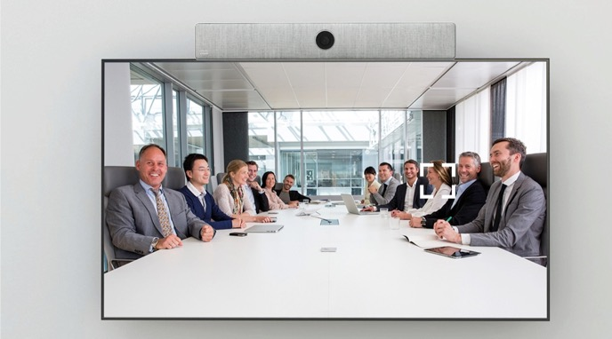
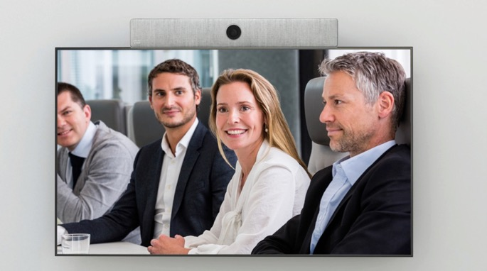
Intelligent Framing of Meeting Room Participants
SpeakerTracking
1. Detects person speaking
2. Selects best framing for person speaking

Slide 28
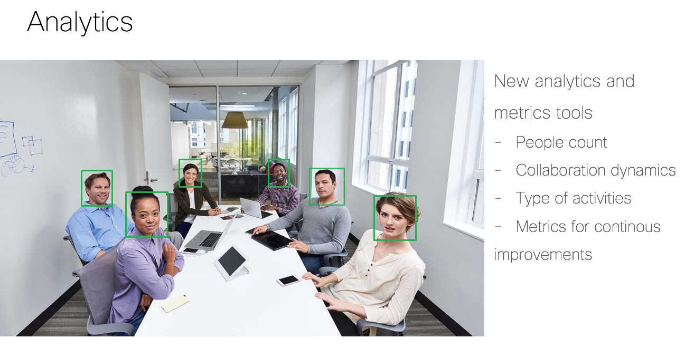

Slide 29
Business Messaging & Team Collaboration

Slide 30



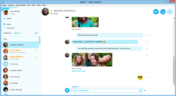



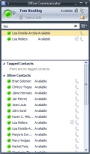


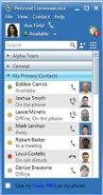

Mobile
messengers
Consumer
Skype
AOL IM
1997
1998
2003
2007
2010
2015
Business
Messaging
Business
MOC
CUPC
Notes:
Let’s take a look at how we got to where we are today

Slide 31

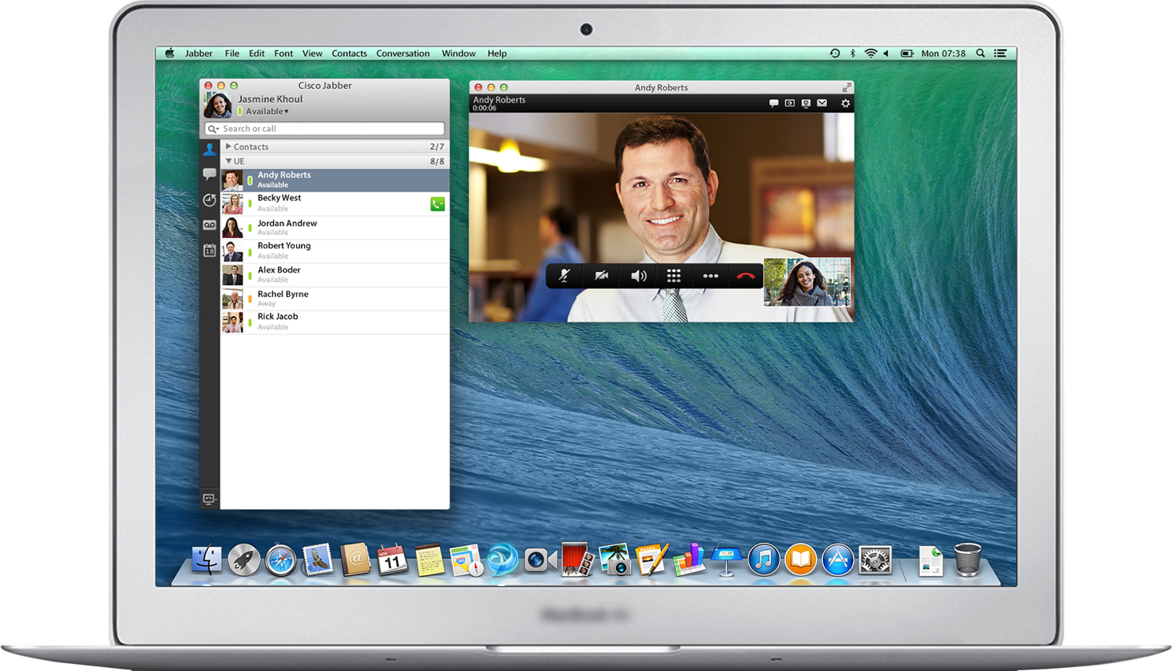

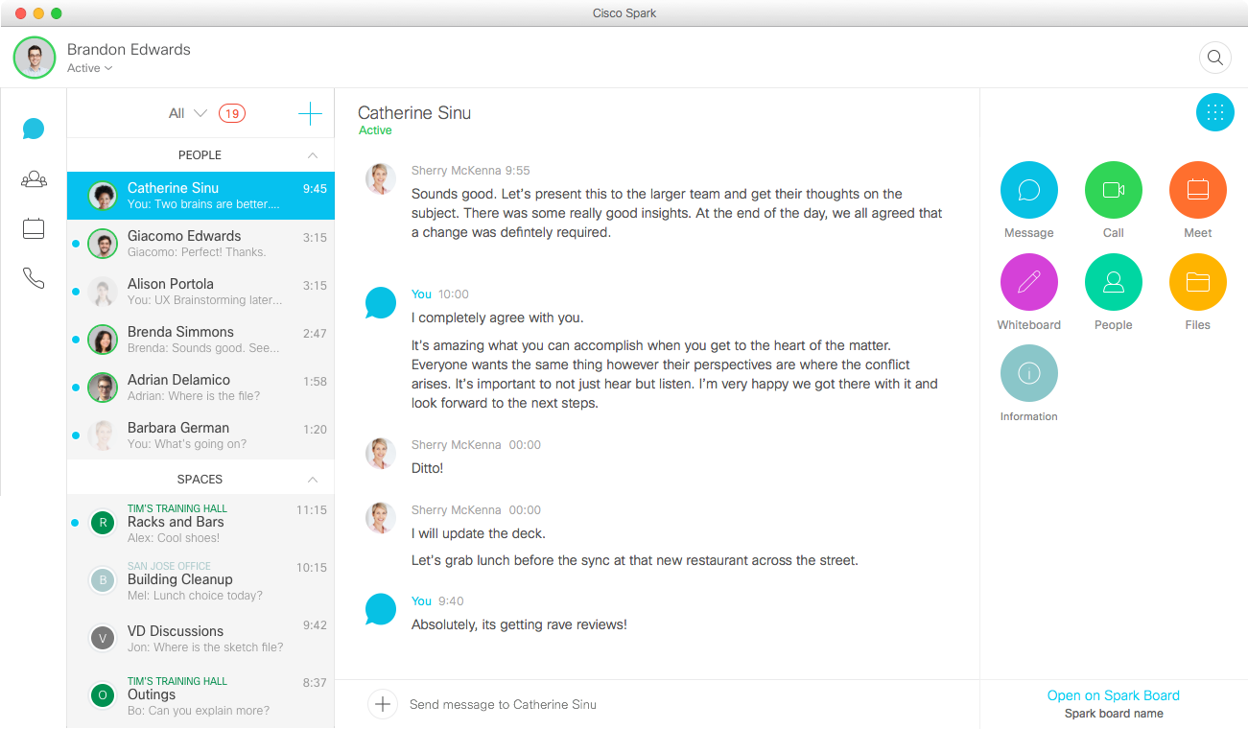

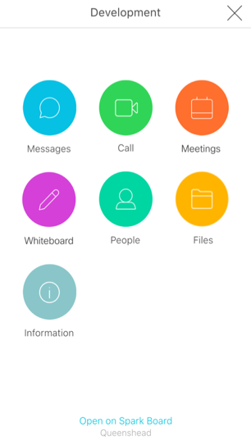
Business Messaging
1:1 and team persistent messaging & content

Slide 32



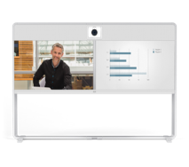
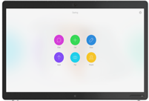








On any Device and in any App
Mobile / Web
Desktop
Conference Room
Business Apps

Slide 33


At your Fingertip

Slide 34

Enable External Participants

Slide 35
Chat
White Board
Call
Files
Video
Notes
Screen Share
Stickies

Slide 36
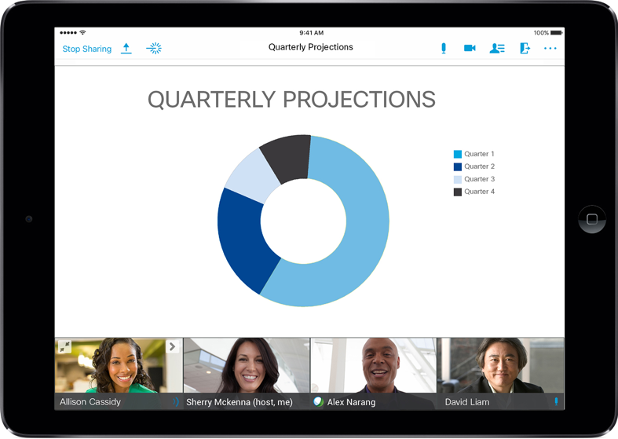
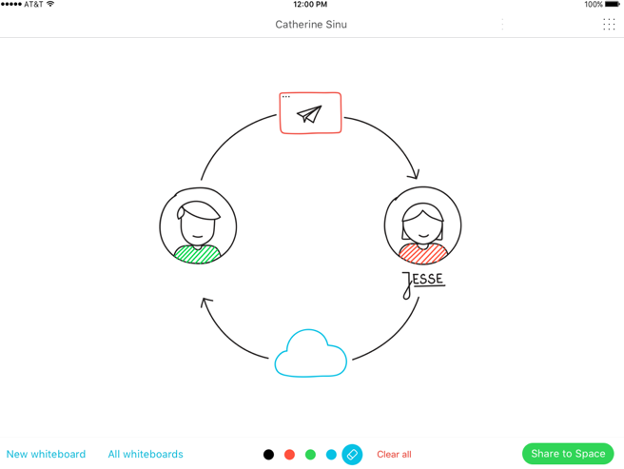
In App White Boarding
Notes:
Sometime you need to more than talk. You may need to sketch out your ideas – ideation.

Slide 37



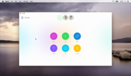
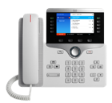




App Centric
App
Desk Devices
Room Devices
App
Spark Board
Any device
IP phones and desk devices
Video enable conference rooms
Get creative
Enable work to live where ever the collaborators go

Slide 38
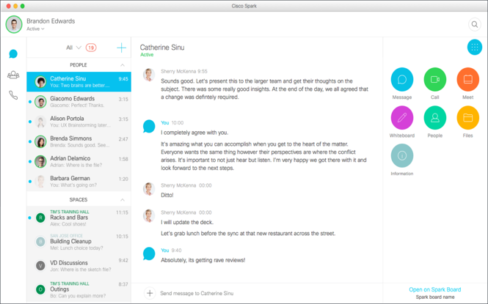
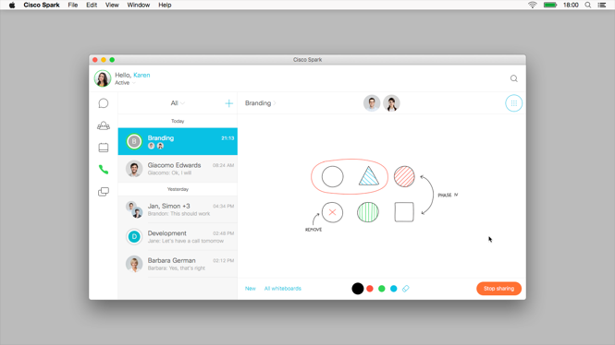
User Centric

Slide 39








Connect physical and virtual worlds
Rich Content and Rich Communications
Mobile - Desk - Room

Slide 40
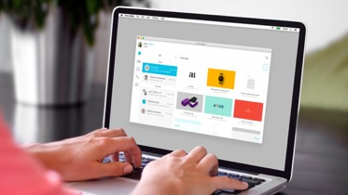
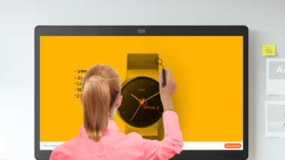
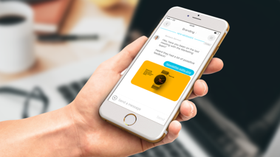
Enable a Continuous Workstream
Before
During
After

Slide 41
Enable this
Scheduled
Meetings
Ad Hoc
Meetings
ENGAGEMENT
Furious
Chat
REALTIME
Occasional
Messaging
TIME

Slide 42
Digitize your Business

Slide 43
Workplace
Teamwork at its best
01000011 01101001 01110011 01100011 01101111
Digitization
Transformation
Workstream
01010011 01110000 01100001 01110010 01101011
Notes:
Digitization is transforming the tools we use (the workplace) and the way we work together (workstreams*, or workflows) with organizational processes and with business process applications and tools.
Slide Transition
Imagine being able to continue the conversation when you break up from that group, when you get back to your desk, your office, your desk
Digital Business = the creation of new business designs by blurring the digital and physical worlds
Workplace = where people work, in rooms, at their desk, mobile - together, alone
Workstream = The progressive completion of tasks completed by different groups within a company which are required to finish a single project
Notes on Digital Business
The age of Digital Transformation is upon us. Businesses, in order to stay competitive if not merely in business, must transform. Karl-Heinz Streibich, in his book entitled “The Digital Enterprise”, states that “every business must become a digital business, regardless which industry it operates in.”
So what is a digital business? It’s about combining the digital and the physical world. Combining data, wherever it may be coming from, with the digital processes of the company. It’s about changing the way you interact with customers and partners. It’s about disrupting existing business models. And it’s about speed, scale, responsiveness, and agility. The digital business is constantly changing; this is the agility aspect. We have to move with that change and quickly – this is the speed aspect.
Use the backdrop of digitization, digital business, and the digital workplace that are driving workplace transformation and transforming where we work (the workplace) and how we work (work streams).
* workstream is fast becoming a standardized industry term – led by Gartner amongst other key leading industry analysts

Slide 44






Integrate Your Apps
APP
APP
APP
developer.ciscospark.com
depot.ciscospark.com
Off the Shelf APIs
Custom Development
Notes:
Animation – click to bring in visual of team, tools, work
An open and extensible platform that enables you to accelerate your digital business transformation with your own custom solutions and services or take advantage of off-the-shelf integrations, APIs and SDKs.

Slide 45

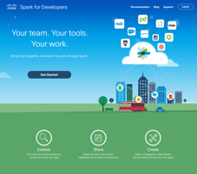










Extend and Connect
From Simple Native Integrations to Custom Development
Business Users
3rd Party Built Solution Integrations
Workflow Connector Tools
Full Development
Ready-to-Consume
Integrations
Packaged Solutions
Light Development
Custom Full Development

Slide 46



Example Integrations
Business Users
3rd Party Built Solution Integrations
Workflow Connector Tools
Full Development
Ready-to-Consume
Integrations
Packaged Solutions
Light Development
Custom Full Development

Slide 47
How it All Comes Together

Slide 48
Demo

