Slide 1
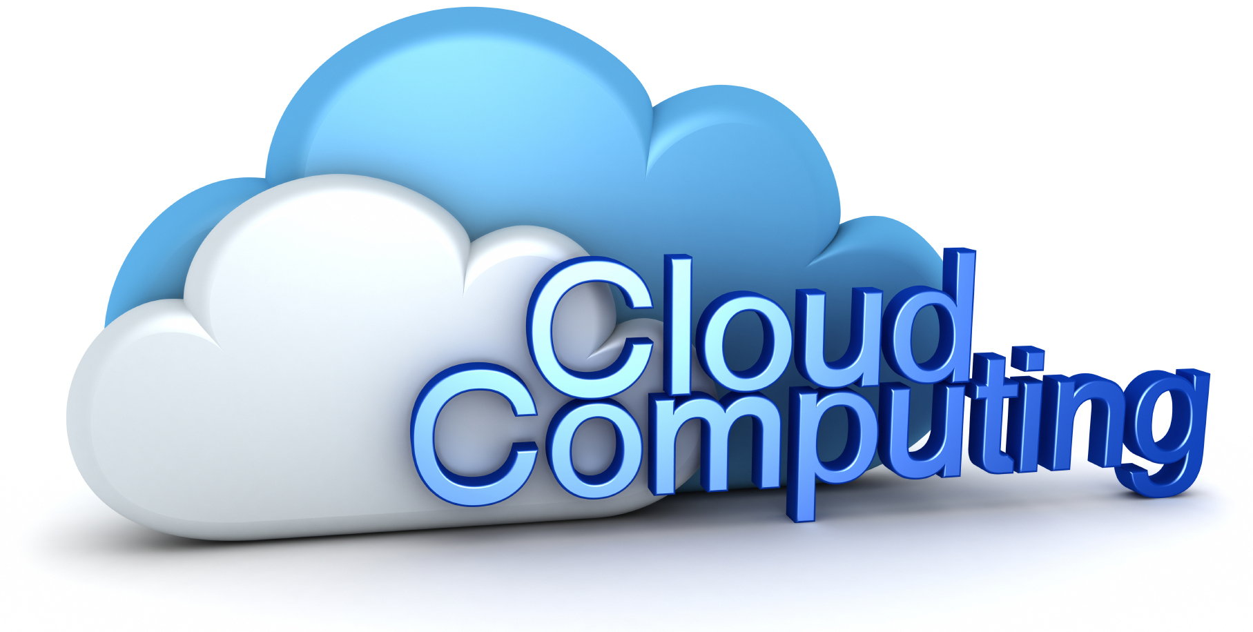
Cloud Strategy
May 4, 2017
Presented by:
Anupam Gupta
Director
Avenues International Inc.
www.avenuesinc.com

Slide 2
Agenda
Topics:
Welcome & Introductions
What is Cloud
How Cloud Works
Benefits of Cloud
Types of Cloud Computing
Cloud computing Deployment Model
Cloud Security
Q&A

Slide 3
What is Cloud:
Cloud Computing", by definition, refers to the on-demand delivery of IT resources and applications via the Internet with pay-as-you-go pricing
Cloud is
On Demand
Via Internet
Pay-As-You-Go Pricing
Cloud provides Rapid Access to Flexible and Low Cost IT resources

Slide 4
What is Cloud…
With cloud computing
No large upfront investments in hardware
No need to spend time in heavy lifting of managing that hardware.
Get resources as you need instantly
Pay only for what you use
Enterprise can Focus on their Business Needs and Not the Infrastructure

Slide 5
How Cloud Works
Cloud Provides Simple way to access:
Servers
Storage
Databases
Applications
….Over the Internet
This is made possible as:
Cloud Providers (such as Amazon, Google, Microsoft etc.), Own and Maintain the Network Connected Hardware Required for Cloud

Slide 6
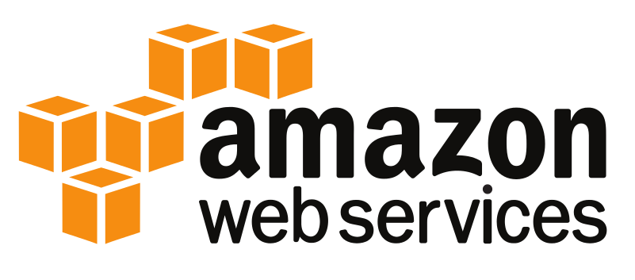
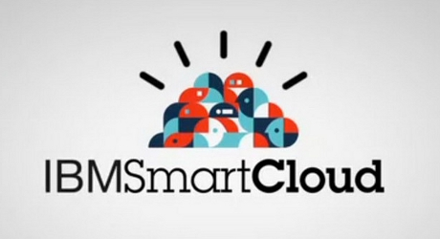
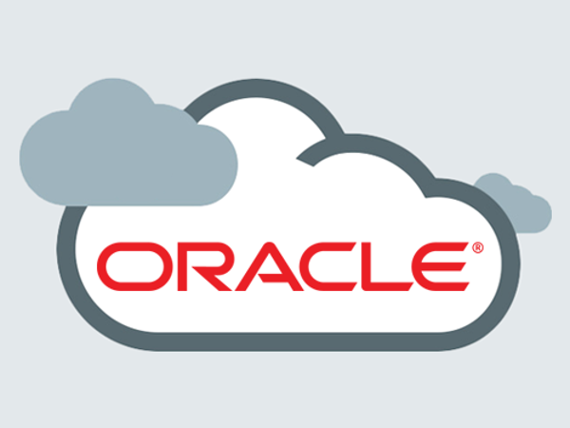
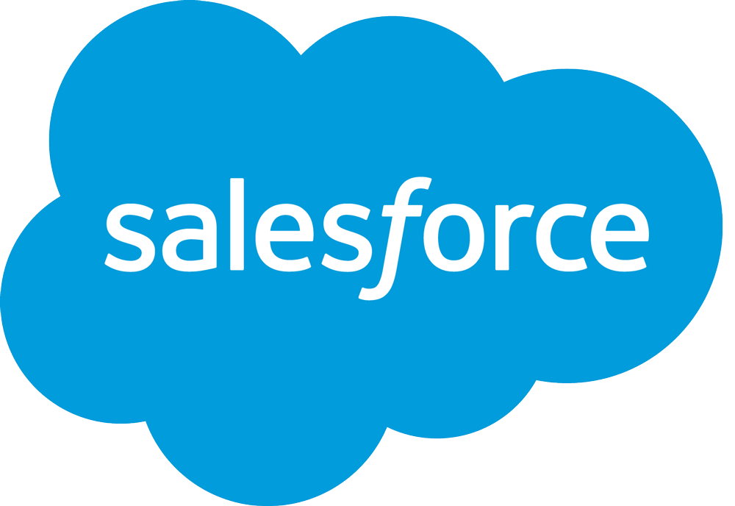
Major Cloud Providers

Slide 7
Benefits of Cloud (1):
Reduce Capital Expense
No need to invest heavily in data centers and servers
Pay when you consume computing resources
Massive Economies of Scale
Cloud providers achieve higher economies of scale
Which brings lower cost for cloud users
Unlimited Capacity (on fingertips)
Scale up and down infrastructure capacity as needed…in minutes

Slide 8
Benefits of Cloud (2):
Increase Speed and Agility
IT Resources are made available in minutes
Increase in agility for the organization
Focus on Business and Not infrastructure
Companies can concentrate on core business and customers rather than worry about infrastructure
Global Reach
Deploy application worldwide with just few clicks
Lower latency and better experience for customers

Slide 9
Benefits of Cloud(3)
Business
Almost zero upfront infrastructure investment
Just-in-time Infrastructure
More efficient resource utilization
Usage-based costing
Reduced time to market
Technical
Automation
Auto Scaling
Efficient Development Life Cycle
Better Disaster Recovery and Business Continuity

Slide 10
Type of Cloud Computing
Infrastructure as a Service (IaaS):
Platform as a Service (PaaS):
Software as a Service (SaaS):

Slide 11
Infrastructure as a Service (IaaS)
Infrastructure as a Service (IaaS):
Basic building blocks for cloud IT
Provide access to
Networking features
Computers
Data Storage Space
Provides highest level of flexibility and management control over the IT resources
Similar to existing IT resources

Slide 12
Platform as a Service (PaaS)
Platform as a Service (PaaS):
Removes the need for organizations to manage the underlying infrastructure (usually hardware and operating systems)
Allows focus on deployment and management of application
Provides set of services for developers, to develop and test apps, without having to worry about the underlying infrastructure
PaaS works on top of IaaS

Slide 13
Software as a Service (SaaS)
Software as a Service (SaaS):
Completed product that is run and managed by the service provider
Applications are hosted by a service provider and made available to customers over the Internet
End User Application
User need not worry about hardware and software management, and need to think only about how to use the application
Example: Salesforce.com, Web based email

Slide 14
Cloud Deployment Model
Public Cloud
Private Cloud
Hybrid Cloud

Slide 15
Public Cloud:
Public Cloud:
Multi Tenant environment
Hosted at Provider location
Shared Infrastructure
Access over internet
Low cost

Slide 16
Private Cloud
Private Cloud:
Single Client
Hosted at Providers/Organization location
Access over internet or private network
High Security
Easier compliance (Such as HIPAA, Sarbanes Oxley etc.)
Hardware, Network and Storage Performance can be customized

Slide 17
Hybrid Cloud(1)
Hybrid Cloud:
It uses a private cloud foundation combined with the strategic integration and use of public cloud services
Allows companies to keep critical application and sensitive data in private cloud or traditional data center and take advantage of public cloud resources
SaaS, for the latest applications,
IaaS, for elastic virtual resources
It extends existing data center / private cloud to public clouds as needed

Slide 18
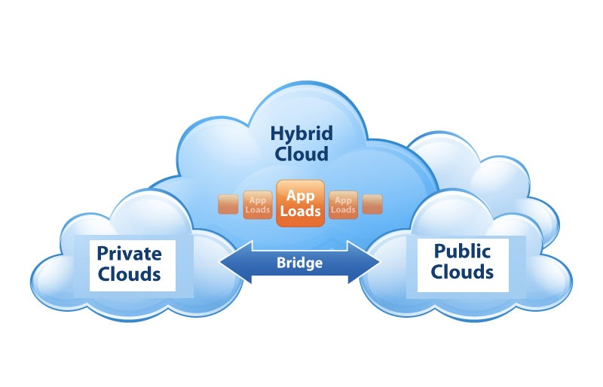
Hybrid Cloud(2)
The cloud infrastructure is a composition of two or more clouds (private or public) that remain unique entities but are bound together by standardized or proprietary technology that enables data and application portability

Slide 19
Cloud Security- Infrastructure
Cloud Provider - Data Centers are:
Highly Secure
Electronic Surveillance
Multi Factor access control system
Trained security guards
Multiple geographic regions and availability zones
Physical Infrastructure security is typically ensured by Cloud Providers

Slide 20
Cloud Security Features
Cloud Provider - Security Features:
Secure access
Built-in firewalls
Unique users
Multi-factor authentication (MFA)
Private Subnets
Encrypted data storage
Security logs
Centralized key management
Etc.

Slide 21
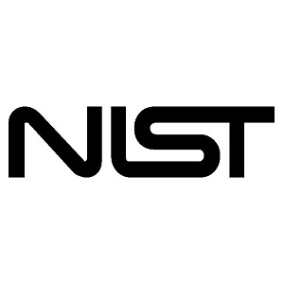
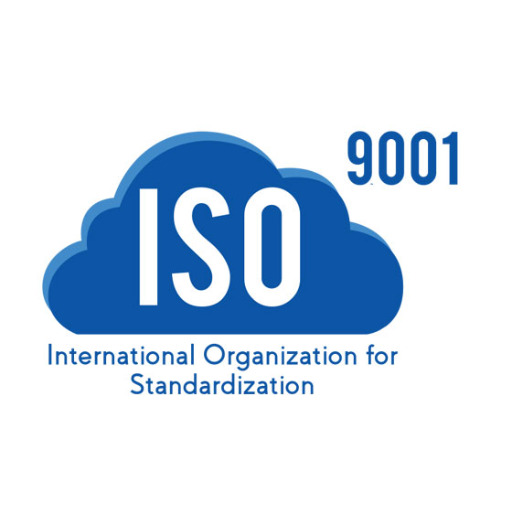
Cloud – ENSURES Compliance
And Many More….

Slide 22
Cloud Security: For the Users
Security in the cloud is very similar to security in any premise data centers
Only without the costs and complexities of protecting facilities and hardware.
Cloud Users need to use software-based security tools to monitor and protect the flow of information into and of out cloud resources. Example:
OS and applications updated with the latest security patches
Perform backups of the data
Install anti-virus, intrusion detection, and security incident and event monitoring (SIEM) tools
Use security features from Cloud Provider

Slide 23
Security - Perception is improving
The perception of cloud application security has changed dramatically over the last year.
A survey of over 2,200 cybersecurity professionals shows that 52% of organizations are now confident that cloud apps can be as secure as premises-based apps, up from 40% a year ago.

Slide 24
Summary
“Cloud computing not only reduces business costs, but also makes applications accessible from any location, and reacts swiftly to changes in business needs”
“TBR predicts worldwide public cloud revenue will increase from $80B in 2015 to $167B in 2020”
“Interoperability and data security issues may hinder market growth, the future of cloud computing seems very promising”

Slide 25
Questions
Presenter Name: Anupam Gupta
Avenues International Inc.
Tel: 973-202-3384
anupam@avenuesinc.com
www.avenuesinc.com

