Slide 1

Workshop 4: Developing a one page business case
Reinventing the way we do things
May 04, 2017

Slide 2
Agenda for today
Intro – 10 min
Interactive – 35 min
  Problem – 5 min
  Customer Segments– 5 min
  Unique Value proposition – 5 min
  Solution– 5 min
  Key Metrics– 5 min
  Revenue Stream– 5 min
  Cost Structure– 5 min
Report Back and Discussion – 15 min

Slide 3
KPMG’s XDE Client Approach

Slide 4
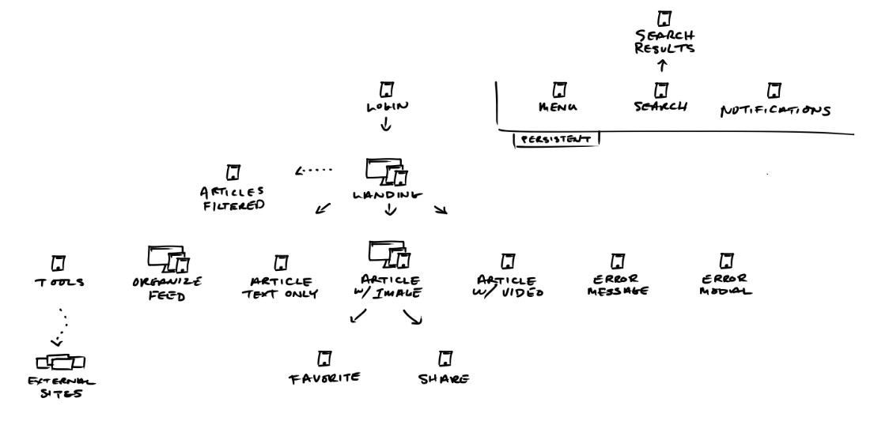

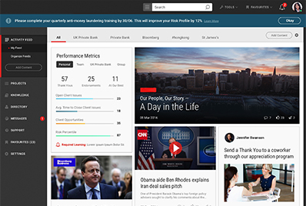
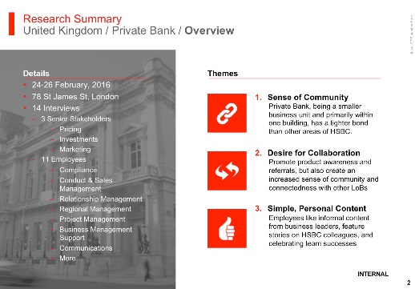
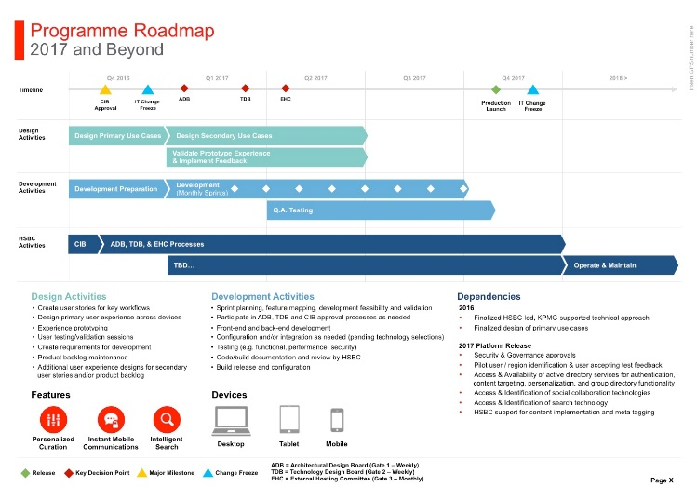

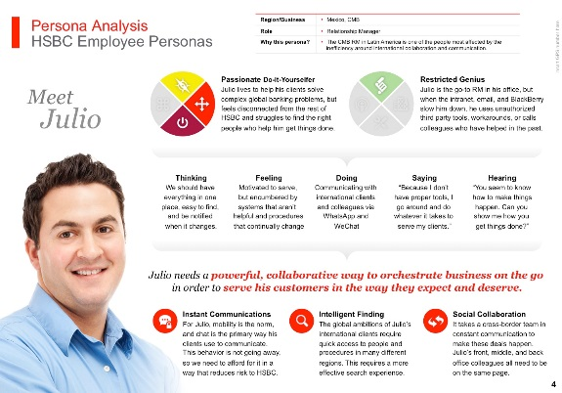
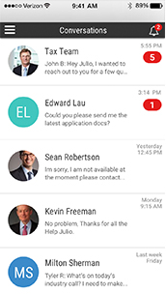
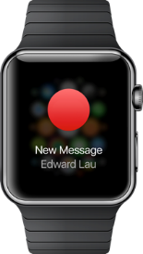
Creating a human-centered digital experience
Contextualize
Empathize
Prototype
Expand
Implement
Evolve
Business needs/goals
Product strategy
Technical assessment
Value definition
User research
Behavioral analysis
Journey mapping
Persona creation
Feature ideation
Conceptual design
Motivational design
Interactive prototyping
User validation
Stakeholder alignment
Information architecture
Workflow mapping
Visual design
Style guides
Road mapping
Technical architecture
Agile development
Experience-driven development
Continuous improvement
Iterative releases
Analytics-based refinement
Feature prototyping

Slide 5
Human-centered approach
Creating Value
Improving the System
Business
Technology
Business
Technology
Consumer
Team Member
Service
Product
Business Model
Process
Tool
Role
Notes:
Our participatory activities center around human interaction at every stage, from the initial observation and learning phases, through to the prototyping and validating of potential future states.
Our methods facilitate deep understanding of the values and problems that are the drivers of innovative solutions. We build upon that understanding by designing and testing potential solutions with participants who represent actual consumers.
This approach leads to the creation of new value through the design of transformative business models and innovative service, and product experiences.

Slide 6
The Importance of Capital Investment Planning
Creates traceability and clear line-of-site from strategic plans to individual project investments
Enables consistency in measurement of performance against project plans and goals
Allows the enterprise to measure return-on-investment and protect against duplication and waste
Encourages business vendor and vendor accountability

Slide 7
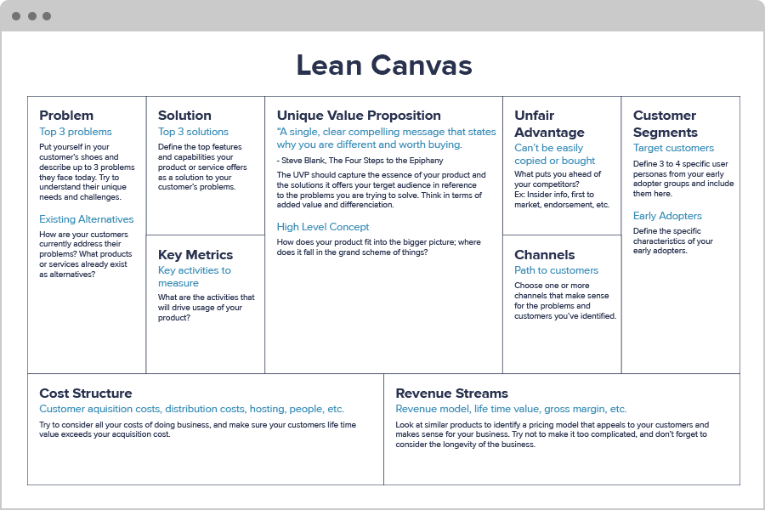
The One Page Business Case - Lean Canvas
XDE Experience Design
Lean Canvas is an adaptation of Business Model Canvas created for the Lean Startup method
Lean Canvas promises an actionable and innovation-focused business plan
It focuses on problems, solutions, key metrics and competitive advantages and the people that will benefit from the solution

Slide 8
Interactive exercise
Let’s GO! And have fun

Slide 9
What’s the Problem? (5 Minutes)
Put yourself in the shoes of your customer and describe up to 3 problems they have today. It is the difference between your current and desired state.
Think about…
Think about…
Think about…
What is broken
or needs improvement?
Why this gap matters?
Are there root causes
that could be tackled?

Slide 10
Who are your customers? (5 Minutes)
Define 3 to 4 specific user personas from your early adopter groups to include here.
Think about…
Think about…
Think about…
Do you have a single /
multi segmented market?
Their unique needs
and challenges
Defining characteristics
of your early adopters

Slide 11
What is the Unique Value Proposition? (5 Minutes)
A single, clear and compelling message that states why the solution is different and worth receiving investment.
Think about…
Think about…
Think about…
Current alternatives
Why people would
prefer this value prop?
Is the problem
underserved?

Slide 12
What is the solution? (5 Minutes)
How do you intend to solve the problem?
Think about…
Think about…
Think about…
How does it meet
customer needs?
Does it align with the
Value proposition?
Is it achievable?

Slide 13
What are the Key Metrics? (5 Minutes)
What are the activities to measure during the project?
Key Metrics
Think about…
Think about…
Think about…
What activities will drive
usage of the solution?
What data will help
improve the solution?
How can you measure
impact of the solution?

Slide 14
What is the revenue stream? (5 Minutes)
Define the revenue model, the life time value, or the gross margin etc. This is part of the financial value of the solution
Think about…
Think about…
Think about…
Look for similar
pricing models
Tying it back to
the customer
The sustainability

Slide 15
What are the Costs? (5 Minutes)
What is it going to take to get this project up and running? What materials, personnel will you need?
Think about…
Think about…
Think about…
Cost of doing business
Do the revenue streams
offset costs?
The sustainability

Slide 16
Interactive exercise
Debrief
What about the process/template worked well?
What about this process/template proved the most difficult or challenging?
How was this different from other types of planning you have done?
How would the group adapt the template for future use?

Slide 17
kpmg.com/socialmedia
The information contained herein is of a general nature and is not intended to address the circumstances of any particular individual or entity. Although we endeavor to provide accurate and timely information, there can be no guarantee that such information is accurate as of the date it is received or that it will continue to be accurate in the future. No one should act on such information without appropriate professional advice after a thorough examination of the particular situation.
© 2016 KPMG LLP, a Delaware limited liability partnership and the U.S. member firm of the KPMG network of independent member firms affiliated with KPMG International Cooperative (“KPMG International”), a Swiss entity. All rights reserved. NDPPS 621825
The KPMG name and logo are registered trademarks or trademarks of KPMG International.

