Slide 1
Geospatial Coordinating Board
May 4, 2017

Slide 2
Content
Background
Approach
Coordination Framework
Task Forces
Data Program Task Force
Governance Task Force
Service Delivery Task Force
Accomplishments
2017 Goals

Slide 3
Background
Established per Act 178 in October 2014
Advise and prepare recommendations for issues and data standards
Coordinate efficient policy and technology issues
Memberships from entities
Local, county and state government agencies
Academia and private sector professionals
Facilitated by Office of Administration

Slide 4
Approach
CURRENT
EXECUTION
FUTURE
Lessons Learned
GOVERNANCE TASK FORCE
Refresh Base Map
Current Challenges
Data Sharing Opt In
DATA PROGRAM TASK FORCE
Situational
Analysis
Funding Coord.
Strategy / Actions
SERVICE DELIVERY TASK FORCE
Strategic Plan
IMPROVEMENTS

Slide 5
Coordination Framework
Governance
STANDARDS
CONSUME
Author
Approve
Publish
Applications & Infrastructure

Slide 6
Task Forces
Service Delivery | Evaluate how geospatial services are delivered today in the commonwealth Evaluate how other states and counties deliver geospatial services Identify recommendations for how geospatial services should be delivered in the commonwealth to maximize investments.
Data | Identify initiatives and approaches that remove barriers to sharing geospatial data Promote cost effective approaches to data sharing. Drive operational efficiencies and value-add solutions Advance the delivery of geospatial services
Governance | Document the geospatial governance process in the commonwealth (to include all governmental entities) Establish a list of major priorities or initiatives to address the needs of the broader geospatial community Evaluate approaches to accomplishing initiatives within existing budget constraints Identify opportunities for collaboration to meet common objectives Coordinate activities across other geospatial governing bodies.

Slide 7
Data Program Task Force
Mission
The mission of the data program task force is to identify initiatives and approaches that remove barriers to sharing geospatial data across the commonwealth and promote cost effective approaches to data sharing.
The focus is on driving operational efficiencies and value-add solutions while advancing the commonwealth’s delivery of geospatial services

Slide 8
Data Program Task Force
Challenge
No official base map exists for PA
Business Rationale
A single base map should be created so that entities using GIS data are working from the same base data with established standards. Authoritative data ownership is needed to reduce redundant efforts and multiple copies of base data layers. Standards need to be created to ensure data consistency.
Barriers to Implementation
Cost, ownership of technology and data, frequency of updates, service delivery methods
Effort to Complete
Coordinate the ownership of the base map technology, service delivery, and then identify the data layers that need to be included and ensure that only the authoritative source is providing updates and ownership of the specific layers. Develop data standards.

Slide 9
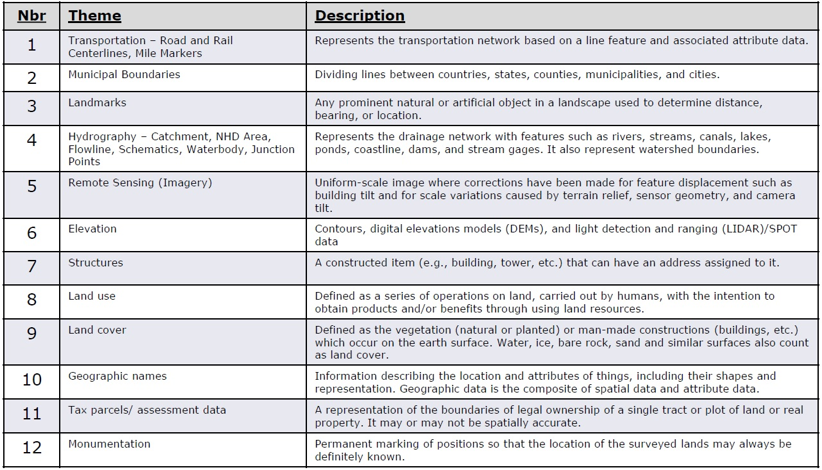
Adopted Base Map Layers

Slide 10
Data Program Task Force
Challenge
No single data sharing agreement exists between government entities with in the commonwealth
Business Rationale
A single data sharing agreement would foster over all sharing and simplify the task of ensuring that data is shared openly and in a manner that protects the interests of the data owner.
Barriers to Implementation
Buy-in from all entities about how the agreement should be structured, legal issues, RTK issues, coordination of the collection and ownership of the data agreements
Effort to Complete
Review what other states have done and evaluate the fit for PA. Involve local government organizations (CCAP, Municipal League, etc..) to get feedback. Involve legal to give review and final blessing. Review a need for incentivizing the sharing of data.

Slide 11
Governance Task Force
Mission
The mission of the governance task force is to document the geospatial governance process in the commonwealth (to include all governmental entities), establish a list of major priorities or initiatives to address the needs of the broader geospatial community, evaluate approaches to accomplishing initiatives within existing budget constraints, identify opportunities for collaboration to meet common objectives and coordinate activities across other geospatial governing bodies.

Slide 12
Governance Task Force
Goals
Evaluation of the current state of GIS in PA
Must understand the status of PA’s GIS community before we can do any work
Development of GIS Strategic Plan
Lead the development of a commonwealth wide Geospatial strategic plan and business plan in coordination with the other task forces, existing geospatial governing bodies, other governmental entities and interested parties.
Assessment of key funding opportunities and a means to disseminate the information
Coordinate information technology investment strategies that may be underway so as to maximize investments.
Identify and evaluate creative approaches to fund geospatial activities in the commonwealth given the current fiscal climate.

Slide 13
Governance Task Force
Goal: Evaluation of the current state of GIS in PA
Challenge
No all encompassing statewide GIS Survey exists / occurs on a consistent basis to update state of the State in GIS.
Business Rationale
Knowing the status of GIS throughout the spectrum Commonwealth entities helps target outreach, align goals, implement collaborative projects, and provide valuable information of direction forward.
Barriers to Implementation
Who creates / processes survey; Survey length; Entities to send survey to; Multiple iterations of survey; Industry specific questions; How often?
Effort to Complete
“State Geospatial Coordinating Board Questionnaire” joint TF developed; 8/1/2016 – 8/19/2016 addressing questions regarding goals & objectives of the Geoboard. Results analyzed jointly by TF. Next survey likely dive into more detail of individual GIS operations – Yearly minimum.

Slide 14
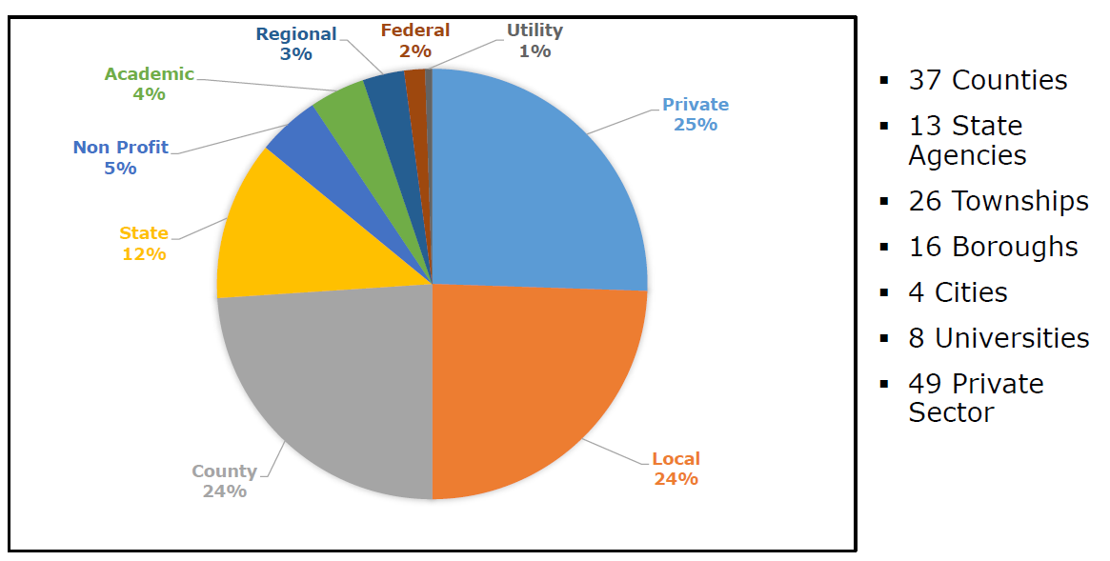
Governance Task Force
Goal: Evaluation of the current state of GIS in PA (continued)

Slide 15
Governance Task Force
Goal: Evaluation of the current state of GIS in PA
Questionnaire Summary
There is a strong need for a Pennsylvania base map to support many different business related activities
Data sharing agreement - most sharing is done with other government agencies while the private sector pays fees to acquire the data; ½ of respondents had DSA
GIS is centralized in about half of the respondents but only a third have developed an internal strategic plan
Respondents are largely unaware of external funding opportunities for GIS but almost a third have unmet funding needs for GIS related activities
About half of the respondents provide some form of GIS service delivery; overwhelming majority of those services are consumed both internally and externally

Slide 16
Governance Task Force
Goal: Development of GIS Strategic Plan
Challenge
The Commonwealth of Pennsylvania currently lacks an up to date, statewide, all encompassing, comprehensive GIS strategic plan. Business Rationale
Without a strategic plan, the Commonwealth is not able to take advantage of opportunities related to funding, enhanced cooperation, and streamlined operations. A plan can provide the overarching guidance necessary to capture these opportunities and increase the efficiency of GIS within the State.
Barriers to Implementation
Who creates / revisits / maintains plan; Revisitation timeline - how often?; capture needs of many entities; interaction with other plans; Feedback & Revisions vital
Effort to Complete
GIS Strategic Plan is currently being drafted by the Governance Task Force.

Slide 17
Governance Task Force
Goal: Development of GIS Strategic Plan (continued)
GIS Strategic Plan Preview
Key Tenets
Sustainability of GIS in the Commonwealth
Sustainable Funding
Sustainable Personnel
Sustainable Model of Governance
Cooperation, Collaboration, and Coordination
Cooperation Between Entities
Collaboration Among Entities
Coordination Across Entities
Phased Approach
Constructed to include objectives that have similar criteria:
priority
implementation time frame
resource allocation
pre-requisite dependencies
Constructed in a chronological manner to allow for continued operations and measurements of milestone success as we the Geospatial community progress through the strategic plan

Slide 18
Governance Task Force
Goal: Development of GIS Strategic Plan (continued)
Geoboard Vote – Final Acceptance of GIS Strategic Plan / Phase 1 Implementation Plan
Geoboard Vote - Accepts Annual Report
Feedback
Round 2
March 20, 2017
July 15-24, 2017
August 14, 2017
Geoboard Vote – Proceed / Alter Current Plan Direction
Feedback
Round 1
Professional Writer Review
May 8, 2017
July 1 - 9, 2017
July 31, 2017
March
April
May
June
July
August
March 20, 2017
July 10-15, 2017
July 10-15, 2017
Round 1 Revision
Final review
Governance TF Given Go-Ahead to Proceed Drafting Strategic Plan Based on Previously Explored Key Tenets & Goals
July 25-30, 2017
Round 2 Revision

Slide 19
Governance Task Force
Goal: Assessment of key funding opportunities and means to disseminate information
Challenge
Budget constraints and shortfalls inevitably stifle the growth & development of GIS across all sectors throughout the Commonwealth, how can PA create a more sustainable funding model for the future?
Business Rationale
Collaboration, cooperation, and coordination provide savings in resources. Using these principals to create a sustainable model of funding opportunities (and disseminating those opportunities) will allow many entities to tap into pooled resources for mutually beneficial results.
Barriers to Implementation
Budget constraints & shortfalls; earmarked budgetary items only allowed for certain uses; staffing to ensure this happens; platform non existent
Effort to Complete
This is an effort outlined in the Draft Plan as an objective. Preliminary research has been conducted at this point but is an ongoing project.

Slide 20
Service Delivery Task Force
Mission​
​
The mission of the service delivery task force is to evaluate how geospatial services are delivered today in the commonwealth, evaluate how other states and counties deliver geospatial services and identify recommendations for how geospatial services should be delivered in the commonwealth to maximize investments. ​

Slide 21
Service Delivery Task Force
Focus Areas
Identify existing challenges and formulate recommendations to improve the current environment.
Assess existing center of excellence models to improve geospatial service delivery as cost effectively as possible
Establish a service delivery framework to improve geospatial service delivery in the commonwealth

Slide 22
Service Delivery Task Force
Challenge
Establish a service delivery framework to improve geospatial service delivery in the commonwealth
Business Rationale
Develop a “partnership culture” - Create an environment that encourages information sharing that encourages new opportunities to engage and collaborate across sectors
Avoid redundant investments
Improve the user experience
Barriers to Implementation
Resource constraints, budget limitations, desire to control
Effort to Complete
Explore new channels to better service and delivery effective data services
Continuously improve and measure performance
Focused innovation

Slide 23
Accomplishments
Conducted four board meetings
Held task force meetings
Conducted state-wide GIS survey
Gained agreement on base map themes
Gained agreement on Annual Report

Slide 24
2017 Goals
Advise Governor
Complete a strategic plan
Support PEMA’s upcoming remote sensing procurement preparation
Identify authoritative spatial data layers and their stewards supporting the base map themes
Decide approach to resolving local municipal boundary discrepancies
Define a single data sharing agreement that can be used throughout PA
Determine a strategy for coordinated funding of statewide GIS programs
Define the strategy for leveraging cloud-based services
Implement a GIS governance framework
Continue outreach and education at industry events

