Slide 1
Balancing Security and Innovation with Commercially Supported Open Source Software
Presenter: Mike Bourgeois, State Government Solutions
Notes:
Introduction:
Name, State consulting background, Agenda (company introduction, Government usage of open source, How innovation impacts state government (cost, agility, workforce, risk mitigation), benefits

Slide 2
Business Drivers for Change

Slide 3
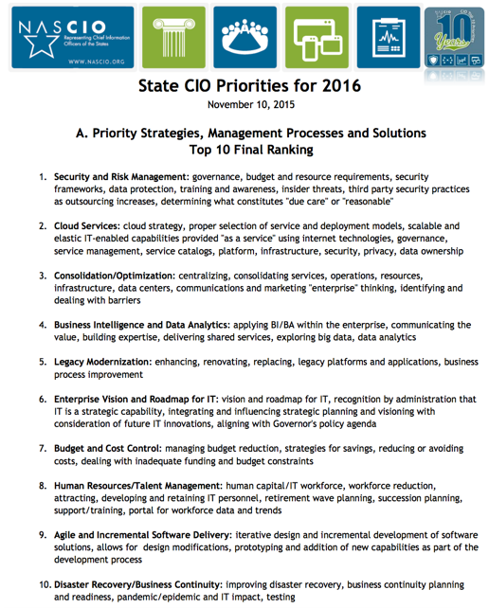
COMMONWEALTH STRATEGIC PRIORITIES
Governor Wolf established 3 priorities to guide agencies in carrying out their responsibilities.
IT-related initiatives primarily align with Government That Works priority.
NASCIO State CIO Priorities 2016
Schools That Teach
Government That Works
Data Analysis & Program Management
Interactive Access
Online Services
Open Data
Efficiency
Jobs That Pay
*
*
Reference: http://www.oa.pa.gov/Programs/Information%20Technology/Documents/IT-strategic-plan.pdf

Slide 4
COMMONWEALTH GOALS
Four Overarching Goals Aligned with Governor’s IT Priorities
Optimize Services
Transform Government
Implement services transformation
Enhance security services
Modernize telecommunications
Improve service management
Modernize legacy systems
Implement a digital government strategy
Evolve functional centers of excellence
Modernize enterprise administrative systems
Empower the Workforce
Foster Collaboration, Communication and Governance
Improve knowledge management
Foster a mobile workforce
Align IT human resources processes
Enrich training
Strengthen strategic planning
Enhance communications
Provide agencies different procurement offerings
Increase business risk awareness

Slide 5
GOVERNMENT AGENCIES HAVE SIMILAR NEEDS
COMMON NEEDS ACROSS MANY STATES
Optimize Services
Transform Government
Implement services transformation
Enhance security services
Modernize telecommunications
Improve service management
Modernize legacy systems
Implement a digital government strategy
Evolve functional centers of excellence
Modernize enterprise administrative systems
Empower the Workforce
Foster Collaboration, Communication and Governance
Improve knowledge management
Foster a mobile workforce
Align IT human resources processes
Enrich training
Strengthen strategic planning
Enhance communications
Provide agencies different procurement offerings
Increase business risk awareness

Slide 6
STATE GOVERNMENT BUSINESS CHALLENGES
AGENCIES REQUIRE MORE SERVICES, DELIVERED FASTER, FOR LOWER COST
*
*
Increased expectations from business to deliver new functionality faster.
Pressures from the business to reduce cost.
How can we do more with less?

Slide 7
STATE GOVERNMENT IT CHALLENGES
EXPECTATIONS REQUIRE IT TRANSFORMATION
*
*
100%
70%
30%
of resources
to maintain current portfolio
to invest in innovation, differentiation

Slide 8
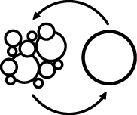
TRANSFORM THE IT LANDSCAPE
APPLICATIONS AND SERVICES CAN BE DELIVERED FASTER WITH LOWER COST
RE-BALANCE MAINTENANCE & INNOVATION
REDUCE / AVOID VENDOR LOCK-IN, LICENSE MODELS
BECOME MORE PRODUCTIVE WITH LIGHTWEIGHT TECHNOLOGY
REMOVE TECHNICAL DEBT & RISK
ADOPT AGILE METHODOLOGIES, DEVOPS, OR CLOUD

Slide 9
DIGITAL TRANSFORMATION ENABLES PRODUCTIVE TEAMS
Enable experimental approach to product development
Create high performance teams
Improve quality of work
Drive loyalty
Overall improvement in quality
Frequent Deployments
Faster Recovery from Failures
Effects of Modernization
Lower change failure rate
Shorter lead times

Slide 10
Commercially Supported Open Source

Slide 11
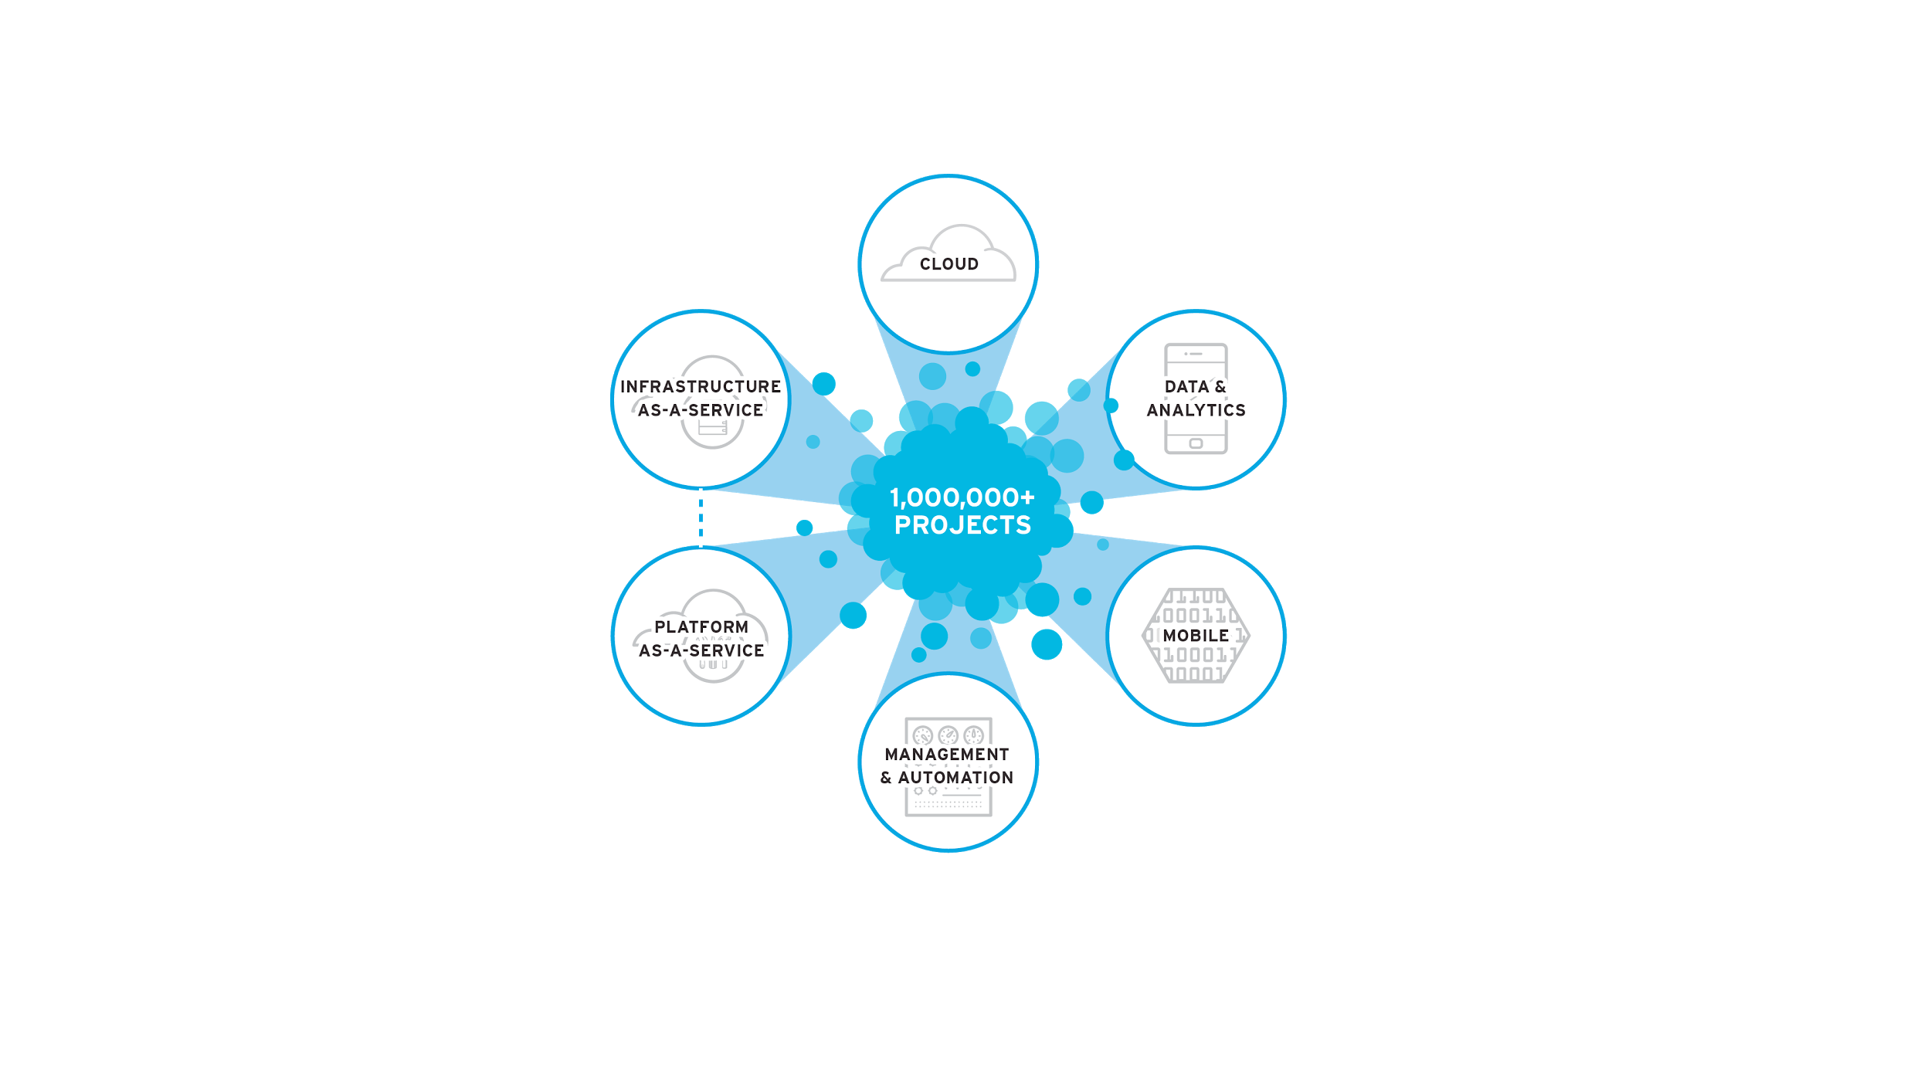
OPEN SOURCE FUELS RAPID INNOVATION
*

Slide 12
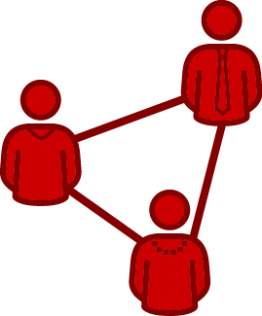
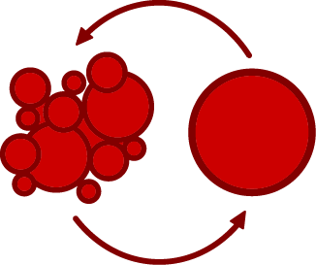
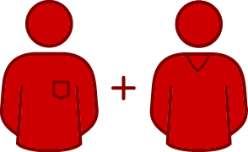
OPEN SOURCE CULTURE
Collaboration
Shared problems are solved faster
*
Transparency
(both access and the ability to act)
Working together creates standardization

Slide 13
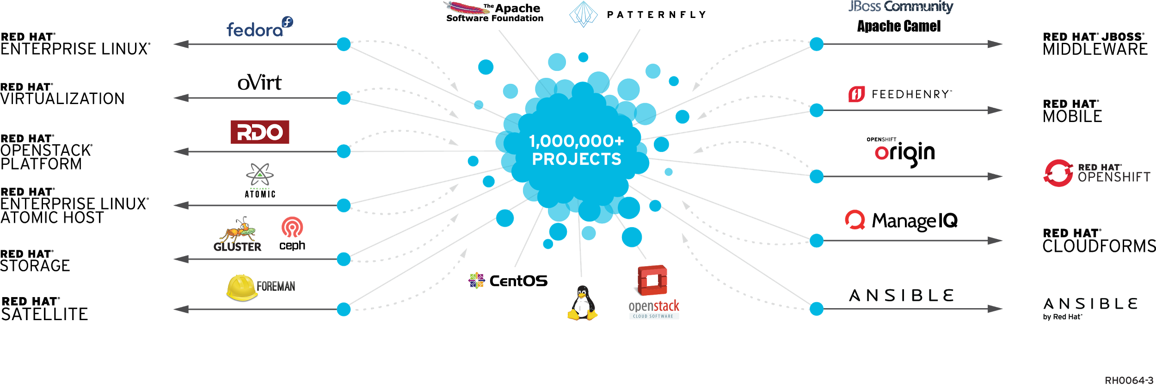
COMMUNITY PROJECTS TO ENTERPRISE PRODUCTS
*
*
PARTICIPATE
INTEGRATE
STABILIZE
We participate in and create community-powered upstream projects.
We integrate upstream projects, fostering open community platforms.
We commercialize these platforms together with a rich ecosystem of services and certifications.

Slide 14
How Open Source Helps Government

Slide 15
GOVERNMENT AGENCIES MUST ADDRESS
PEOPLE, PROCESSES, AND TECHNOLOGY
DIGITAL TRANSFORMATION REQUIRES AN EVOLUTION IN…
APPLICATIONS
INFRASTRUCTURE
PROCESS
New ways of developing, delivering, and integrating applications
Modernize existing and build new cloud-based infrastructure
More agile process
across both IT andthe business

Slide 16
APPLICATION REFERENCE MODEL
ACCELERATE
Application Delivery
Web Server
Application Platform
Mobile Application Platform
DEVELOPMENT &
MANAGEMENT TOOLS
Business Process Management
Business Rules Management
SECURITY
AUTOMATE
Business Rules & Processes
*
INTEGRATE
Applications, Data & Devices
Enterprise Service Bus
Data Virtualization
PHYSICAL VIRTUAL CLOUD PUBLIC CLOUD PRIVATE CLOUD
Notes:
<<Mention the goal of technology is to have common building blocks and avoid sprawl>>

Slide 17
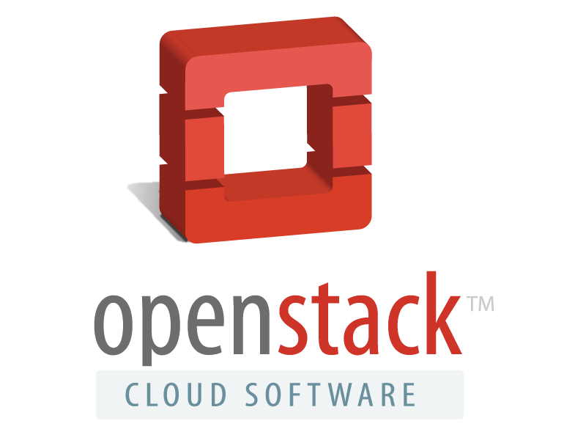
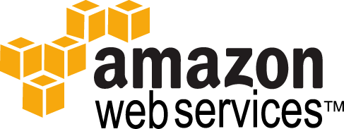
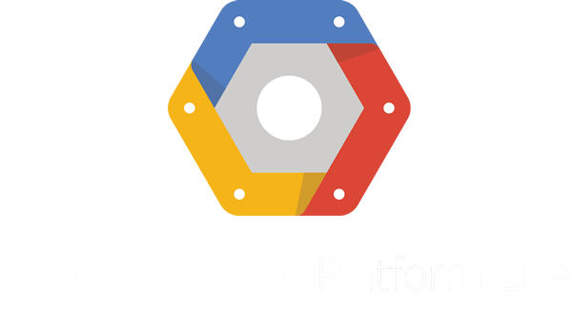
APPLICATION REFERENCE ARCHITECTURE
Web Server
Application Platform
Mobile Application Platform
Apache
JBoss Enterprise Application Platform
Red Hat Mobile Application Platform
DEVELOPMENT/MANAGEMENT TOOLS
JBoss Developer Studio IDE, JBoss ON
SECURITY
RED HAT IdAM, Red Hat SSO,
3Scale API Management
Business Process Management
Business Rules Management
JBoss Business Process Management
JBoss Business Rules Management
*
Enterprise Service Bus
Data Virtualization
JBoss Fuse
JBoss Data Virtualization
JBoss Data Grid
PLATFORM as a SERVICE
PHYSICAL VIRTUAL CLOUD PUBLIC CLOUD PRIVATE CLOUD

Slide 18
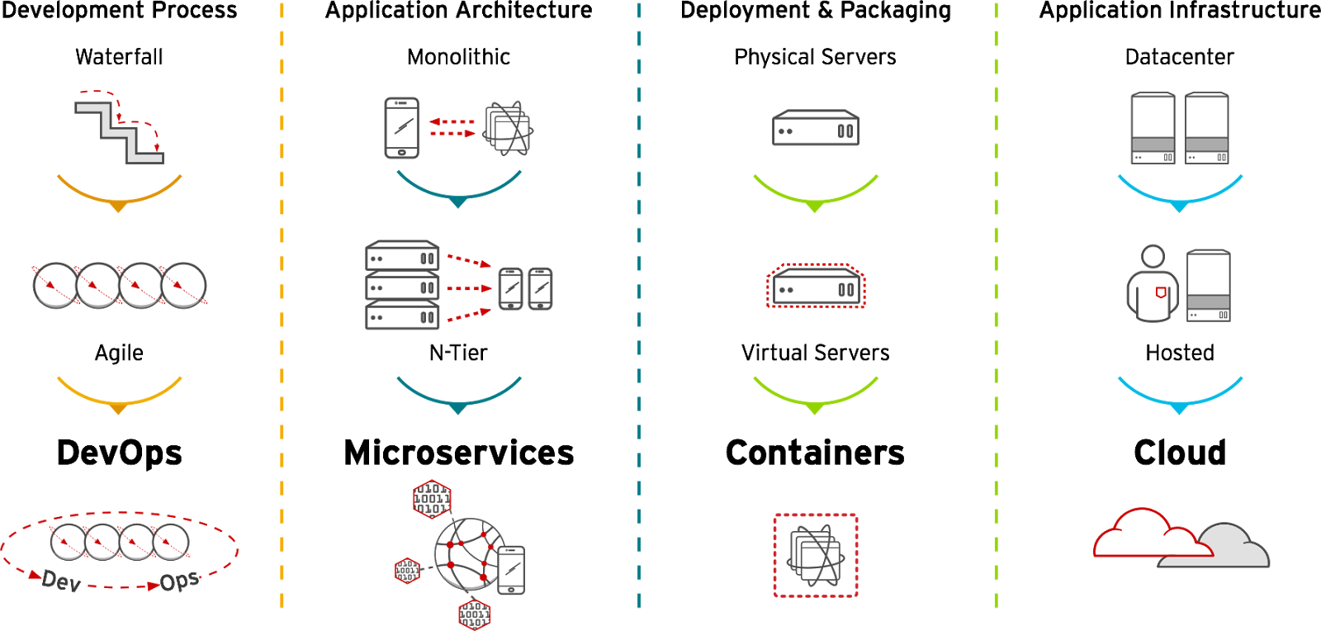
DIGITAL IT MUST EVOLVE TO SERVE AGENCY NEEDS
TRANSFORMATION OF PROCESS, TOOLS, SOFTWARE ARCHITECTURE AND DEPLOYMENT STRATEGY
Application Lifetimes
Months & Years
Weeks & Months
Days & Weeks

Slide 19
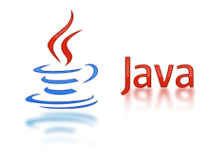
DELIVERY CHALLENGES WITH MONOLITHIC APPLICATIONS
SUCCESS WAS ONCE DEFINED AS MOVING APPLICATIONS FROM THE MAINFRAME
Developer
Developer
Release Plan
Intg, QA & UAT
Ops replace old with new
Developer
Developer

Slide 20
DELIVERY CHALLENGES WITH MONOLITHIC APPLICATIONS
COMPLEX MONOLITHIC APPLICATIONS CANNOT KEEP UP WITH BUSINESS DEMANDS, REQUIRE LONG TESTING CYCLES, AND EXPENSIVE TO MAINTAIN
Developer
Bugs
Developer
Release Plan
Intg, QA & UAT
Ops replace old with new
Developer
Bugs
Developer

Slide 21
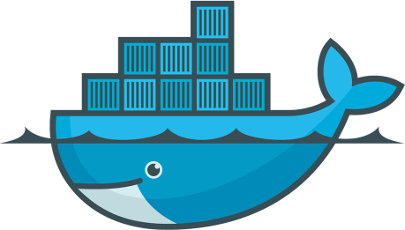
DIGITAL APPLICATIONS ARE LIGHTWEIGHT AND SEPARATE KEY LAYERS OF THE ARCHITECTURE
COMPONENTS ARE INDEPENDENTLY DESIGNED, TESTED AND DEPLOYED
Developer
Release Plan
Feature to Prod
Developer
Rules Engine
Release Plan
Feature to Prod
Legacy App still running
Enterprise Service Bus
Developer
Application Server
(Web Application)
Release Plan
Developer
Feature to Prod
Business Process Server

Slide 22
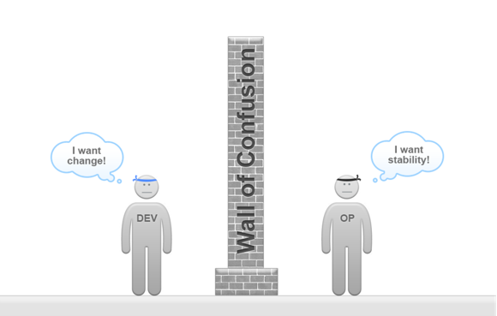
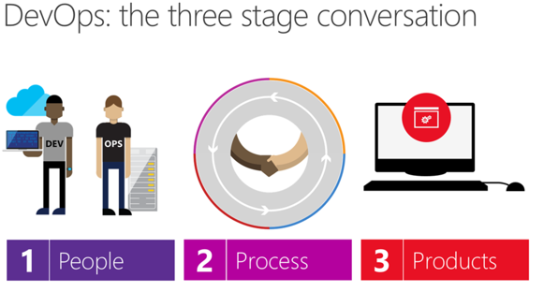
ADDRESSING THE APPLICATION SDLC PROCESS CHALLENGE
I need new technology, such as mobile!
Security is a top priority for everything!
DevOps SDLC
Traditional SDLC

Slide 23
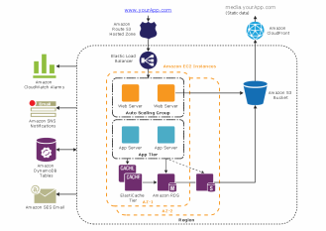
DEVELOPMENT AND OPERATIONS SEE THINGS DIFFERENTLY
Software Development Lifecycle
Business
Requirements
Design
Code
Test
Deploy
Iterate
Development
SATISIFIES
Maintainability
Disaster Recovery
Security
Service Level Agreement
Reliability
Quality Attributes
Highly Available Environments
Performance
Security Requirements
Operations
Scalability
Data Backup Policy
Operational Integrity & Resilience

Slide 24
Enterprise PLATFORM for both Dev and Ops
Platform as a Service (PaaS) Designed for Development and Operations

Slide 25
What are containers?
It Depends on Who You Ask
DEVELOPERS
SYS-ADMINS / OPS
Package my application and all of its dependencies
Deploy to any environment in seconds and enable CI/CD
Easily access and share containerized components
Sandboxed application processes on a shared Linux OS kernel
Simpler, lighter, and denser than virtual machines
Portable across different environments

Slide 26
How containers are different than virtual machines?
VIRTUAL MACHINES
CONTAINERS
App A
App B
App…
App A
App B
App…
LIBS A
LIBS B
LIBS…
LIBS A
LIBS B
LIBS…
VM OS
VM OS
VM OS
Container
Container
Container
Hypervisor Platform
Container Mgmt. Platform
Host Operating System
Host Operating System
Physical Machine(s)
Physical Machine(s)
Require a dedicated OS for each server
Run on top of a hypervisor
Require more resources to run apps
Most implementations do not have auto-healing and auto-scaling
Share a single OS on each host
Run as an isolated Linux process
Out of box auto-scaling and auto-healing capabilities
Provide agencies with self-service to provision their own environments

Slide 27
Containers transforms apps, processes & infrastructure
CONTAINERS TRANSFORM
Monolith
Datacenter
Waterfall
N-Tier
Hosted
Agile
Microservices
Hybrid
DevOps
APPLICATIONS
INFRASTRUCTURES
PROCESSES

Slide 28
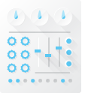
PaaS CRITICAL FEATURES FOR BOTH DEV AND OPS
APPLICATION MIDDLEWARE
Application Server (Java, .Net, PHP)
Data Virtualization
Business Rules Management
Business Process Management
Enterprise Service Bus
Mobile Application Platform
API Management
Business
Automation
Integration
Web Apps
Mobile Apps
<Other apps>
Container
Container
Container
Container
Container
Self-Service
Service Catalog
(Language Runtimes, Middleware, Databases)
Build Automation
Deployment Automation
OpenShift Application Lifecycle Management
(CI/CD)
Container Orchestration & Cluster Management
Orchestration
Management
Red Hat Storage
Networking
Storage
Registry
Logs &
Metrics
Security
Infrastructure Automation & Mgmt.
Enterprise Container Host
Secure Operating System
Container Runtime & Packaging
(docker)
Atomic Host
Red Hat Enterprise Linux
Notes:
At the lowest layer, OpenShift is:
Installed on Secure RHEL as the host Container operating system:
In order to run linux containers you need Red Hat’s secure linux operating system.
Clustered Container Infrastructure
In order to run containers at scale you need an orchestration engine that can deploy, connect, and coordinate all of those containers in a consistent manner.
You need to be able to attach persistent storage to these containers in order to support government service applications
And you need a way to securely manage all of these containers, including the contents of each container.
Enterprise Container Platform
OpenShift create a seamless experience for developers with all the tools and services they need.
OpenShift provides a way to automate the building and deploying of applications as well as an easy way to visualize where those deployments are occurring in real time.

Slide 29
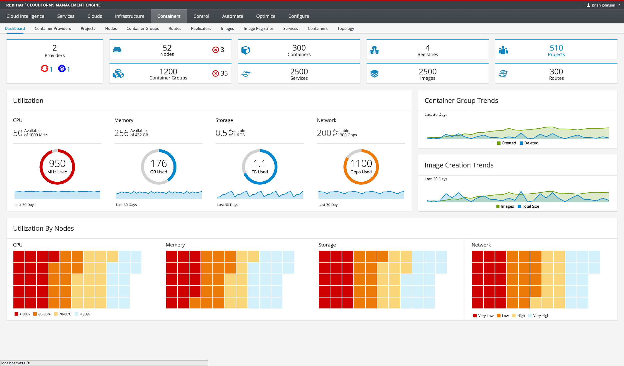
Consistent container management
CloudForms management included with OpenShift Enterprise to improve control over apps and infrastructure
Monitor and manage resource consumption of containers
Docker and Kubernetes aware (containers, pods, services)

Slide 30
Benefits of implementing devops to agencies
BUSINESS VALUE HIGHLIGHTS
531% average five-year ROI
$1.29 million average annual benefits per 100 developers per year
66% faster application development life cycles
35% less IT staff time required per application developed
38% lower IT infrastructure and development platform costs per application

Slide 31
Open Source Case Studies

Slide 32
State government using open source
Maryland
MD Health Benefit Exchange | Application Server, Enterprise Service Bus | Agency Objective The agency was interested in replacing proprietary middleware products to substantially lower TCO. Solution The solution is a health insurance exchange serving the needs of millions of citizens applying for subsidized and fully funded health insurance Results Year 1 license cost reduction by approximately 80% Out year maintenance cost reduction by approximately 40% Solution is running in production environment

Slide 33
State government using open source
Tennessee
Office of Information Resoures | Application Server, Standard Operating System | Agency Objective Agency looking for a cost-effective and standards based application server and secure standard operating system. Proprietary application server technology was too expensive , inflexible and limited the state’s ability to develop new systems, and scale to meet constituent demands Solution After evaluating a number of Java enterprise edition (JEE) application servers using a number of evaluation criteria, OIR selected JBoss enterprise application platform that integrates seamlessly with Red Hat Enterprise Linux operating system. Results Lower total cost of ownership (TCO) Increased performance Readily available resources familiar with the technology OIR can quickly and easily add new servers to its architecture
https://www.redhat.com/en/files/resources/en-rhjb-tennessee-migrates-middleware-environment-jboss-eap-3610777.pdf

Slide 34
State government using open source
North Carolina
Dept. of Information Technology – Digital Commons | PaaS Platform | Agency Objective To meet the Governor McCrorey’s mandate to improve the state’s websites, NC Department of Information Technology needed to overcome complex processes and limited resources Solution As the foundation for the project, the state chose a Drupal content management system (CMS) built on Red Hat’s OpenShift Platform as a Service Dedicated and hosted on Amazon Web Services (AWS). Results Reduced the maintenance and staffing costs of managing state websites Easier to launch new content and manage existing content Improved user experience (UX) Increased site traffic
https://www.redhat.com/cms/managed-files/cl-north-carolina-transforms-state-case-study-inc0391796lw-201605-en.pdf

Slide 35
Federal government using open source
General Services Administration (GSA): The GSA supports the basic functions of the US federal government and generates massive amounts of data.
General Services Administration (GSA) | Enterprise Service Bus Business Process Mgmt. Data Virtualization Secure Operating System | Agency Objective The GSA needed a way to use this data to make more intelligent decisions. Solution A systems integrator helped the GSA accomplish this goal using a commercially supported open source platform to enable big data analytics. Results GSA gained easier, unified data access and analysis Gained flexibility and scalability to meet future needs Supported innovation while maintaining critical agency security requirements Increased site traffic
https://www.redhat.com/cms/managed-files/rh-summit-acuity-systems-improves-government-data-analysis-case-study-inc0409158sw-20616.pdf

Slide 36
Working With Red Hat

Slide 37
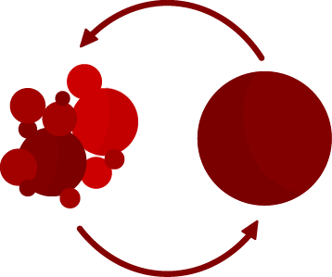
WHAT WE BRING TO YOUR AGENCY
Technology
Assurance
Expertise
Secure. Stable. Reliable.
Enterprise-grade certainty.
Experience you can trust.

Slide 38
THE WORLD’S LEADING DEVELOPER AND SUPPLIER OF
OPEN SOURCE SOFTWARE
FOR ENTERPRISE I.T.

Slide 39
THANK YOU
plus.google.com/+RedHat
facebook.com/redhatinc
linkedin.com/company/red-hat
twitter.com/RedHatNews
youtube.com/user/RedHatVideos

