Slide 1

Case Study
How the State of Georgia Implemented an Innovative Governance Process
Phil Weinzimer
Strategere Consulting
May 1, 2018

Slide 2
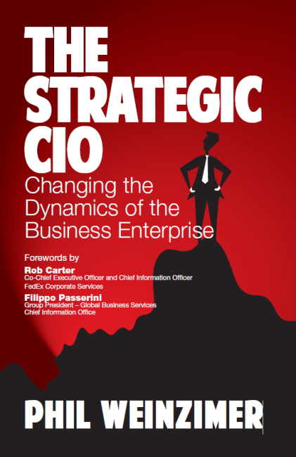

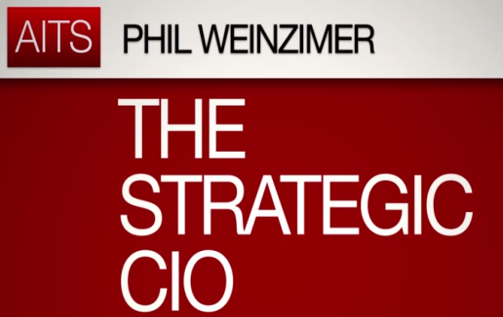


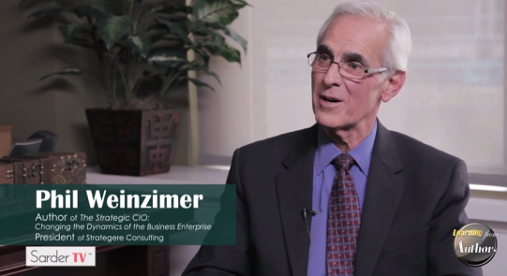

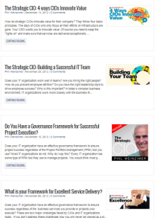

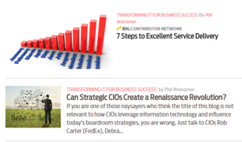












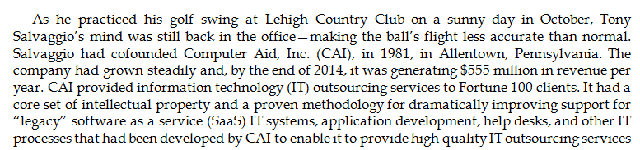


Phil Weinzimer
0000
©2018 Strategere Consulting
2

Slide 3
Topics
Why Project Governance is Necessary
State of Georgia Technology Strategy
Georgia Governance Process History
Georgia Enterprise Management System (GEMS)
CIO.com article and Video
3
©2018 Strategere Consulting
3

Slide 4

How US State Governments
Can Improve Customer Service
“A McKinsey Center for Government survey finds that Americans are often dissatisfied with state services—and identifies significant opportunities for improvement.”
http://www.mckinsey.com/insights/public_sector/how_us_state_governments_can_improve_customer_service?p=1
©2018 Strategere Consulting
4

Slide 5
Common Themes
Speed, Simplicity and Efficiency Make Citizens Happy
Satisfaction is Often Lower for More Essential Services
Citizens are Less Satisfied with Government Services
than with Private Sector Services
Most Citizens Prefer to Interact with Government Online
©2018 Strategere Consulting
5

Slide 6
Recommendations
Seize the Opportunity
Put Services for Citizens on the Leadership Agenda
Set Priorities for Innovation
Focus Transformation Programs on Service Elements that
Matter Most to the Satisfaction of Citizens
Measure Citizen Satisfaction Regularly
©2018 Strategere Consulting
6

Slide 7
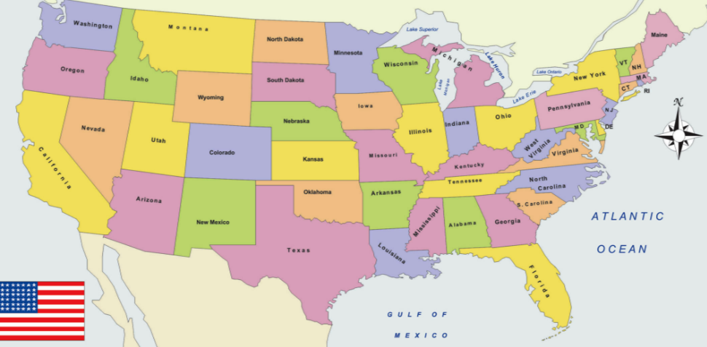
How US States Improve
Service to Citizens
PENNSYLVANIA
ILLINOIS
COLORADO
MARYLAND
GEORGIA
TEXAS
©015 Strategere Consulting
©2018 Strategere Consulting
7

Slide 8
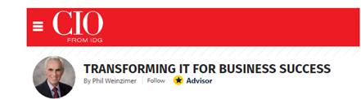




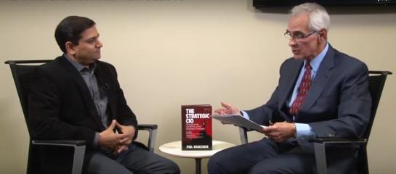
http://www.cio.com/article/3077989/cio-role/illinoiss-cio-is-leading-a-statewide-digital-transformation.html?nsdr=true
A
R
T
I
C
L
E
Illinois is undergoing a digital transformation to improve the services it provides its citizens.
At the core of the transformation is Hardik Bhatt, the state's CIO and secretary designate of innovation and technology.
V
I
D
E
O
https://www.youtube.com/watch?v=RnR1VQVzGts&feature=youtu.be
©2018 Strategere Consulting
8

Slide 9
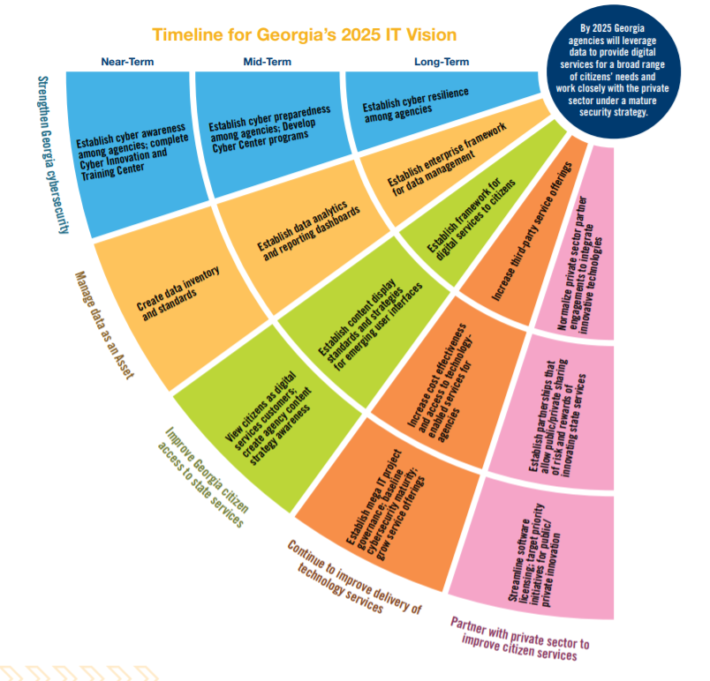

Georgia 2025 Vision
By 2025 Georgia agencies will leverage data to provide digital services for a broad range of citizens’ needs and work closely with the private sector under a mature
Citizen Access to Service
Mobility
Innovation
Calvin Rhodes
State of Georgia CIO
Technology as a service
©2018 Strategere Consulting

Slide 10
GOVERNANCE FRAMEWORK- PROJECT EXCELLENCE
Guiding Principles
Visible Leadership
Defined Tactics
Effective Communication
Vision
Executive Sponsor
Business & IT Owner
Scope
Plan
Change Management
Constant
360 Degrees Perspective
.Factual
Project Excellence Governance Processes and Metrics
Rigorous Processes and Oversight to Ensure Successful Governance of Projects
Focused Metrics to Measure Project Governance and Project Execution
Project Portfolio
Sustain – Maintain the Business
Operational –Run the Business
Strategic –Innovate the Business
Help Desk
Email
Sales /Marketing
Customer Support
New Products / New Markets
Infrastructure
Data Center
Product Development
Logistics
Creative Customer Service
Telephony
Network
Engineering
Manufacturing
Innovative Supply Chain
Project Governance & Portfolio Management Solution
Managing Activities, Schedule, Cost, Resources, Risk
©2018 Strategere Consulting
10

Slide 11


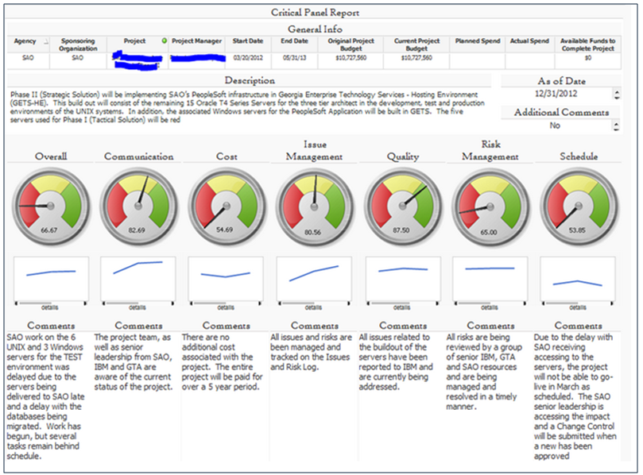
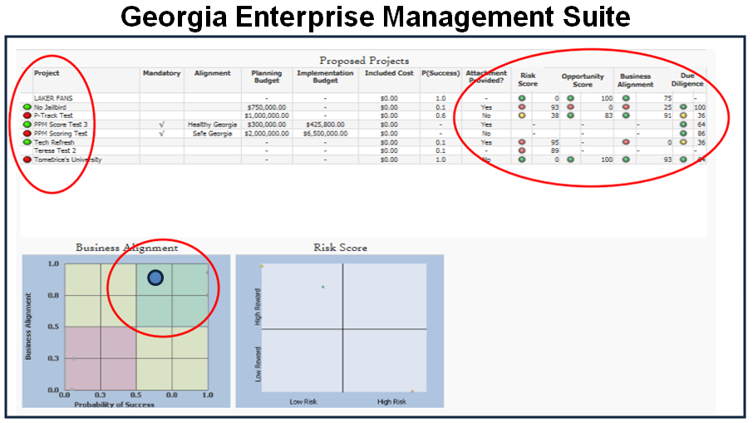
I Improve Value to Georgia Citizens
As the stewards of taxpayer dollars, we need to ensure project success through a well-defined and proven governance process…Calvin Rhodes, CIO-State of Georgia
Identifies the Key Predictors for Project Success
Proactive versus Reactive Solution
Multi Million Dollars Savings to Reinvest in Innovative Projects
Promotes Teaming through Active
Communication /Training via
Assessment Process

Slide 12
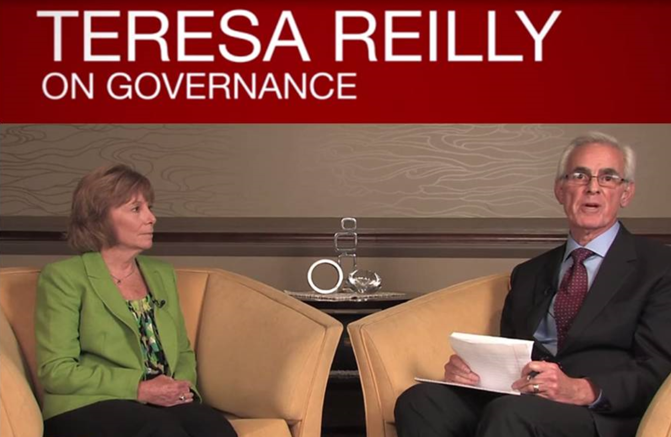
Governance Philosophy
Project Governance is a defined discipline, but you need a balanced view of how the project is progressing.
Provide a level of discipline in managing projects to reduce project risk.
Project managers need to be more proactive in anticipating risks.
Project Stakeholders are an integral part of the project process.
Make sure you collect the right data
Data gathering time must be minimized
Make sure data is analyzed properly
Teresa Reilly – PMO Director, Georgia Technology Authority
https://www.youtube.com/watch?v=MOVG86hCH5s&feature=youtu.be
©2018 Strategere Consulting
12

Slide 13
Key Observations
Each Agency uses a different PPM System to manage projects.
Three failed Enterprise-Wide PPM implementations failed
PMO collects data from each agency for key projects/collates, enters data into Excel spreadsheets and analyzes data for the monthly Enterprise Executive Management Meeting.
Spreadsheets are consolidated into an overall document, which is used by PMO to Review Projects
©2018 Strategere Consulting
13

Slide 14
Key Challenges
Current systems are manually intensive/ Complex projects require oversight
Cumbersome effort in gathering project data from each agency
Time consuming process to prepare monthly dashboard reports
Qualitative data, in the form or comments, provided by the project manager, represent the Program Manager’s view of the project.
Current system is cumbersome to use in capturing project issues
Key stakeholder input is NOT represented in project status
©2018 Strategere Consulting
14

Slide 15
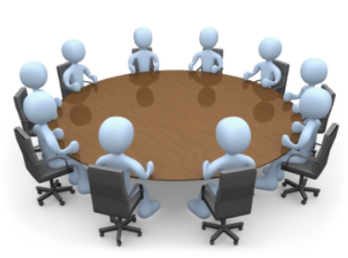
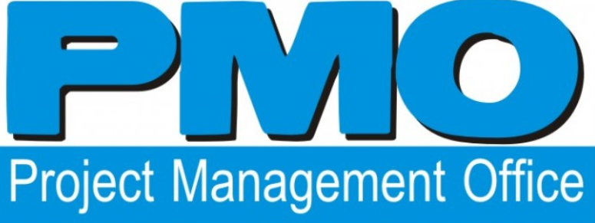


STATE OF GA NEW PROJECT GOVERNANCE PROCESS
129 STATE
AGENCIES
Critical Project Review Panel
Provides Oversight For Complex/Critical Projects
CRITERIA
PARTICIPANTS
  Projects -> $1M
  Or with significant business risk that would impact the citizens of the state; regardless of project cost.
The State CIO-Chair
PMO Director
State Agency Project Manager,
Business Owner/ Vendor Project Manager
Governor’s Office Representative
  400-600
  projects/yr
  Projects -> $10 Million
-Project Assessments
through project lifecycle
-PMO attends Status Meetings
©2018 Strategere Consulting
15

Slide 16
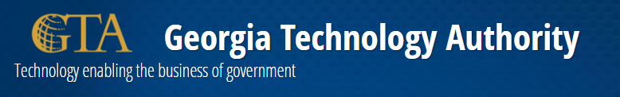
GTA contracted with vendor (CAI) to offer enterprise-wide portfolio management application
The application, Georgia Enterprise Management Suite (GEMS), provides insight into the health and status of in-flight projects through the ability to combine traditional, quantitative operational data with qualitative assessment data from multiple stakeholders.
The benefits include:
  Anytime, anywhere accessibility since GEMS is a hosted, web-based application
Capability for all contributors – such as project managers, team members and
other key stakeholders – offer input regarding status and health of the project
Easy monthly reporting
Better analytical tools that look at the entire range of project indicators
Improved visibility into the performance of projects, programs and portfolios throughout their entire lifecycle

Slide 17
Three Project Savings Examples
PROJECT
SAVINGS
ISSUE
Finance Project
$ 300k
Vendor Issue
Case Management
$ 700k
PM Issue
Health Management
$ 400k
Poor Requirements

Slide 18
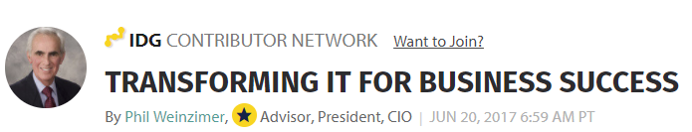
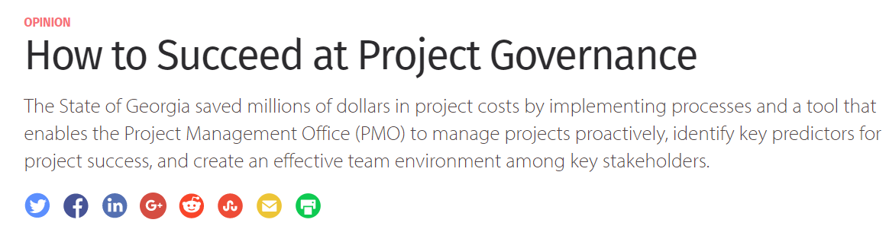
https://www.cio.com/article/2693222/project-management/how-to-succeed-at-project-governance.html?nsdr=true

Slide 19
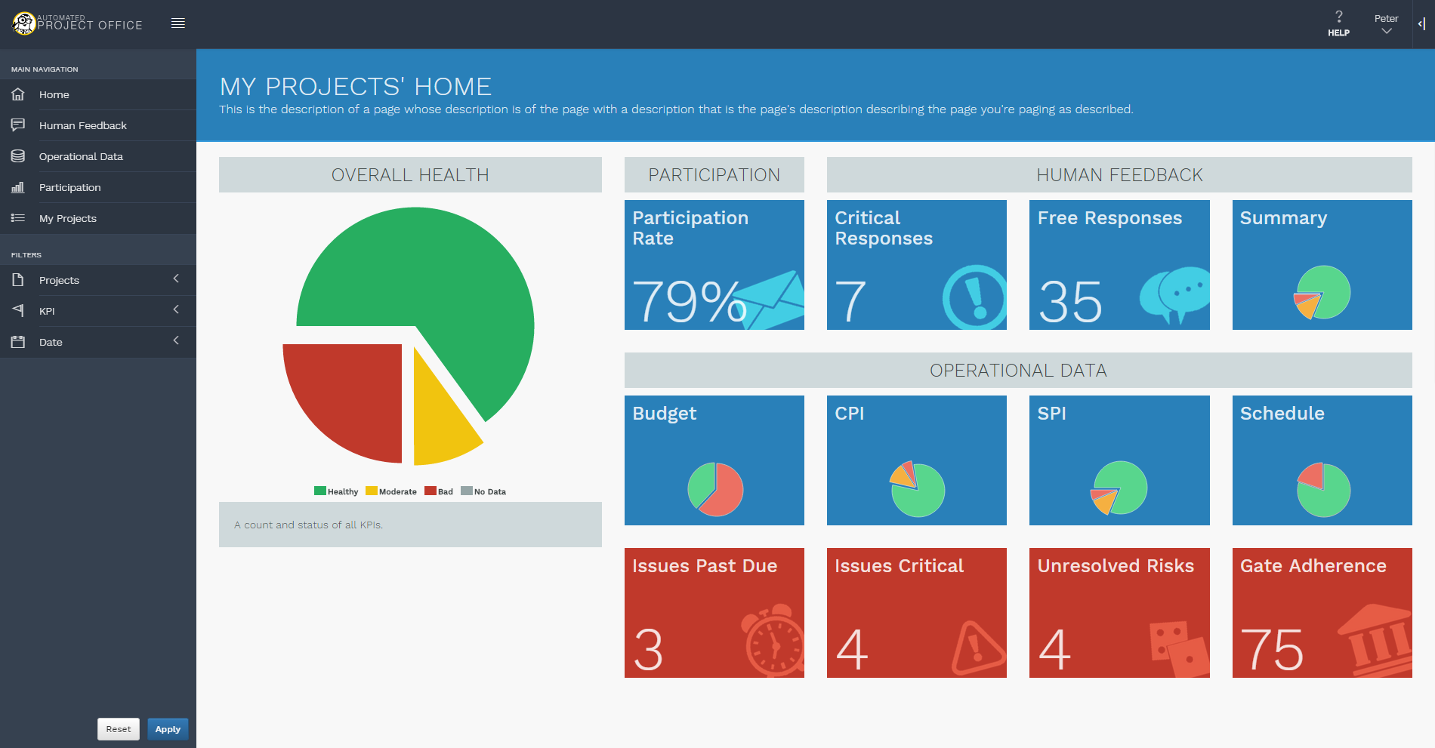

OVERALL HEALTH
PARTICIPATION
HUMAN FEEDBACK
OPERATIONAL DATA
Notes:
<<CLICK>>
As I launch my app I am presented with a My Home dashboard
For all my projects I see a one page “At a Glance” dashboard of my key indicators.
<<CLICK>>
MY overall health
<<CLICK>>
The participation level of my people
<<CLICK>>
Remember the funnel? The two key aspects of it are “Human Feedback” and
<<CLICK>>
“Operational Data”
<<CLICK>>
Through my left options I can navigate to other analysis or filter my data based on projects, KPIs and dates that are of interest to me.
<<CLICK>>
All the data that I need to see is summarized for me to see but I could click further to see the details below…
<<CLICK>>
Who has or has not participated
<<CLICK>>
There are 7 questions that had a response that was deemed “Critical”. I may want to take a look.
<<CLICK>>
35 people keyed something in that they want to tell me.
<<CLICK>>
3 issues are past due and need attention
<<CLICK>>
4 issues are critical
<<CLICK>>
There are 4 unresolved risks
<<CLICK>>
And I have adhered to only 75% of my gates
<<CLICK>>
Red, yellow, and green colors are used throughout the system to draw attention for the user.

Slide 20
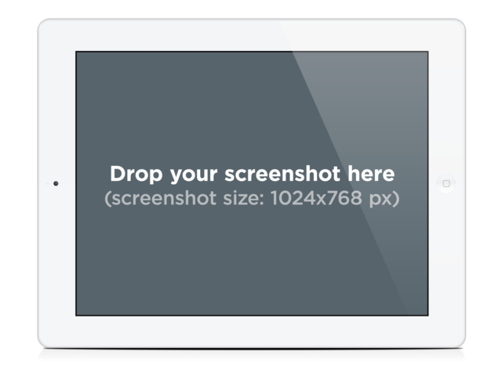
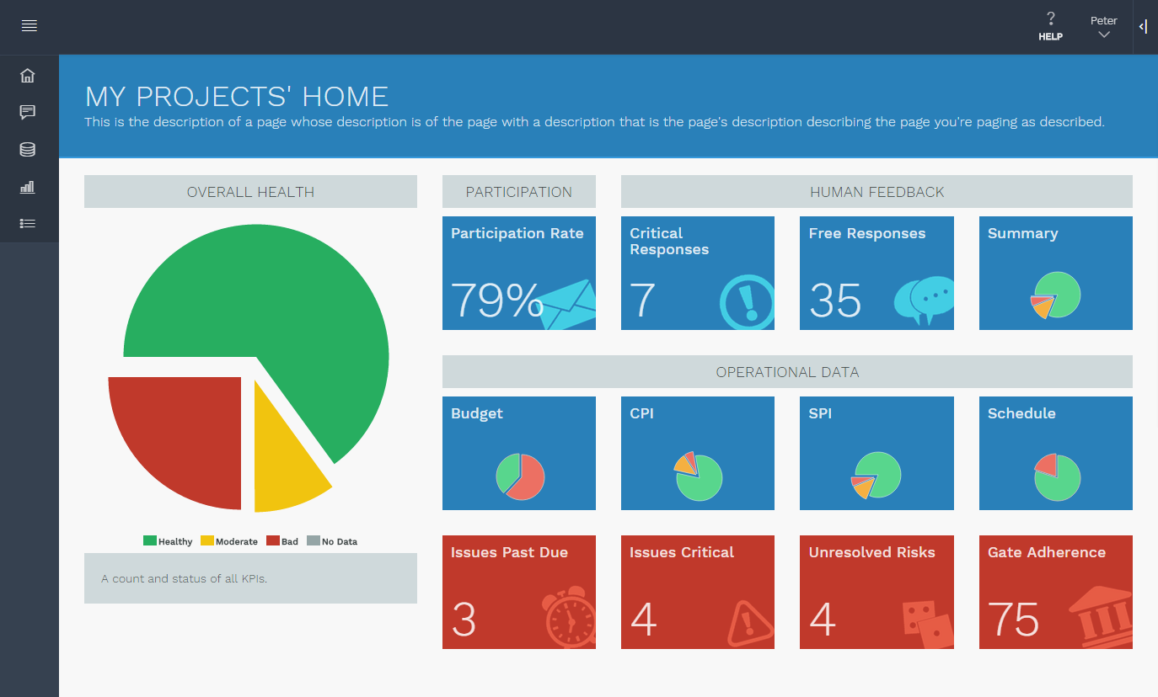

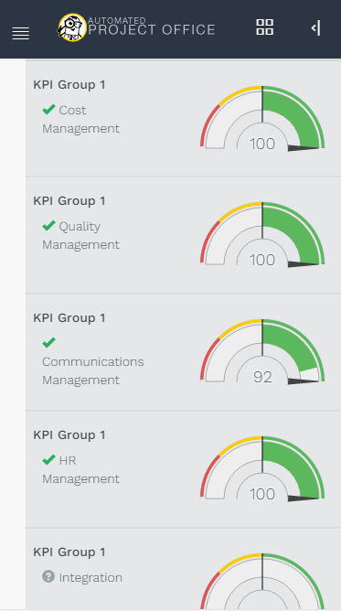
Notes:
The app is also responsive and runs on mobile devices.
We employ “Graceful degradation”
That is the app shrinks in size depending on the browser.
When the size gets so small such as on smaller tablets the app will reconfigure the ordering of the screen.
<<CLICK>>
Getting even smaller will result in removal of selected information such as some of the graphics, while preserving the key information

Slide 21
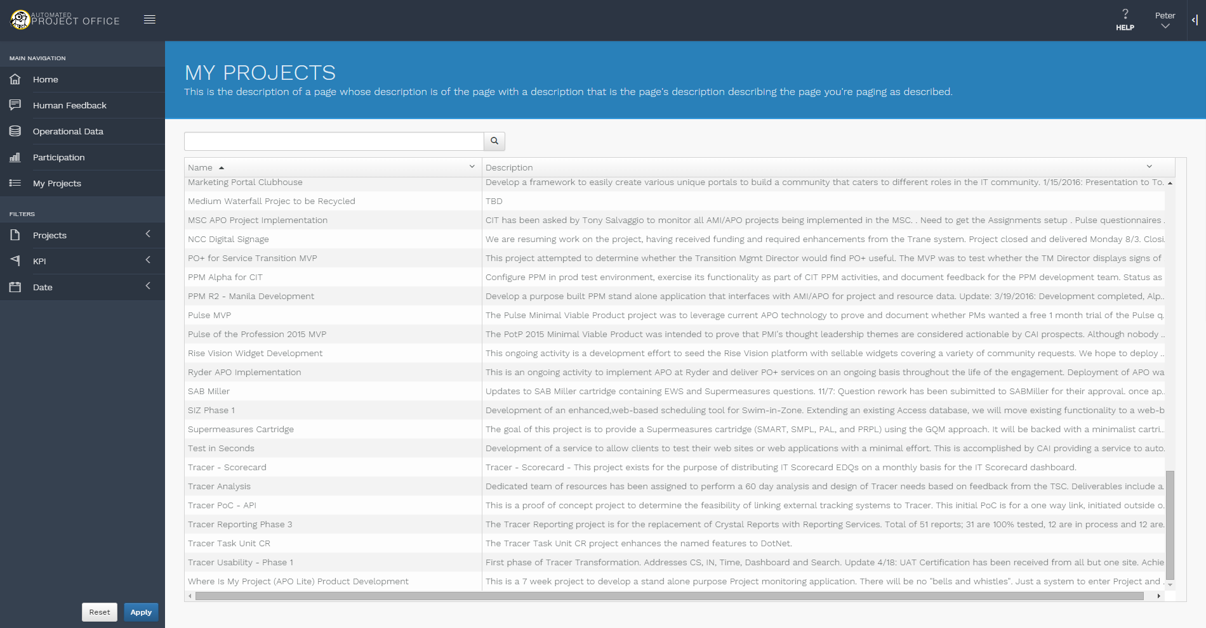
Notes:
Clicking on the “My Projects” tab brings up a list of all projects that I’ve entered into the system.
This list shows project name, as well as a short, user-defined description.
It is searchable both by project name, and by description.
<<CLICK>>
If I go ahead and click on an individual project, I’ll be taken to a dashboard for that specific project.
<<CLICK>>

Slide 22
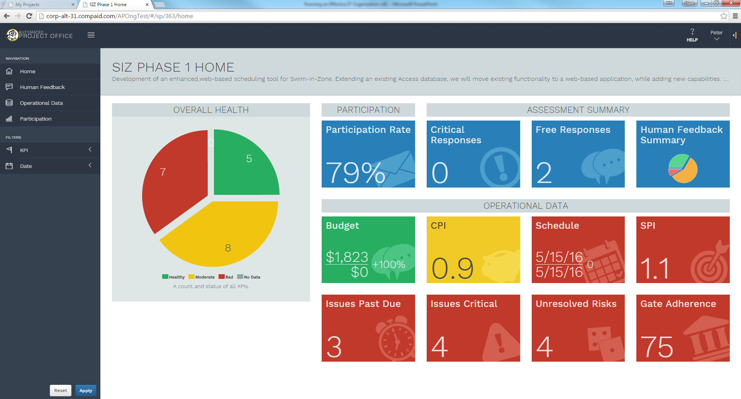
Notes:
So here is the individual project dashboard.
It looks similar to the first multi-project dashboard, however, the color scheme is now grey as opposed to blue and it shows the project name up top.
This screen shows project health broken down into individual Key Performance Indicators.
It also shows participation, human feedback, and operational data for this specific project, instead of the entire portfolio.
<<CLICK>>
As you can see, I can have multiple tabs open for multiple individual projects, and I can even have multiple tabs open for the same project.
<<CLICK>>
Next, let’s take a look at the “Human Feedback” tab.

Slide 23
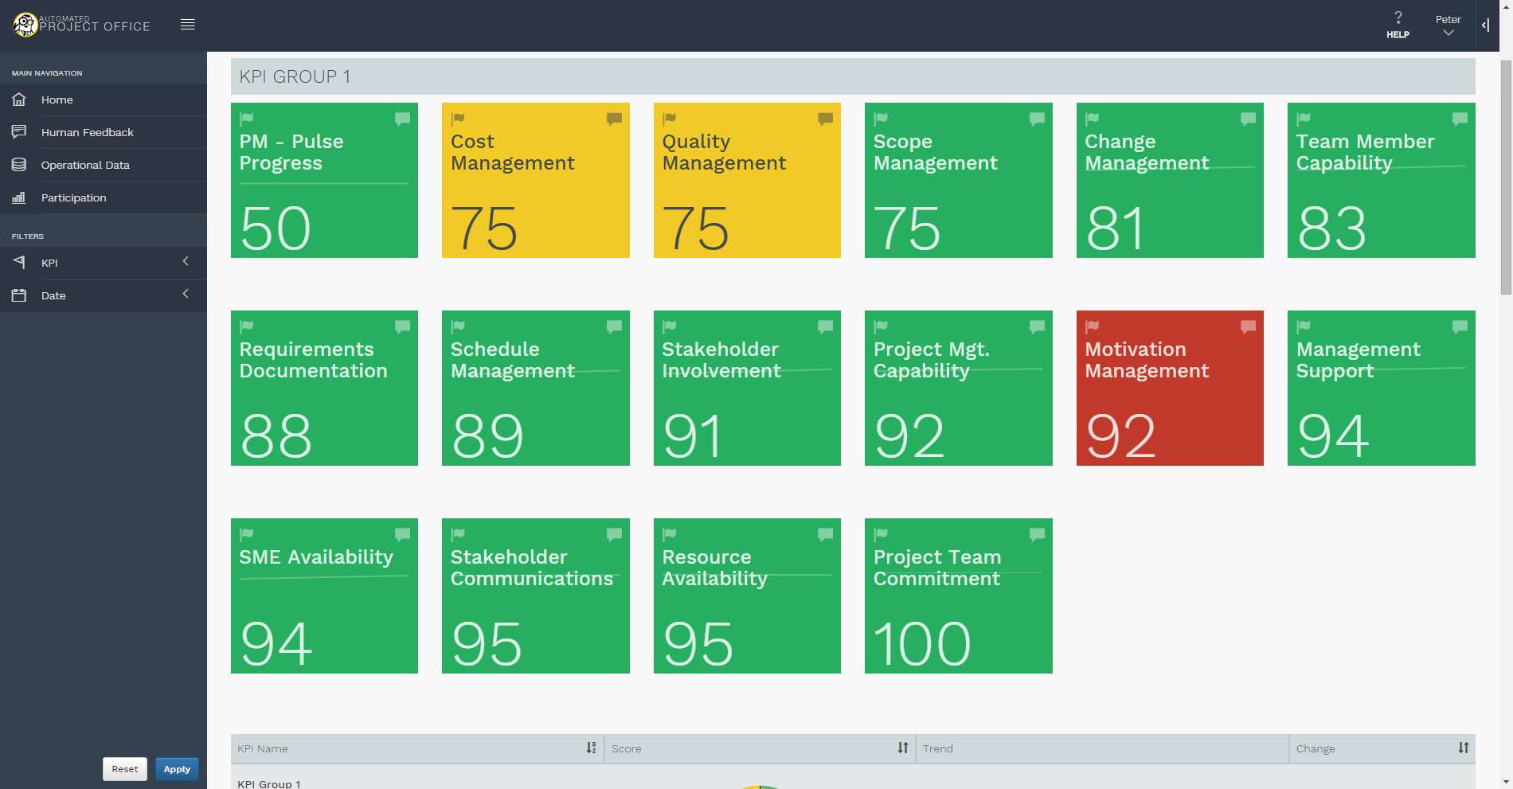
Notes:
In the “Human Feedback” tab, a billboard of KPIs is displayed based upon feedback from questionnaires.
As you can see, a score of 92 in Motivation Management is displayed as bad, while a score of 50 in PM – Pulse Progress is displayed as good. Why is that?
That is because different thresholds can be manually set for each KPI.
For example, a score of 50 could be considered excellent for PM – Pulse Progress, while anything under 95 in Motivation Management could be considered unacceptable.
This is just an example, again, this is all configurable by the customer.
<<CLICK>>
<<CLICK>> (do we want to just remove the mouse pointer exit?)

Slide 24
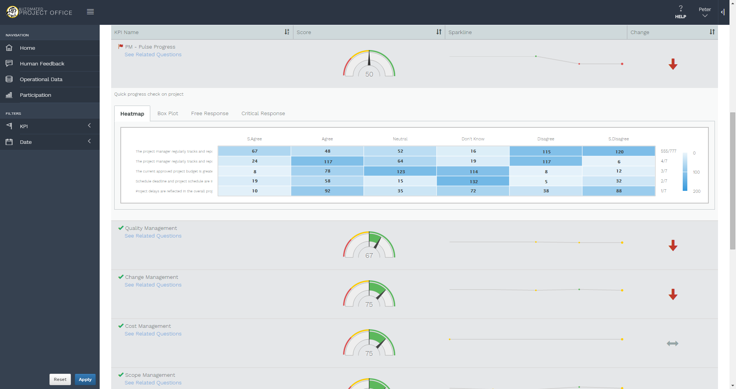
Notes:
Further down on the Human Feedback tab, users can see individual KPIs and their health, as well as a trendline and an arrow indicating, at a glance, whether the KPI is getting better or worse.
<<CLICK>>
When an individual KPI is clicked, the user can switch between a heatmap, a box plot, and a section which shows the free responses to each given question.
<<CLICK>>
By default, a heatmap is available which shows how people responded to questions relevant to that KPI.
Boxes on the heatmap are highlighted lighter or darker depending on how many people replied with each specific answer.
<<CLICK>>
Now, let’s take at the Box Plot.
<<CLICK>>

Slide 25
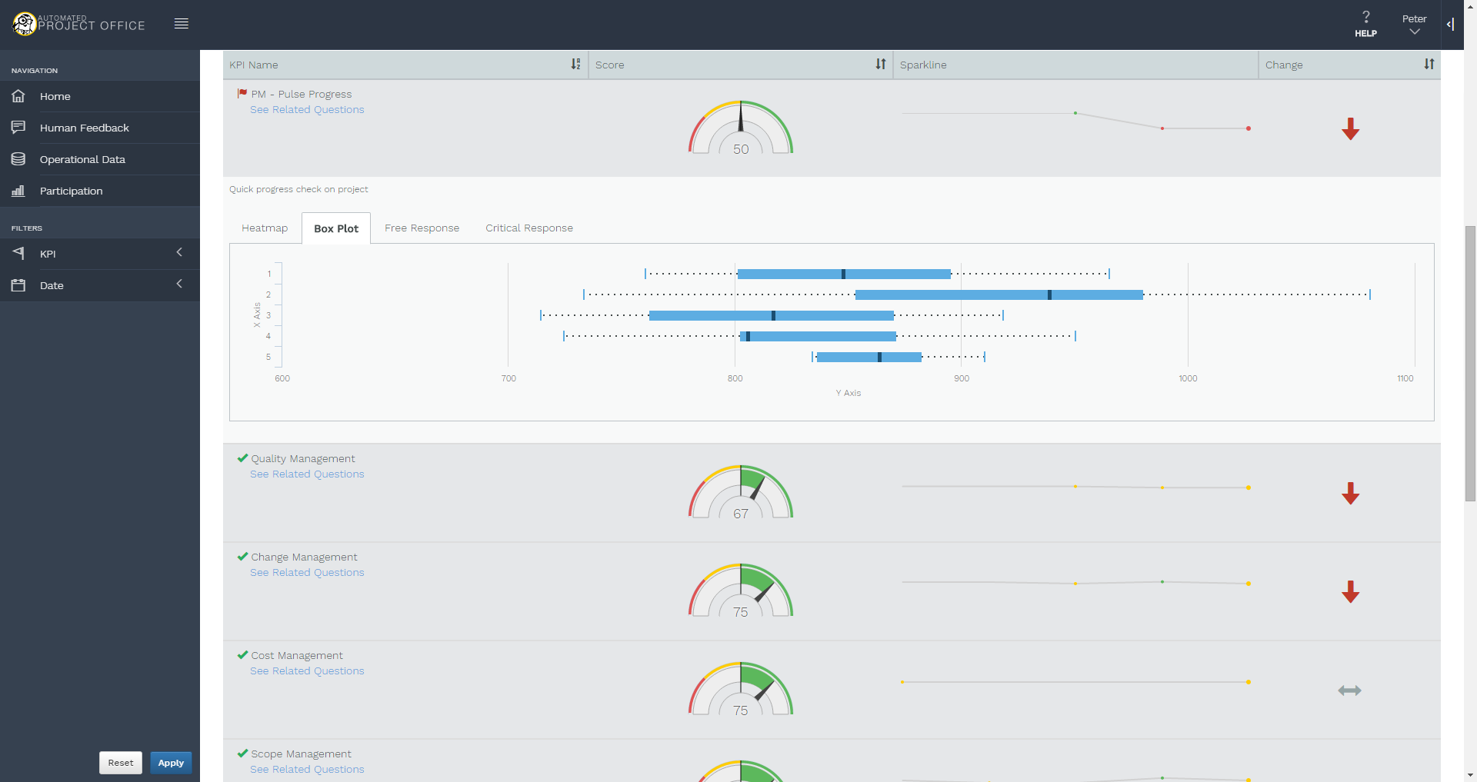
Notes:
The Box Plot is useful because it highlights distribution of data, rather than individual responses. This allows for greater insight into the way that KPIs are trending.

Slide 26
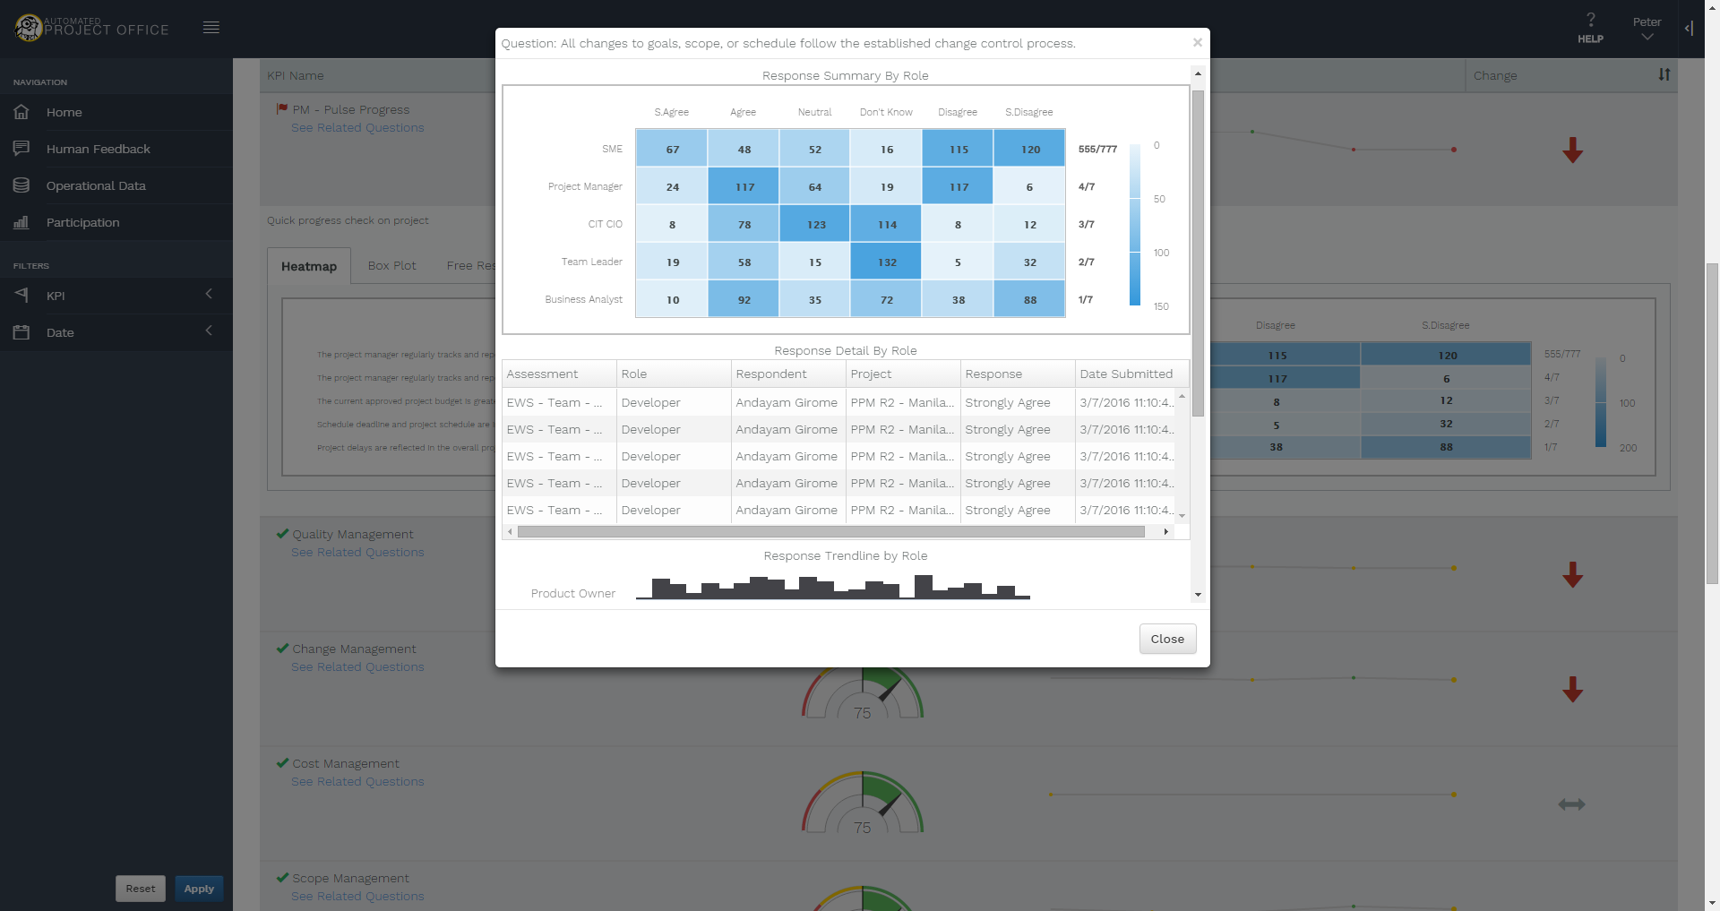
Notes:
When an individual question on the heatmap is clicked, an overlay appears which provides greater insight into responses to that question.
This overlay shows the selected question at the top, a breakdown of how individuals in each role responded, a spreadsheet of each individual’s responses to that question, and a trendline of responses by role.
<<CLICK>>
<<DOUBLE CLICK>> (this starts the video as soon as the next slide shows. I’ve applied a 14 second timer to the slide, meaning that after 14 seconds, even if the video hasn’t finished, it will transition.)

Slide 27
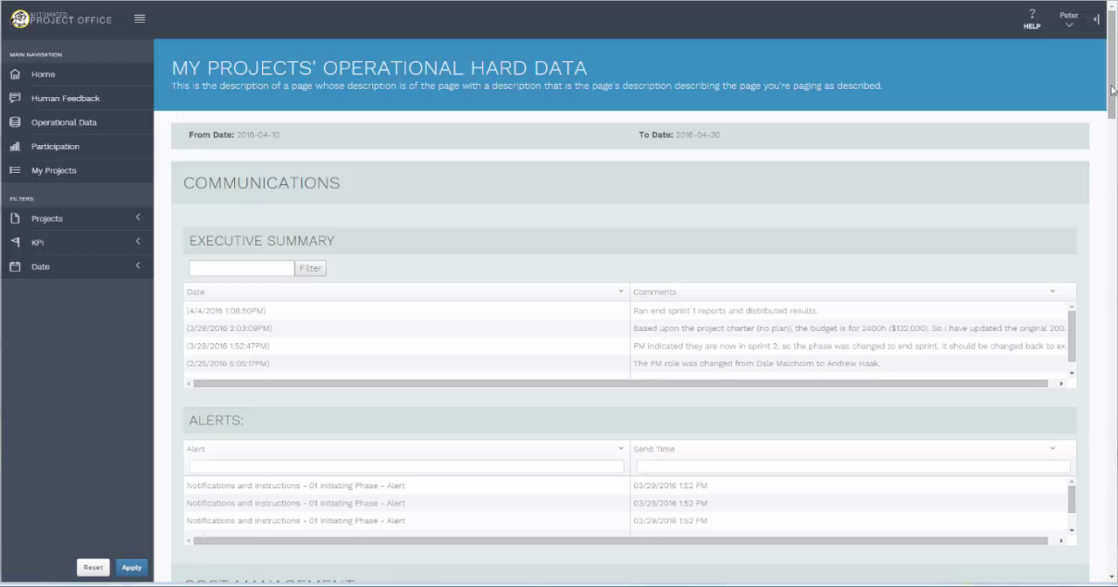

Slide 28
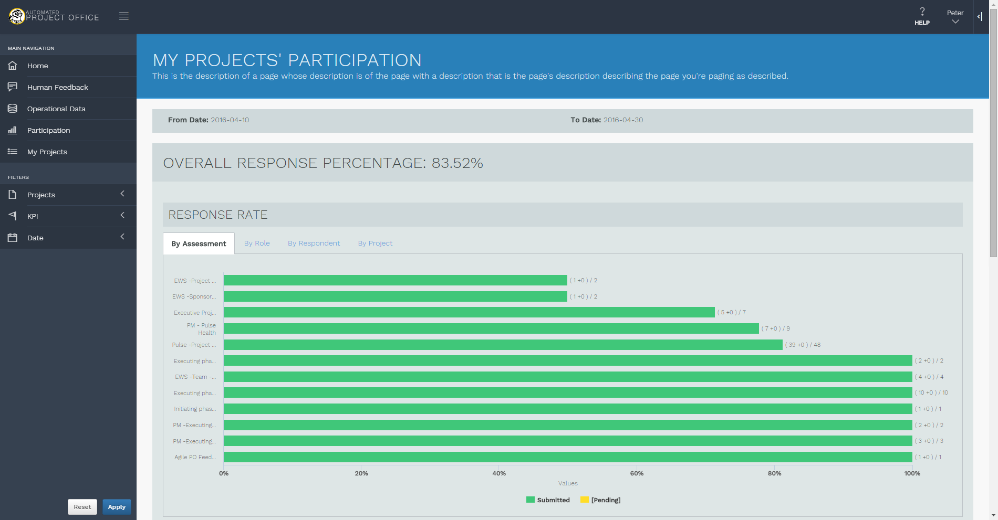
Notes:
Finally, let’s take a look at the Participation tab.
<<CLICK>>
This tab looks at assessment response rate.
<<CLICK>>
It can be sorted by assessment, by role, by respondent, and by project.
<<CLICK>>
This tab gives insight into how accurate your information is. The more people who respond to questionnaires, the more accurate your numbers will be.

Slide 29
Governance Process/Tool - Best Practices
Effective governance process for the entire portfolio of projects
Web-based tool that is easy to implement and use
Capture qualitative data from key stakeholders (360 degree)
Dashboard metrics of key project indicators
Capture key data for project requests and analyze data based upon business need and potential risk.
Identify key risk indicators/provides predictive risk scores
Easily import project data into the governance solution
Effective Issue Management Capability
Improves PM skills(self-learning/360 degree feedback.
©2018 Strategere Consulting
29

Slide 30

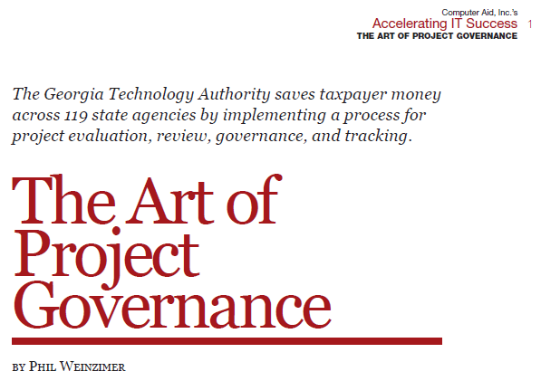
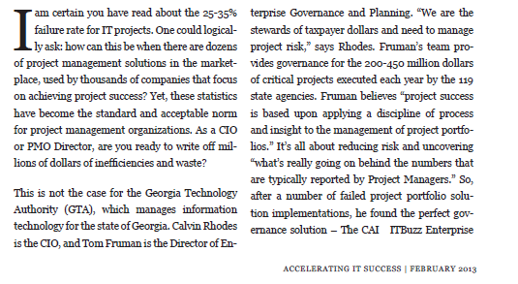
©2018 Strategere Consulting
30

Slide 31
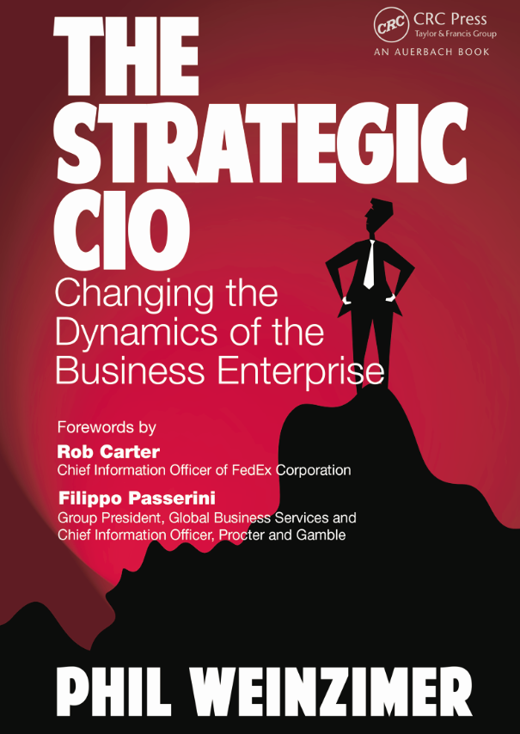
      Phil Weinzimer
      Pweinzimer@gmail.com
      Strategere Consulting
      610 509 2583
      www.strategere.com

Slide 32
END

