Slide 1

Microsoft Cognitive Services
Philip Coachman
Cloud Solution Architect – Data & AI

Slide 2
Big compute
Powerful algorithms
Massive data
Notes:
Like Harry Shum - our , Executive Vice President or Microsoft AI and Research – said :
“A few years ago, it was hard to think of a commonly used technology tool that used AI.
In a few years, it will be hard to imagine any technology that doesn’t tap into the power of AI.”
Today, 3 mega trends are converging, making AI possible and impacting enterprises and developers:
#1 Big compute in the cloud (how you can take advantage of massive compute capabilities with the click of a button) - The Cloud now enables elastic compute and storage at low cost.
#2 Powerful algorithms (amazing progress in deep learning algorithms available for you as a developer)
#3 Massive data (the fuel that powers AI and your apps) – this is related to the availability of new types of data from sensors, devices, social platforms and third party sources allows us to better predict outcomes.

Slide 3

Microsoft Cognitive Services
Democratizing intelligence
Notes:
So, what are Cognitive Services? Cognitive Services are a collection of artificial intelligence APIs, and we believe in democratizing artificial intelligence. So what that means is, regardless of your skill level -- whether you're a high school student running your first program or working in industry or in a giant enterprise -- that you should be able to use our APIs incredibly quickly in a matter of minutes.
And regardless of your platform -- whether you're on Android or IOS or Windows, or making a website -- all of our APIs are rest APIs, which means you can call them as long as you have an Internet connection. And so that's pretty huge because what we're doing is making it so that everyone can build these smarter, more context-aware applications.
The technology used in our APIs is the same technology that powers our products today. And so, when you think of things like the Bing search APIs, it's the same technology from Bing.
Today I’m going to talk with you about the entire collection spanning vision, speech, language, knowledge, and search.
The other things that I want to point out is that you can get started for free with all of the APIs, but we do have pricing available for a number of them, which are in public preview on Azure.
The other piece is the developer resources. So, all of our documentation is on the website and actually in GitHub as well, so we do welcome community submissions. We have a set of SBKs that are also available on GitHub where we welcome poll requests and post everything on there. The SBKs vary from API to API, but they are all included in this one repository for people to see.
And then we have three different communities that we support. We have our MSDN forums, our Stack Overflow, and we have User Voice that we use for feedback requests.

Slide 4







Microsoft Cognitive Services
Give your apps a human side
Vision
From faces to feelings, allow your apps to understand images and video
Speech
Hear and speak to your users by filtering noise, identifying speakers, and understanding intent
Language
Process text and learn how to recognize what users want
Knowledge
Tap into rich knowledge amassed from the web, academia, or your own data
Search
Access billions of web pages, images, videos, and news with the power of Bing APIs
Labs
An early look at emerging Cognitive Services technologies: discover, try and give feedback on new technologies before general availability

Slide 5
Microsoft Cognitive Services
Give your apps a human side
Computer Vision
Content Moderator
Emotion
Face
Video Indexer
Custom Vision Service
Bing Speech
Speaker Recognition
Custom Speech Service
Bing Spell Check
Linguistic Analysis
Text Analytics
Translator Text & Speech
Web Language Model
Language Understanding
Academic Knowledge
Entity Linking
Knowledge Exploration
Recommendations
QnA Maker
Custom Decision Service
Bing Autosuggest
Bing Image Search
Bing News Search
Bing Video Search
Bing Web Search
Bing Entity Search
Bing Custom Search
Project Prague (gesture)
Project Cuzco (events)
Project Johannesburg (routing)
Project Nanjing (isochrones)
Project Abu Dhabi (distance matrix)
Project Wollongong (location)
Vision
Speech
Language
Knowledge
Search
Labs

Slide 6
Microsoft Cognitive Services
Give your apps a human side
Vision
Speech
Language
Knowledge
Search
Labs
Computer Vision
Content Moderator
Emotion
Face
Video Indexer
Bing Speech
Speaker Recognition
Bing Spell Check
Linguistic Analysis
Text Analytics
Translator Text & Speech
Web Language Model
Academic Knowledge
Entity Linking
Knowledge Exploration
Recommendations
QnA Maker
Bing Autosuggest
Bing Image Search
Bing News Search
Bing Video Search
Bing Web Search
Bing Entity Search
Project Prague (gesture)
Project Cuzco (events)
Project Johannesburg (routing)
Project Nanjing (isochrones)
Project Abu Dhabi (distance matrix)
Project Wollongong (location)
CUSTOMIZATION
Custom Vision Service
Custom Speech Service
Language Understanding
Custom Decision Service
Bing Custom Search

Slide 7










Why Microsoft Cognitive Services?
Easy
Flexible
Tested
Roll your own with REST APIs
Simple to add: just a few lines of code required
Integrate into the language and platform of your choice
Breadth of offerings helps you find the right API for your app
Bring your own data for your custom experience
Built by experts in their field from Microsoft Research, Bing, and Azure Machine Learning
Quality documentation, sample code, and community support
GET A KEY
BUILD
Notes:
Why choose these APIs? They work, and it’s easy.
Easy: The APIs are easy to implement because of the simple REST calls. Being REST APIs, there’s a common way to implement and you can get started with all of them for free simply by going to one place, one website, www.microsoft.com/cognitive. (You don’t have to hunt around to different places.)
Flexible: We’ve got a breadth of intelligence and knowledge APIs so developers will be able to find what intelligence feature they need; and importantly, they all work on whatever language, framework, or platform developers choose. So, devs can integrated into their apps—iOS, Android, Windows—using their own tools they know and love (such as python or node.js, etc.).
Tested: Tap into an ever-growing collection of powerful AI algorithms developed by experts. Developers can trust the quality and expertise build into each API by experts in their field from Microsoft’s Research organization, Bing, and Azure machine learning and these capabilities are used across many Microsoft first party products such as Cortana, Bing and Skype.

Slide 8






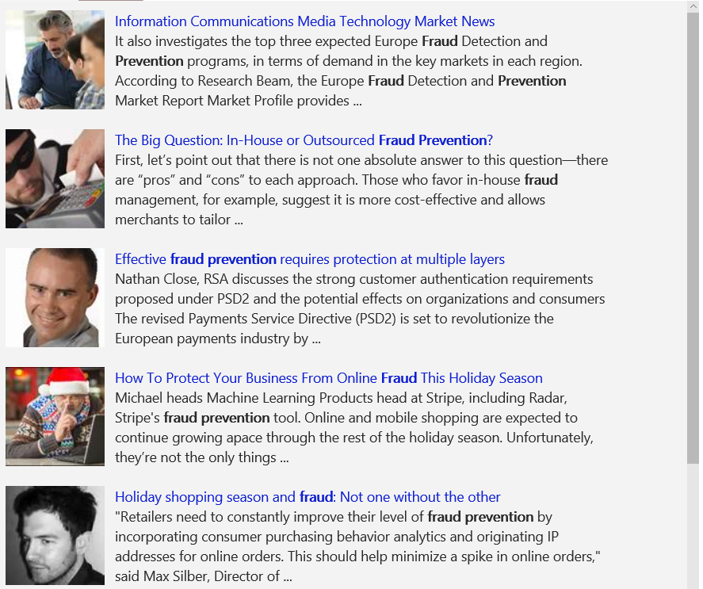
A variety of real-world applications
Vision
Speech
Language
Knowledge
Search
What is in the image?
Give me directions to the nearest local branch.
Play today’s customer call recording.
Top publications in customer lifecycle trends?
Search for ‘fraud prevention’
Computer Vision
Bing Speech
Language Understanding
Knowledge Exploration
Bing News Search
Natural Language Processing
Here are the top results:
Here is what I found:
Intent: PlayCall
Content: Customer#
DateTime.date: today
Customer Relationship Management – 5 Key Trends for 2014 CRM
Oct 28, 2015 – Here are FIVE key trends in 2014 that would help marketers in rolling ... Of late, marketers are looking at customer lifecycle management (CLM)
Information Communications Media Market News
It also investigates the top three expected Fraud Detection and Prevention programs, in terms of demand in key markets…
Predictive Customer Lifecycle Management (CLM)
The purpose of Customer Life-cycle Management (CLM) is to maximize both customer retention and .... Predictive trend analysis provides business visibility.
The Big Question: In-House or Outsourced Fraud Protection?
First, let’s point out that there is not one absolute answer—there are “pros” and “cons” to each. Those who favor in-house…
Category | People; 5 faces
Adult/Racy? | False/False
Dominant colors
Accent color
Convert spoken audio to text
Trends 2016: The Future of Customer Service
Jan 5, 2016 – The top 10 customer service trends for 2016 that .... North American Consumer
How to Protect Your Business from Online Fraud this Holiday Season
Michael heads fraud prevention tool. Online and mobile shopping are expected to continue growing apace…
Convert text to spoken audio
Now Playing
Extract intent of user
11/29/2016 Customer Call
Language Around Customer Lifecycles in the Banking Industry
View PDF
Notes:
Cognitive services span Vision, Speech, Language, Knowledge, and Search. Combining many of these services together can either improve user interaction models, or provide fun and engaging user experiences.
Our examples here shine some light on how some of these APIs work in real-world situations:
Vision
The Computer Vision API is able to extract rich information from images to categorize and process visual data and protect your users from unwanted content. Here, the API is able to tell us what the photo contains, indicate the most common colors, and lets us know that the content would not be considered inappropriate for users.
Speech
The Bing Speech API is capable of converting audio to text, understanding intent, and converting text back to speech for natural responsiveness. This case shows us that the user has asked for directions verbally, the intent has been extracted, and a map with directions provided.
Language:
Language Understanding Intelligent Service, known as LUIS, can be trained to understand user language contextually, so your app communicates with people in the way they speak. The example we see here demonstrates Language Understanding’s ability to understand what a person wants, and to find the pieces of information that are relevant to the user’s intent.
Knowledge
Knowledge Exploration Service adds interactive search over structured data to reduce user effort and increase efficiency. Our Knowledge Exploration API example here demonstrates the usefulness of this API for answering questions posed in natural language in an interactive experience.
Search
Bing Image Search API enables you to add a variety of image search options to your app or website, from trending images to detailed insights. Users can do a simple search, and this API scours the web for thumbnails, full image URLs, publishing website info, image metadata, and more before returning results.
Transition: These APIs are available as stand-alone solutions, or as part of the Cortana Intelligence Suite. They can also be used in conjunction with the Microsoft Bot Framework.
<click>

Slide 9

Microsoft Cognitive Services Labs
An early look at emerging Cognitive Services technologies: discover, try, and give feedback on new technologies before general availability
Project Prague
Project Cuzco
Project Johannesburg
Gesture based controls
Event associated with Wikipedia
Route logistics
Project Nanjing
Project Abu Dhabi
Project Wollongong
Isochrones calculations
Distance matrices
Score location attractiveness
Notes:
Project Prague. SDK to incorporate gesture-based controls into your apps. Quickly define and implement customized hand gestures, creating a more natural user experience. Limited private preview availability at launch.
Project Cuzco. API to help developers find events associated with Wikipedia entities. Begin with a Wikipedia entity, and receive a list of related events organized by time.
Project Johannesburg. API to calculate route logistics for with deeper location intelligence to account for specific enterprise requirements. IE: weight, height length, hazardous materials, etc.
Project Nanjing. API to calculate isochrones - time and distance-based recommendations for enterprise route optimization.
Project Abu Dhabi. API to create distance matrices, enabling you to calculate a histogram of travel times, and serve as stepping stone for enterprise route optimization.
Project Wollongong. API to help ‘score’ the attractiveness of a location, based on how many of a particular amenity are within a specific distance. Ex: restaurants, parks, transit stops.

Slide 10

DEMONSTRATIONS
INTELLIGENT KIOSK
Notes:
Internal version Kiosk Script : https://aka.ms/kioskscript
You can also find the following interactive demonstrations in the Cognitive Services Site :
Vision
Computer Vision
Content Moderator
Emotion
Face
Speech
Bing Speech
Custom Recognition
Speaker Recognition
Language
Bing Spell Check
Language Understanding
Linguistic Analysis
Text Analytics
Translator
WebLM
Knowledge
Academic
Entity Linking
Knowledge Exploration
QnA Maker
Recommendations
Search
Bing Autosuggest
Bing Image Search
Bing News Search
Bing Video Search
Bing Web Search

Slide 11

VISION
From faces to feelings, allow your apps to understand images and video
Computer Vision | Content Moderator | Emotion | Face | Video Indexer | Custom Vision Service

Slide 12
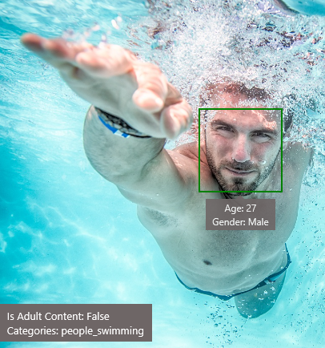
Analyze image
Type of image
Clip Art Type 0 Non-clipart
Line Drawing Type 0 Non-Line Drawing
Black & White Image False
Content of image
Categories [{ “name”: “people_swimming”, “score”: 0.099609375 }]
Adult Content False
Adult Score 0.18533889949321747
Faces [{ “age”: 27, “gender”: “Male”, “faceRectangle”: {“left”: 472, “top”: 258, “width”: 199, “height”: 199}}]
Image colors
Dominant Color Background White
Dominant Color Foreground Grey
Dominant Colors White
Accent Color

Slide 13

OCR
JSON:
{
"language": "en",
"orientation": "Up",
"regions": [
{
"boundingBox": "41,77,918,440",
"lines": [
{
"boundingBox": "41,77,723,89",
"words": [
{
"boundingBox": "41,102,225,64",
"text": "LIFE"
},
{
"boundingBox": "356,89,94,62",
"text": "IS"
},
{
"boundingBox": "539,77,225,64",
"text": "LIKE"
}
. . .

Slide 14
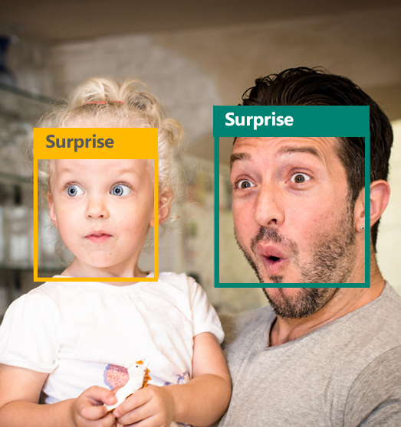

Emotion API
Face detection
"faceRectangle": {"width": 193, "height": 193, "left": 326, "top": 204} …
Emotion scores
"scores": { "anger": 5.182241e-8,
"contempt": 0.0000242813,
"disgust": 5.621025e-7,
"fear": 0.00115027453,
"happiness": 1.06114619e-8,
"neutral": 0.003540177,
"sadness": 9.30888746e-7,
"surprise": 0.9952837}

Slide 15





Face API
Detection
"faceRectangle": {"width": 193, "height": 193, "left": 326, "top": 204} …
Feature attributes
"attributes": { "age": 42, "gender": "male",
"headPose": { "roll": "8.2", "yaw": "-37.8", "pitch": "0.0" }}
Grouping
Identification
Jasper Williams

Slide 16


Custom Vision Service A customizable web service that learns to recognize specific content in imagery
Upload images
Upload your own labeled images, or use Custom Vision Service to quickly tag any unlabeled images
Train
Use your labeled images to teach Custom Vision Service the concepts you want it to learn
Evaluate
Use simple REST API calls to quickly tag images with your new custom computer vision model
Active learning
Images evaluated through your custom vision model become part of a feedback loop you can use to keep improving your classifier
Notes:
An easy-to-use, customizable web service that learns to recognize specific content in imagery, powered by state-of-the-art machine learning neural networks that become smarter with training. You can train it to recognize whatever you choose, whether that be animals, objects, or abstract symbols. This technology could easily apply to retail environments for machine-assisted product identification, or in digital space to automatically help sorting categories of pictures.

Slide 17

LANGUAGE
Process text and learn how to recognize what users want
Bing Spell Check | Language Understanding | Linguistic Analysis | Text Analytics | Web Language Model | Translator Text and Speech

Slide 18


Language Understanding Intelligent Service
Understand what your users are saying
Use pre-built Bing and Cortana models or create your own
Notes:
Understand language contextually, so your app communicates with people in the way they speak.
Do your apps understand language in the way people speak it—contextually? With the Language Understanding Intelligent Service (LUIS) API, you can integrate language models that understand your users quickly and easily. And if one of our preexisting models won't work, it will guide you through building your own.
Prebuilt models will recognize places, times, numbers, and temperatures, and handle common requests like "set an alarm for 8 AM." LUIS supports dialogue and action fulfillment, so your users can carry on a conversation with your app. For example, the input "schedule a meeting with Allison" results in the question "when?," allowing the user to respond "3 PM," and the meeting gets scheduled.

Slide 19
Language Understanding Intelligent Service
Reduce labeling effort with interactive featuring
Use visualizations to gauge performance and improvements
Leverage speech recognition with seamless integration
Deploy using just a few examples with active learning
Define
concepts
Provide
examples
Deploy
Active learning

Slide 20
Language understanding models
{
“entities”: [
{
“entity”: “flight_delays”,
“type”: “Topic”
}
],
“intents”: [
{
“intent”: “FindNews”,
“score”: 0.99853384
},
{
“intent”: “None”,
“score”: 0.07289317
},
{
“intent”: “ReadNews”,
“score”: 0.0167122427
},
{
“intent”: “ShareNews”,
“score”: 1.0919299E-06
}
]
}
“News about flight delays”

Slide 21


Linguistic analysis
Analysis tolls for natural language processing
Access to part-of-speech tagging and parsing, identifying concepts, and actions
Notes:
You know what your users are saying, but do you know what it means? The Linguistic API uses advanced linguistic analysis tools for natural language processing, giving you access to part-of-speech tagging and parsing. These tools allow you to hone in on important concepts and actions. The API can tap into traditional linguistic analysis tools that allow you to identify the concepts and actions in your text with part-of-speech tagging, and find phrases and concepts using natural language parsers. Whether you’re mining customer feedback, interpreting user commands, or consuming web text, understanding the structure of the text is a critical first step.

Slide 22
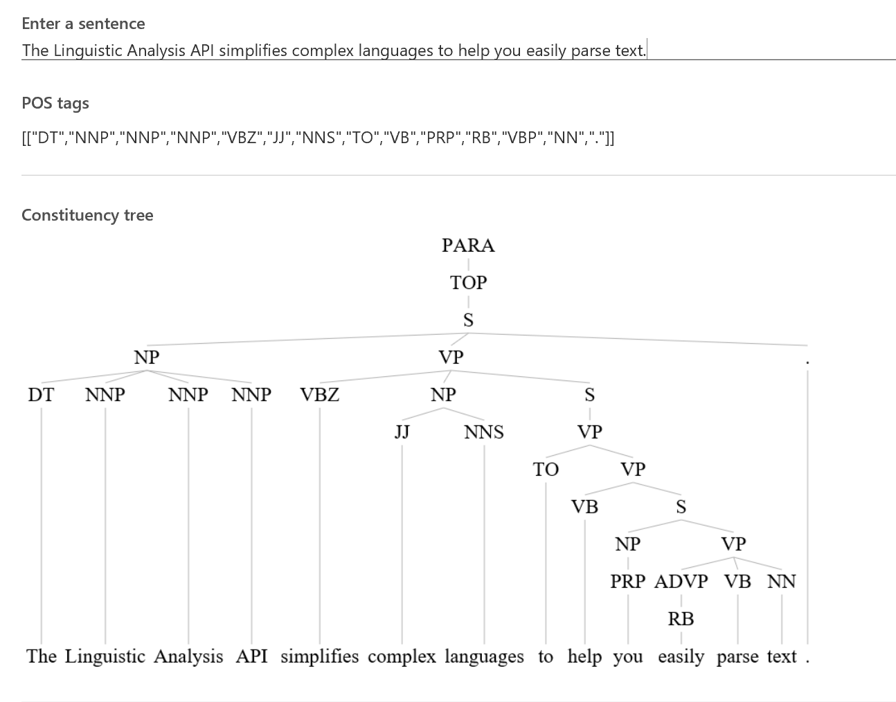
Linguistic analysis

Slide 23


Text analytics
Sentiment analysis
Understand if a record has positive or negative sentiment
Key phrase extraction
Extract key phrases from a piece of text, and retrieve topics
Language detection
Identify the language, 120 supported languages
Notes:
Understanding and analyzing unstructured text is an increasingly popular field and includes a wide spectrum of problems such as sentiment analysis, key phrase extraction, topic modeling/extraction, aspect extraction and more.

Slide 24


Microsoft Translator
Translator Text API
Automatically detect language and easily power translation to and from 60 supported text languages
Translator Speech API
Easily translate real-time speech conversations in 9 support languages
Notes:
. Try now the Speech Translator demo App on : https://github.com/MicrosoftTranslator/SpeechTranslator
. Try now the Document Translator demo, translating (batches of) Word or pdf documents while preserving the formatting : https://www.microsoft.com/en-us/translator/doctranslator.aspx
Language detection
The Translator Text API automatically detects the language of the text that’s sent before translating it. If your application simply needs to know what language the text is in, you can also call the API to detect the language of any text string.
Translation
Add speech translation, for any of the 9 supported languages, and text translation, for any of the 60 supported languages, to your app. Grow your potential user base by localizing your app and its content with clear translations.
Custom translation system
Build a custom translation system, using as little as 1,000 parallel sentences or start out simply by providing a dictionary of company specific words.
Collaborative Translation Framework (CTF)
Improve translations by creating a specific user group that provides suggestions to improve the translations. Users suggest translations and designated approvers either approve or deny changes. These updated translations can then be used for the company’s specific Hub to further improve its custom system.

Slide 25

KNOWLEDGE
Tap into rich knowledge amassed from the web, academia, or your own data
Academic Knowledge | Entity Linking | Knowledge Exploration | Recommendations | QnA Maker | Custom Decision Service

Slide 26


Academic knowledge
Interpret Interprets a natural language user query string. Returns annotated interpretations which can enable rich search-box auto-completion experiences that anticipate what the user is typing
Evaluate Evaluates a query expression and returns academic knowledge entity results
Calchistogram Calculates a histogram of the distribution of attribute values for the academic entities returned by a query expression, such as the distribution of citations by year for a given author
Notes:
Tap into the wealth of academic content in the Microsoft Academic Graph using the Academic Knowledge API.
Do your users know who the top scholars have been in machine learning over the last three years? What about every paper authored by an expert like Li Deng from Microsoft? The Academic Knowledge API answers these and other questions by applying the Knowledge Exploration Service to the Microsoft Academic Graph. Users can start from natural language queries, or you can ping the graph directly through structured query expressions.
Additionally, the Academic Knowledge API can auto-complete natural language queries and return entity results, helping users narrow research results faster.
It can also create a histogram of attribute values for academic entries returned by a query—for example, the distribution of papers by year for an author.

Slide 27


QnA Maker
Create a FAQ service from existing content
Extract questions and answers Extract all possible pairs of questions and answers from user provided content – FAQ URLs, documents and editorial content
Test, train and publish Edit, remove, or add pair before testing and training the knowledge base and publishing your knowledge base as an API endpoint
Integrates with other APIs and solutions Use QnA Maker with Cognitive Services such as LUIS & create something as elegantly simple as a chat bot that answers FAQs, or as complex as an interactive virtual guide
Notes:
QnA Maker is primarily meant to provide a FAQ data source which you can query from your Bot/Application. Although developers will find this useful, content owners will especially benefit from this tool. QnA Maker is a completely no-code way of managing the content that powers your Bot/Application.

Slide 28


Custom Decision Service
A cloud-based, contextual decision-making API that sharpens with experience.
Contextual Understanding context from information you provide, Custom Decision Service ranks the options and makes a decision
Rapid learning Custom Decision Service automatically optimizes based on your feedback. It even experiments with new options to see if the best decision has changed, enabling it to adjust to emerging trends
Easy to use Custom Decision Service is cloud-based, so it’s easy to run, able to plug into your application and help to make decisions in real time
Notes:
A cloud-based, contextual decision-making API that sharpens with experience.

Slide 29

Bringing it all together The Seeing AI App Computer Vision, Image, Speech Recognition, NLP, and ML from Microsoft Cognitive Services
Read blog here
Watch video here
Notes:
Here’s a preview of the Seeing AI app, which started as a research project that helps people who are visually impaired or blind to understand who and what is around them.
The app will use computer vision, image & speech recognition, natural language processing and machine learning from Microsoft Cognitive Services. The app is under development and is not available today but it shows what’s possible with the APIs.

Slide 30
DEVELOPER RESOURCES
Pricing
https://azure.microsoft.com/en-us/pricing/details/cognitive-services/
Documentation
https://docs.microsoft.com/en-us/azure/#pivot=products&panel=cognitive
Client SDKs
https://azure.microsoft.com/en-us/resources/samples/?sort=0&term=cognitive+services https://github.com/southwood/project-oxford-python
Example Code
https://github.com/jsturtevant/happy-image-tester-django
https://github.com/Microsoft/Cognitive-Face-Android https://github.com/Microsoft/Cognitive-Samples-IntelligentKiosk
Join Our Community
https://stackoverflow.com/questions/tagged/microsoft-cognitive
https://cognitive.uservoice.com/
Notes:
Access to strong documentation, sample code and community resources is critical for developers to be able to understand and become users of Cognitive Services. Customize these links based on your own resources or use the ones listed here.

