Slide 1
PA TechCon 2018 – Digital Transformation:
Giving the Internet of Things a Voice
Matthew Clare, Product Manager, Mitel
May 1, 2018

Slide 2
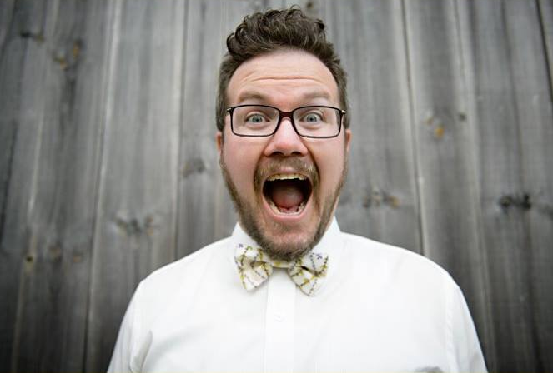
Who Am I?
CURRENTLY:
Product Manager for Mitel’s flagship customer experience platform
PREVIOUSLY:
Over a decade helping companies strategize and implement customer experience solutions
ALSO:
Loving father and “active-yet-practical” musician on the scene

Slide 3

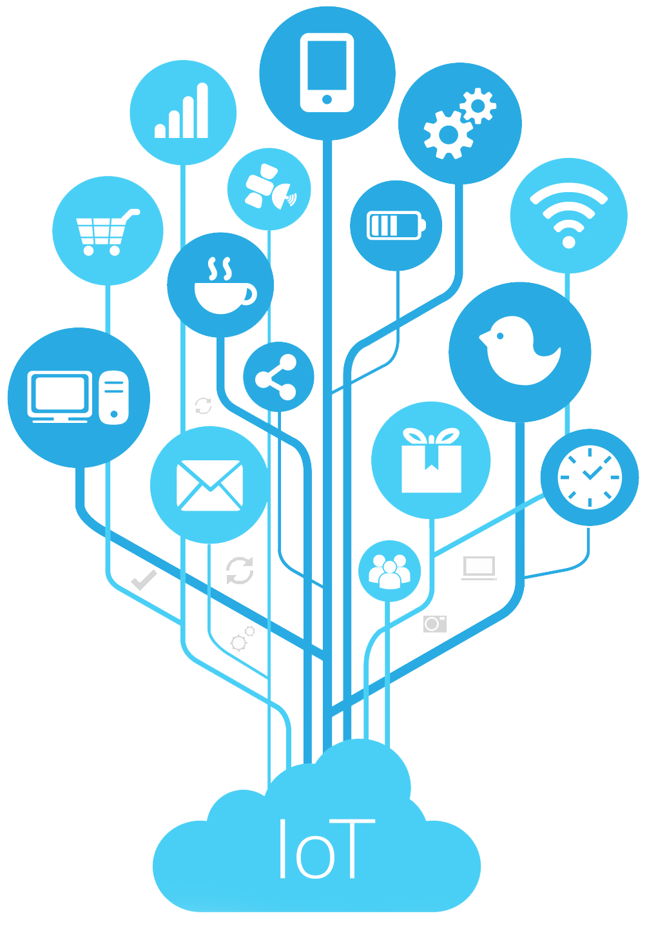

Today’s Agenda
Notes:
The topic of today’s breakout presentation is giving IoT a voice. But specifically, we’re going to focus on how enterprises can make the case for implementing IoT and give business IoT a voice!

Slide 4

Digital Transformation
Notes:
This slide speaks to the changes in today’s world which are impacting all enterprises. Easily 20% of enterprises are firmly on this path and it is part of their thought process. This was evidenced in Gartner’s global summit in Barcelona which surveyed the audience and ~20% of the audience was already implementing micro-services thus many more are at least thinking about it.

Slide 5


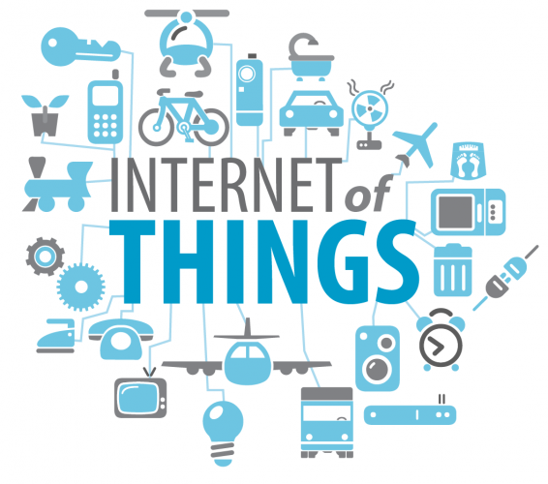














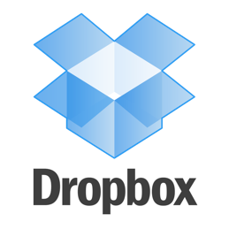







NEW BUSINESS MODELS
NEW TECHNOLOGIES
Microservices
Notes:
Cloud vendors and IT organizations are changing the tools they use simplifying the integration of SaaS products. New ways of creating solutions is disrupting traditional business models creating pressure on traditional business to adapt hence why IT organizations are familiar with the concepts.

Slide 6
Success in the Future Will Be About
Customer Experience
Leading companies understand that they are in
the customer-experience business, and that how
an organization delivers for customers is beginning
to be as important as what it delivers.

Slide 7
Digital Transformation is Strategically Linked to CX
Two years ago
Today
Two years ahead
“What was the primary focus of your process improvement efforts two years ago?
What is it today?
What will it be
in two years time?”
Cost reduction
30%
46%
50%
Productivity
22%
26%
31%
CX improvement
21%
13%
9%
Regulatory compliance
12%
9%
7%
Digital transformation
12%
2%
1%
Note: Not all answers are shown
Source: Forrester’s Q2 2016 Digital Business Automation Survey
Notes:
Digital transformations often begin at the boundary of the organization to drive enhanced customer experience. Examples include modern websites, mobile apps and ecommerce tools. The reason is urgency. Customers are making purchase decisions now based on

Slide 8
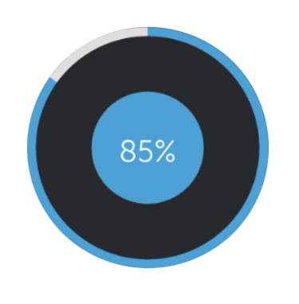
The Future of Customer Experience
By 2020,
The customer will manage
Businesses have to respond to customers’ needs at:
    Increased pace
    During new hours
    Using new methods
Consumers are demanding the flexibility to interact with companies through the digital channel of their choice
Consumer choices have broadened
Customer experience will be the new battlefield for competitive advantage
(Gartner, 2015)
85%
85%
of relationship with an
enterprise without interacting
with a human
Source: Gartner
89%
of businesses will compete mainly
on customer experience
Source: Gartner, 2015
89%
Notes:
Customers demand multiple methods of interaction, anytime service and rapid response. Businesses wanting to compete MUST make the digital transformation at the edge.

Slide 9

The Current State of the
Internet of Things

Slide 10
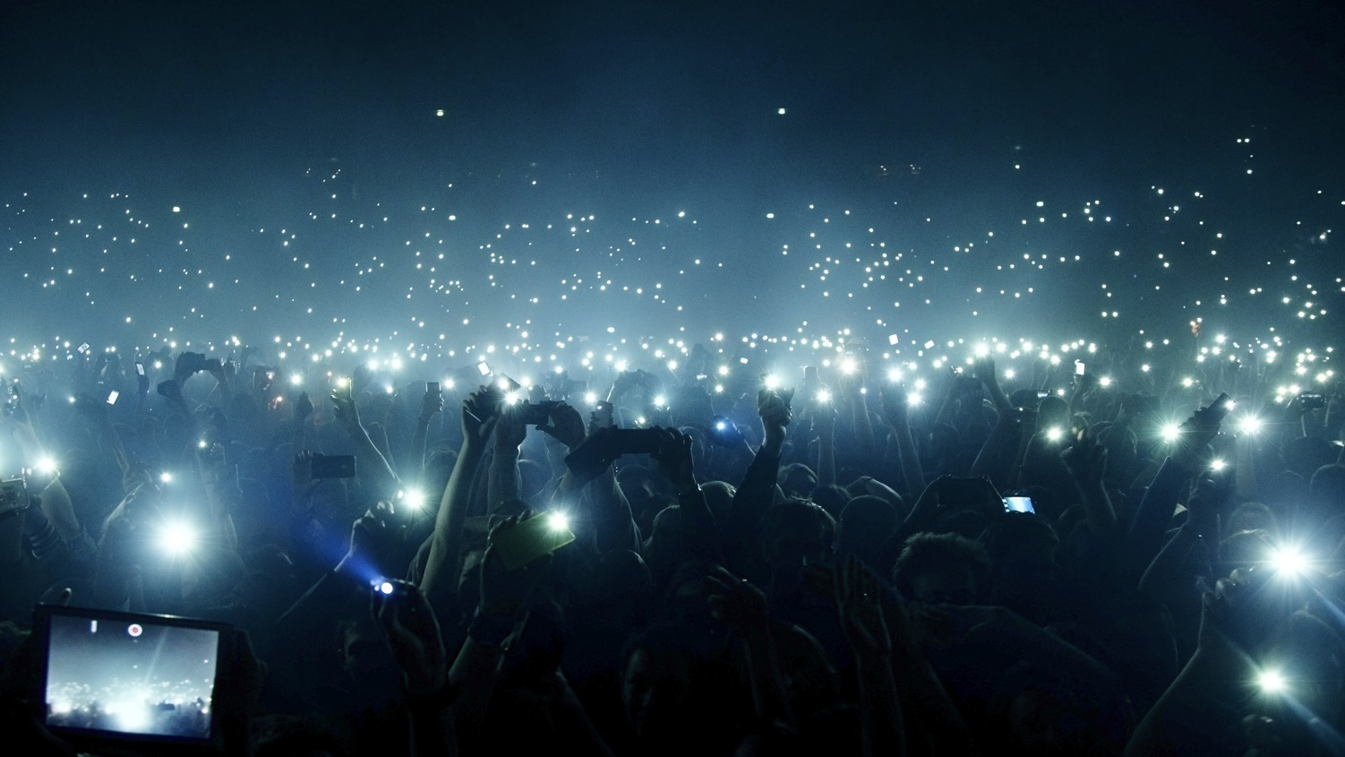
Anything That Should Be Will Be
Connected
Intelligent
Real-Time
Customizable
Multi-Platform
Notes:
Today we live in a world that anything that should be connected will soon be connected - if it is not already. It will be intelligent. Real-Time. Customizable. And Multi-Platform.

Slide 11
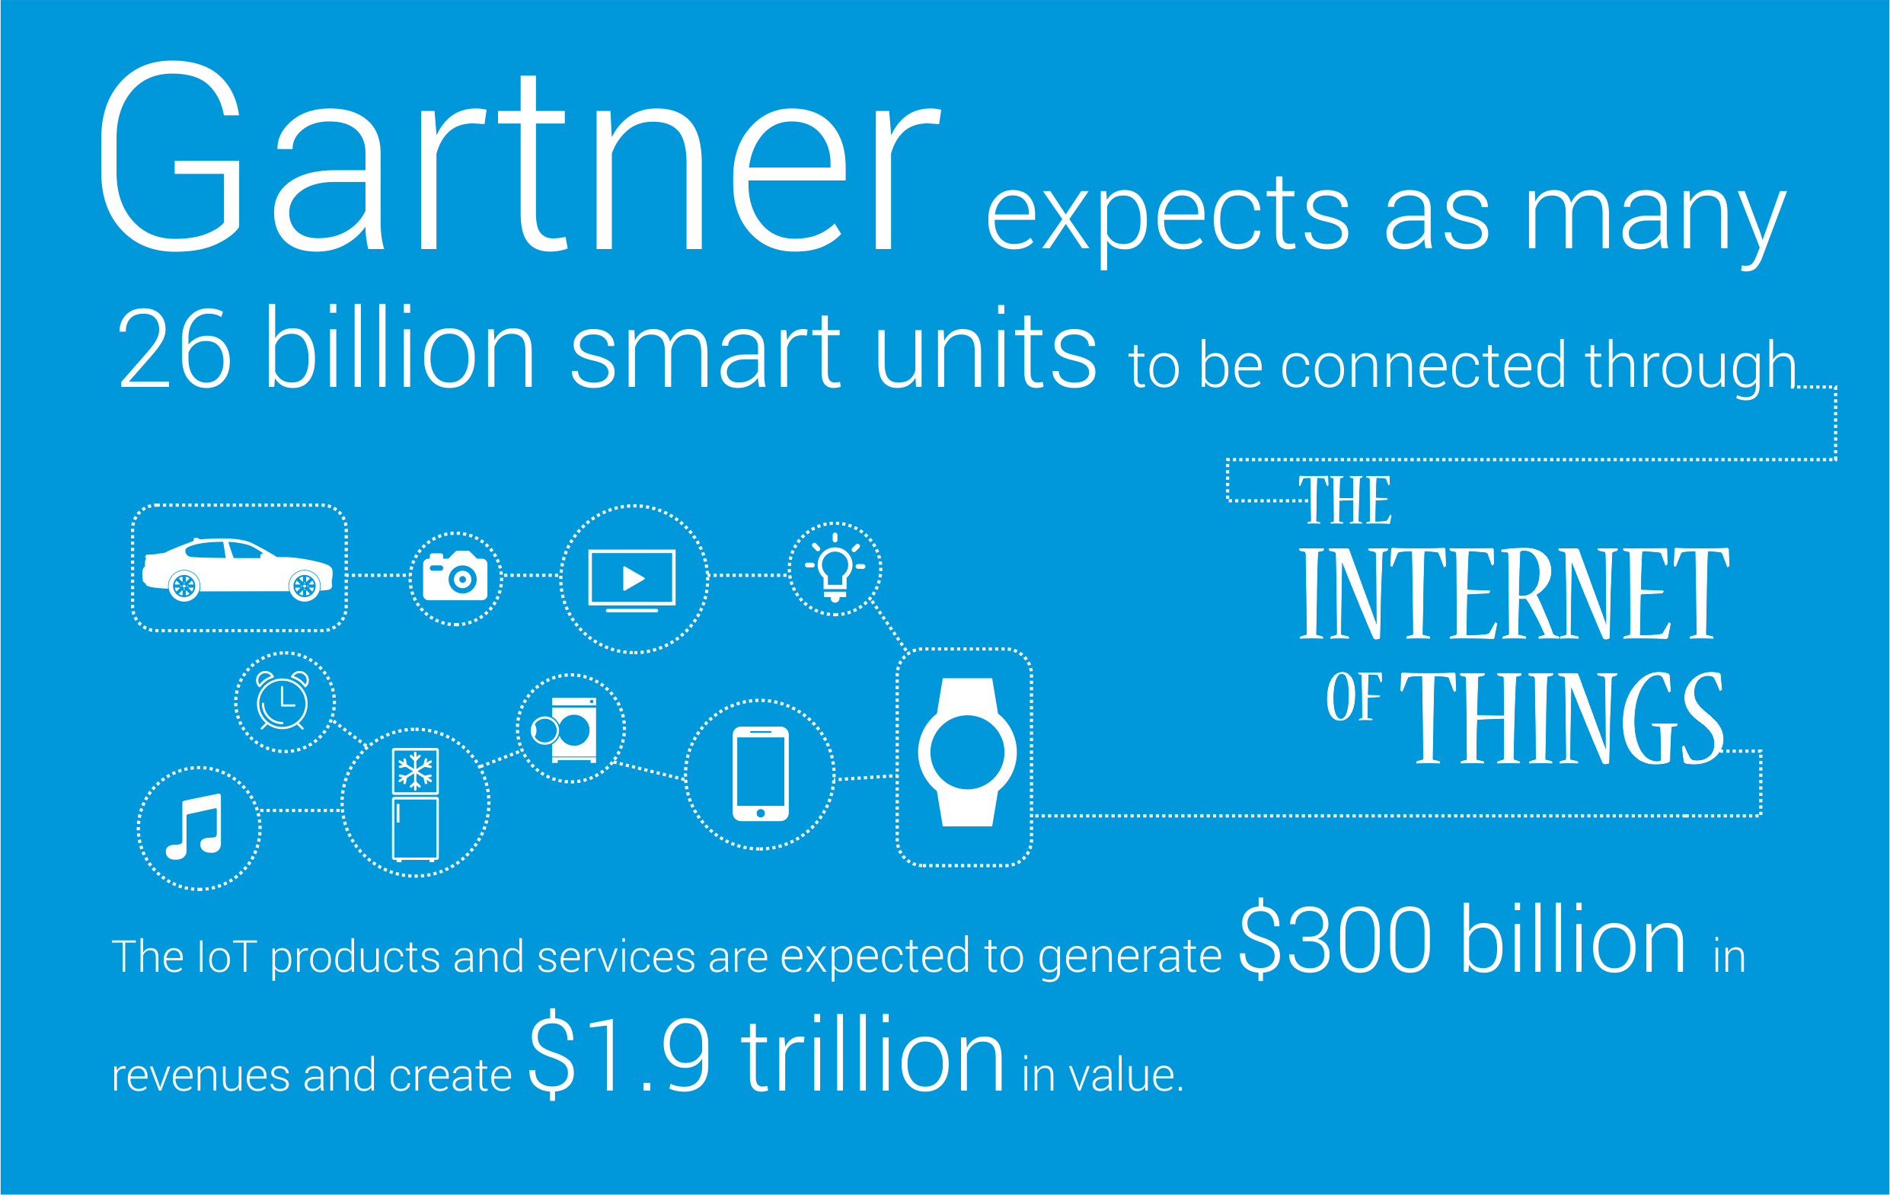
Understanding the Internet of Things (IoT)
Notes:
Today’s presentation is going to be all about understanding the rise of the Internet of Things and how its transforming customer experience forever….
But before we dive in, what exactly is the Internet of Things?
The internet of things (IoT) is the network of physical objects—devices, vehicles, buildings and other items—embedded with electronics, software, sensors, and network connectivity that enables these objects to collect and exchange data.

Slide 12
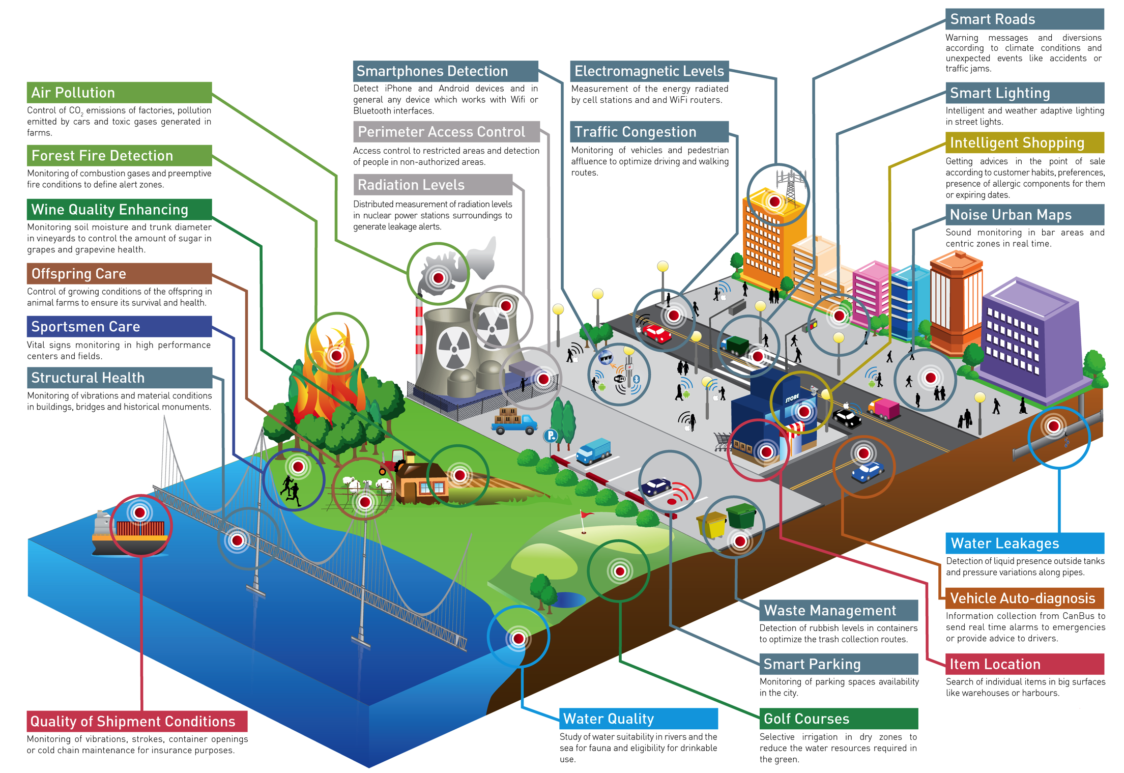
The Opportunity for Connected Devices Is Huge!
Notes:
Review this image with the audience to understand the breadth of capabilities.
ASK:
How many of you have connected devices at home?
Any bots like: Alexa or Google Home?
The rise of technologies like If This Than That (or IFTTT) or Zapier enable us, even as general home consumers, to connect IoT devices and power rich user experiences that streamline and improve our quality of life.
To the end user, IoT is fairly easy to understand since consumer grade IoT is everywhere these days! I have a colleague who drives his connected car, into his connected garage, which in turn turns on the connected lights in his house, and control his connected thermostat.
BUT… for the enterprise, IoT can be more challenging…

Slide 13
The Challenges of IoT
IoT initiatives are not easy to implement
Developing a business model for IoT is not easy
Understanding the success metrics is not easy
1
2
3

Slide 14
The Current State of the
Customer Experience

Slide 15



CX Matters to the C-Suite
Reputation
Loyalty
Revenue
58% of consumers Tweeted using their mobile phones while shopping in-store, rising to 78% for 18-29 year olds.
(Pew Research 2013)
An engaged customer:
2.4X
Buys more frequently
90%
Top performers in customer experience
rating are found to
achieve double the revenue of laggards.
(Harvard Business Review 2014)
Spends more
60%
Delivers more
value to the brand
3X
(Rosetta 2014)
Notes:
Delivery of a positive customer experience can have such a significant impact on a business’ reputation, customer loyalty, and revenue – that it’s now seen as a #1 priority for C-level executives world wide.
The impact of a negative customer experience can be instantaneous. Social networks facilitate reaching a much wider audience and also it happens in the heat of the moment. Reputations are staked on each and every customer experience, and we need to ensure success at every turn.
80% of your revenue comes from 20% of your customers – those customers that are happy and engaged with your company buy and spend more, and ultimately deliver better value (are 3x more loyal).
So, it’s really important that we measure and manage that experience to ensure the success of our organization.
The results are truly shown at the bottom line. HBR finds that organizations that take customer service/engagement as a top priority deliver >2x revenue. It’s no longer just about having the best widget, it’s about having the best widget and the best customer service to go with it. This allows your business to stand up and differentiate from the competition.

Slide 16
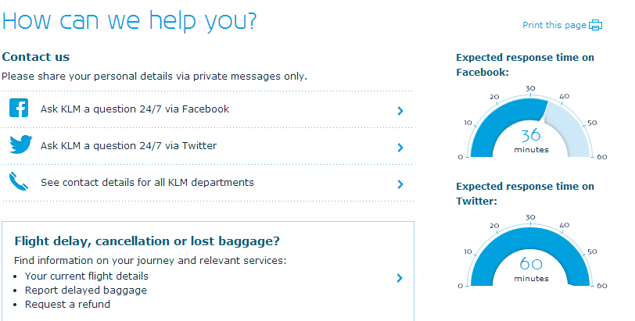
The Modern Consumer Expects
Personalized experiences
Quick response times
Relevant information
Timely information
Proactive experiences
Notes:
Note on KLM example here: KLM Now Displays Social Media Customer Service Response Time. It displays its social media team’s live response time in the header of its Twitter account and on the customer support page at KLM.com. It is also visible on KLM’s global Facebook page .

Slide 17

But Today’s Companies Still Deliver
  Impersonal experiences
  Long wait times
  Irrelevant information
  Too little, too late
  Reactive experiences
Notes:
So why are customers still delivering poor customer experience?
Lack of technology tools: no CRM, no screen pop, no customer profiling via IVR, no data retention from one interaction/segment to another, etc.
Lack of skilled agents, forecasting tools, WFO/WFM tools for monitoring/coaching and scheduling, unified desktop client, etc.
Lack of outbound IVR for proactive messaging and outreach
Inability to provide seamless, predictable CX over all channels
Inability to provide the channels customers want to use
Etcetera

Slide 18

Differentiating Customer Experience with the Internet of Things
18

Slide 19

Digital Darwinism
52% of the companies that were on the Fortune 500 list in 2000 are gone
65% of SMB’s are non existent after 10 years in business
Notes:
The time is now!
The barriers to entry are low and every industry is being transformed
If you don’t think yours is, you may already be too late
52% of the Fortune 500 companies from 2000 are no longer on the list
By 2025 emerging economies will account for more than 45% of the Fortune Global 500

Slide 20
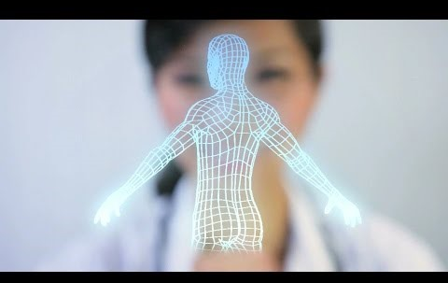
Notes:
Page: http://www.mitel.com/insights/mobile-customer-experience-future
Source video: https://www.youtube.com/watch?v=hHICj_b2Afs

Slide 21


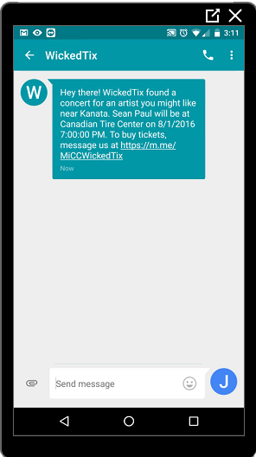
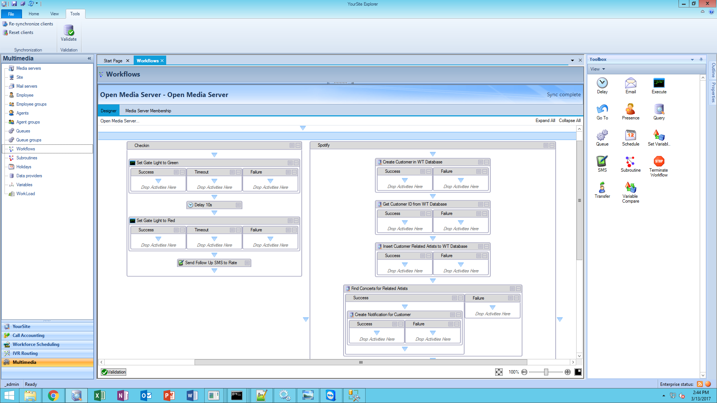

How does CX with IoT work?
LISTEN
ROUTE
ENGAGE
Ingest events from IoT connected devices
Trigger events in real time based on routing workflows
Proactively engage customers for service and support

Slide 22


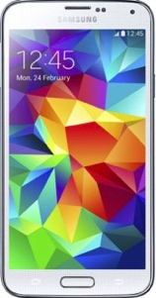

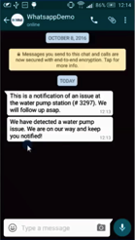
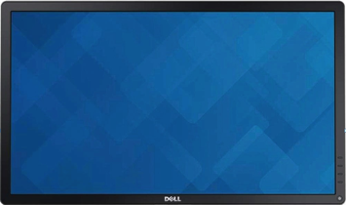
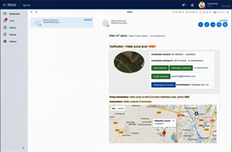





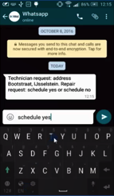







Use Case: Breaking Down the Silos with Collaboration
Water Station Sensor
Sends Alarm
Agent Notified
Customer Updated
Visually Collaborate on Problem
Technician Consults Expert
Technician Notified via Chatbot

Slide 23
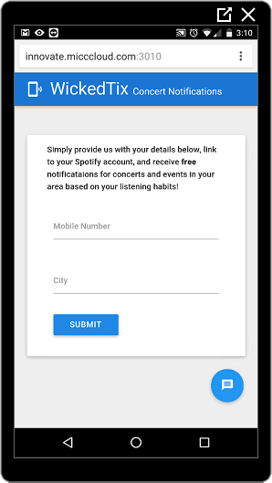
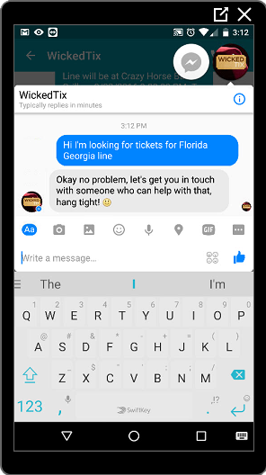


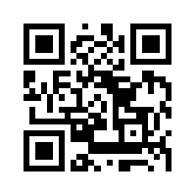
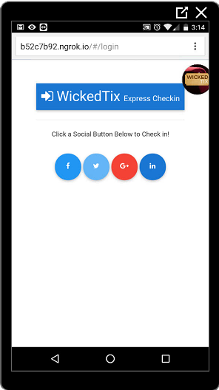
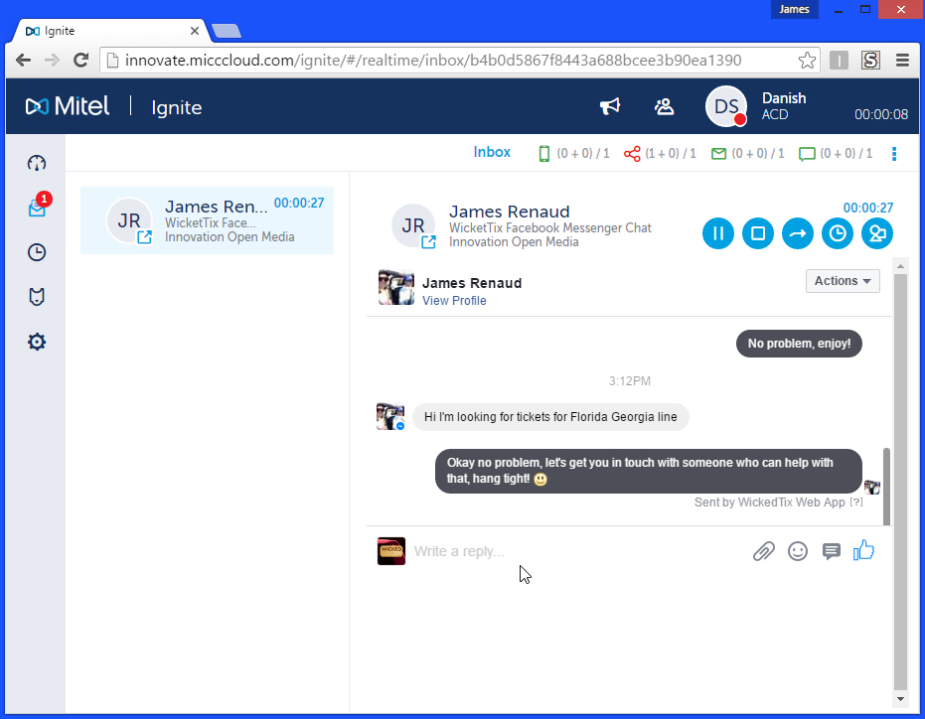

Use Case: Proactive CX with Web Services and IoT
1. Customer subscribes to concert notification service
2. Customer receives notification based on their listening preferences in Spotify
3. Customer confirms purchase over native Facebook Messenger interaction
4. Agent interacts with customer from familiar Facebook Messenger UI
6. Customer ticket is validated and IoT connected gate allows them to enter the concert venue
5. Customer arrives at venue, uses automated check-in via QR Code and Mobile app

Slide 24
Pest Control Use Case
Sensors
H20
Pheromone
Traps
Better Service
Less Chemicals
Notes:
So you might ask, where should we focus our efforts… Reducing waste and improving Customer Experience?
Let’s talk about some of the companies we’ve been working with at Mitel that are leveraging, IoT and Big Data to reduce waste and improve customer service for their customers
A large pest control company is installing water sensors in their customers lawns because they have found that pest outbreaks are linked to rain and draught events
This way, they can treat when necessary and advise their customers if they need to increase watering.
They have also developed rat traps with sensors, pheromone sensors for grain silos, and to sensors to track cockroaches
They have found a way to be more responsive to their customers while reducing the cost and pollution of unnecessary truck rolls or using more chemicals than necessary

Slide 25

Manufacturing Use Case
Just-in-time
Logistics
Empowered by
IoT
Notes:
We have worked with the largest manufacturing plant in North America to respond quickly when there is an interruption on one of their plant lines
They are using IoT to trigger notifications to shift workers, and transportation companies of a delay to prevent lost time and payroll expense, and then update all stakeholders once the line is back in service

Slide 26
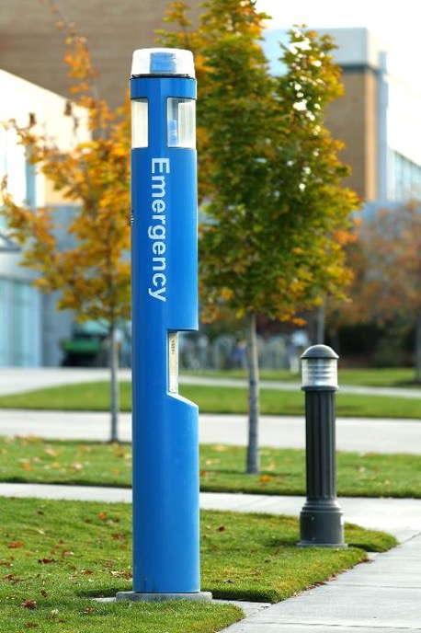
University Use Case
Sensors
Panic Buttons
Voice
Video
Location
Real Time Communication
Faster Response
Notes:
I’m sure you’ve seen similar machines – these are the emergency phone stations, or a one-push security button that triggers an immediate security response to that location. When a person needs help, the button alerts the proper authorities to coordinate an appropriate response.
It got me thinking about how we could add Mitel’s real-time communications and collaboration technology to this type of scenario, and help security staff respond even more effectively.

Slide 27
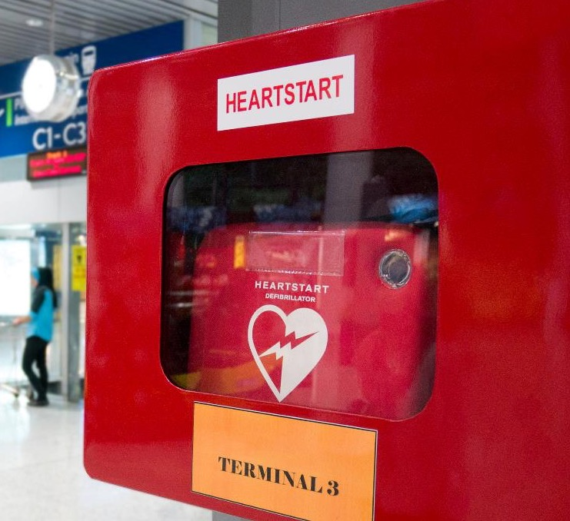
Airport Use Case
IoT Technologies
improving
Security
Life and Safety
Operations
Notes:
I am sure many of you are frequent travelers, and can imagine as you travel through a busy airport with your loved ones there would be nothing more distressing than someone experiencing a heart attack. Fortunately, there are AEDs or Automated External Difibrillators throughout the Airport. But having experts respond quickly in that situation is of the utmost importance.
With HubOne, we've given AEDs a voice. When a cabinet is opened, an IoT sensor detects the event and sends us a notification which we analyze and then respond by helping the right people communicate in real time.

Slide 28
Best Practices for Giving
Machines a Voice
28

Slide 29

Bring the outside in
Pinpoint the pain point
Apply radical ideas
Build to learn - iterate
Notes:
Getting to market first is important, being perfect is less important
You all have to transform your companies into software companies
Leverage agile methodologies to innovate and iterate based on Minimum Viable Products
Find lighthouse customers or communities and work with them to co-ideate, identify problems to solve and apply new methodologies: Like one I heard from Edmunds combining lessons from the Lean Startup, their own experiences and failures:
Bring the outside in (look for what new technologies are out there)
Pinpoint the painpoint, what is the problem you are trying to solve
Apply radical ideas to deliver real impact
Build to learn (Iterate) – because the build times are short, you can afford to tear it down and take a different approach quickly

Slide 30

Build a Compelling Vision
Invest in Software Talent
Transform the
Company Culture
Bring the outside in
Pinpoint the pain point
Apply radical ideas
Build to learn - iterate
Notes:
Some great lessons I have taken from Vijay Gurbaxani, the Head of the Center for Digital Transformation
Build a compelling Vision – companies like Lyft imagine the world without personal cars – packing lots back to green space… SpaceX – reusable rockets to enable a mission to Mars
Invest in software talent – Companies like GE require that new hires have some coding background
Transform the culture – today’s companies are too hierarchical, without the ability to work across domains, established structures stifle innovation (a great read on how to prevent those pitfalls is “The Other Side of Innovation, Solving the Execution Challenge” by the Harvard Business Review)

Slide 31

Three Steps Progressive
Organizations Can Take Today
1.
Build a blueprint of
what to automate versus what requires personal intervention
2.
Determine how
best to leverage your prior investments
3.
Leverage new
tools to improve productivity
and customer engagement

Slide 32
In Conclusion

Slide 33

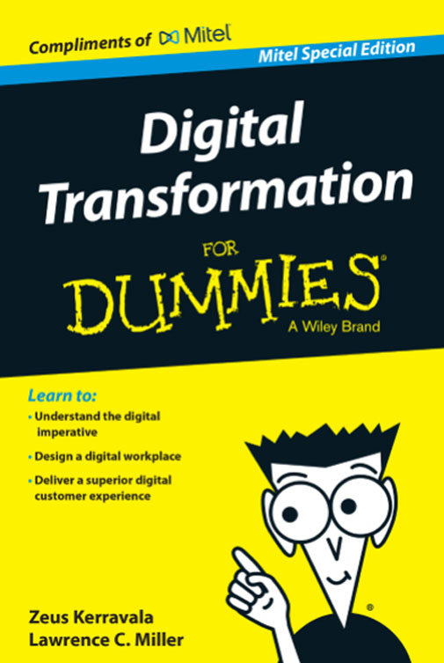
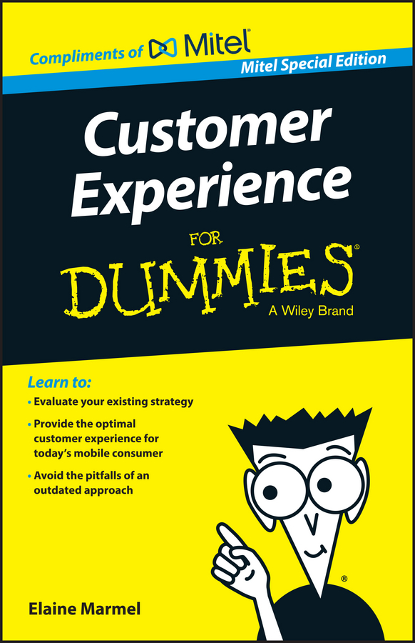
Questions?
Free copies available after the session or at:
http://www.mitel.com/digital-transformation-for-dummies &
http://www.mitel.com/cx-for-dummies
Matthew.Clare@mitel.com

