Slide 1
Supporting Citizens in the Digital Age: New Opportunities for Government IT Professionals
Mark Forman, Global Head and VP, Public Sector

Slide 2
Three numbers to guide our discussion
IT job opportunities are growing faster than the labor force, and government increasingly needs IT and related skills… YOU will have many opportunities to make a difference
12%
0.6%
22,400,000
Notes:
12%...the increase in Technology employment opportunities over the next 5 years according to the HR firm MODIS
The labor force is projected to grow at a compound annual rate of 0.6 percent according the BLs (October 2017 Monthly Report)
Employment in government was essentially unchanged in March (+1,000). The number of jobs in government is largely unchanged since September 2016, and although there have been spikes and some declines, the level is the same as in 2008.

Slide 3

What are the skills you need to succeed
The digital component of most jobs is accelerating rapidly, but there is no concerted effort to help employees continuously improve their digital skills
Source: The Secret to Digital Transformations Is Analog: Why a Digitally Dexterous Workforce Is the Key, Gartner, Jan 2018
Most CIOs feel that their organizations lack the right technical skills to become digital. While key gaps are emerging, some of the biggest gaps are in softer skills like strategy and vision
Source: Organize Your People For Digital Success, Forrester, Jan 2017
Digital transformation is the top ranked business priority among government CIOs, followed by security and governance. Cloud solutions and analytics top the ranking of key technologies and new spending, while data center, infrastructure or legacy modernization are commonly targeted for savings
Source: 2018 CIO Agenda: Government Insights, Gartner, Oct 2017
Notes:
Key tech expertise needs according to Forbes tech Council (December 2017)
The field of artificial intelligence is seriously understaffed. Specifically, finding technology leaders (CIO/CTO, head of product, etc.) who know how to credibly manage teams made up of AI, data science and innovative product specialists
Skills To Envision, Design And Develop Augmented Reality and Machine learning Apps
Mobile Apps - successful app developers should be fluent in multiple programming languages, including Java, HTML5, Objective-C, C++, C#, Python and Swift. Also, app developers with UX and UI design skills can offer much more value for project management.
Given the recent infiltration of networks, there will be an increased need for excellence in cybersecurity. Organizations need to ensure they are protecting the data they capture behind the walls of their networks.
IT professionals with skills in cloud computing and software as a service (SaaS) will be the hot ticket in 2018.
Virtualization skills in Amazon AWS, Microsoft Hyper-V and VMware for private cloud hosting will, without a doubt, help you stand out from the crowd. Experience with DevOps, containers, the entire cloud stack and IPv6 will also benefit your chances for a top job tremendously.
One of the most important characteristics of a tech star is the ability to adapt to new technologies. It is almost impossible to predict what will be the norm six months from now. Someone who is constantly learning will be very successful in the future of this unpredictable field. - Arthur Pereless, Pereless Systems
There’s an increasing amount of overlap between different job functions, and communicating effectively with different members of an organization is essential. Projects require collaboration between developers, marketers, and designers, and not everyone adapts to understanding the different languages and workflows of each team
An important skill is to identify and implement digital platforms across the whole organization that will impact operational efficiencies and increase revenue.

Slide 4
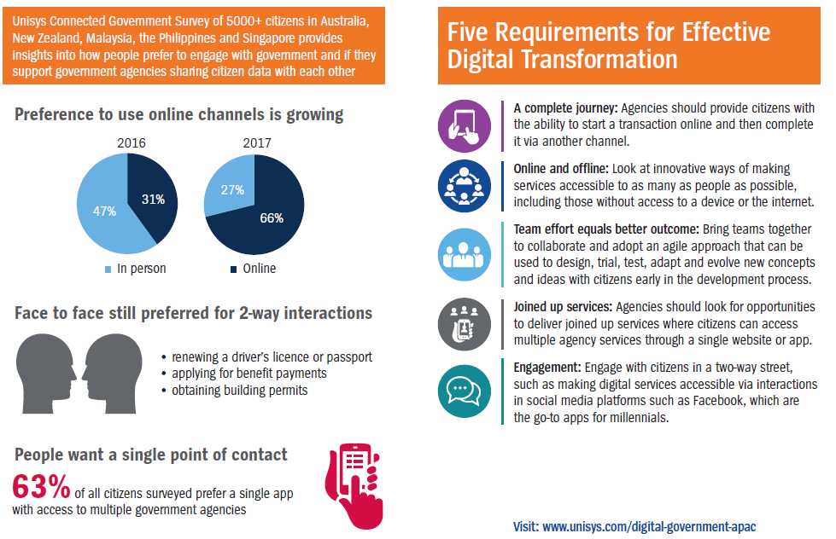
Citizen Expectations in a Digital Age

Slide 5
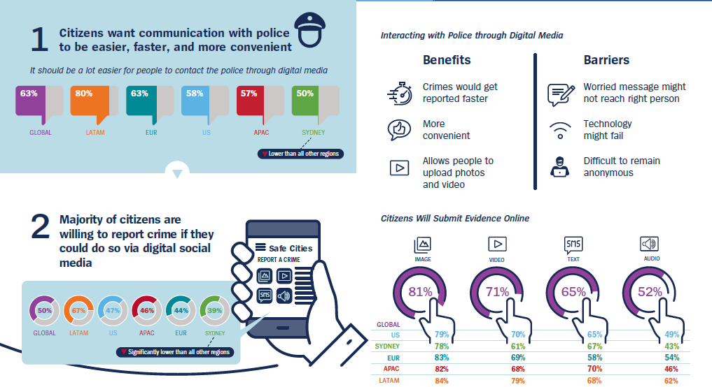
Citizen Perceptions of Digital Integration…a Case Study

Slide 6


Changing Needs of Digital Citizens Require A Hybrid Approach
Technology
Moment of Truth
Analog Approach
Digital Approach
Focus on driving transformation that matters
at the point of service through a hybrid approach

Slide 7
Barriers to Scaling Digital Transformation [Across Industries]
As per Gartner’s 2018 CIO Survey, CIOs believe that corporate culture is the biggest barrier to digital transformations, followed by resources and talent.
Those three elements make up 82% of digital business impediments.
Source: The Secret to Digital Transformations Is Analog: Why a Digitally Dexterous Workforce Is the Key, Gartner, Jan 2018

Slide 8
Framework to Boost Workforce’s Digital Dexterity
Source: The Secret to Digital Transformations Is Analog: Why a Digitally Dexterous Workforce Is the Key, Gartner, Jan 2018

Slide 9
Skills Needed For Digital Transformation
How critical are the skills gaps you face for the following?
Source: The Organize Your People For Digital Success, Forrester, Jan 2017

Slide 10






Digital Transformation Outcomes
ANYWHERE

Slide 11
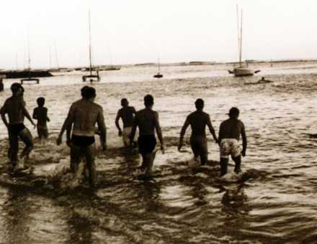
Preparing to Succeed: Three Questions to Ask Yourself
"People who think that an IRONMAN is unattainable – I tell them that it is possible. I can take anyone – a person that does not have an athletic bone in their body and make them into a triathlete if they’re willing to put in the time. I’m the perfect example. I am not a great athlete, just a hard worker." – John Duke, IRONMAN Legend
Am I open to, or am I resisting, change?
Am I up to date in knowledge and skills?
Am I working hard enough to get the needed results?

