Slide 1
Yes, You Can Have Security & Trust in the Cloud – Here’s How
Diana Kelley
Cybersecurity Field CTO
@dianakelley14
PA TechCon, May 1, 2018
10:15a-11a

Slide 2
Agenda
Something old, something new
Cloud as a security opportunity
Hybrid Cloud and an Integrated Experience
Shared Responsibility
Security Built in Cloud

Slide 3



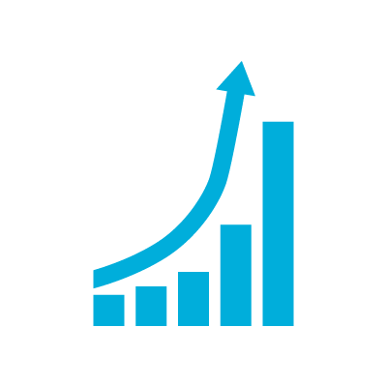
Information Security is in Transformation
Enterprise IT is Cloud Hybrid
Cloud adoption is inevitable (Digital Transformation + industry momentum)
Legacy systems will take years to migrate or retire
Technology Mobility and Volume is Exploding
Increasing demand for first class experience on mobile devices
Variance in trustworthiness of mobile devices
Pervasive Digital Transformation and IoT
IoT adoption driving a wave of app development and cloud usage
Enterprise PC Security strategies applying poorly to IoT devices
IoT
Increasingly Hostile Environment
Increased attack surface with new technologies creates new blind spots
Attacks rising in volume and sophistication to capture illicit opportunities
Note: Attackers generally invest in technical sophistication only as needed

Slide 4




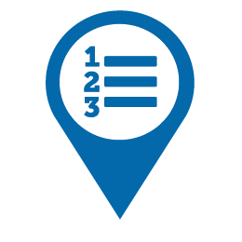



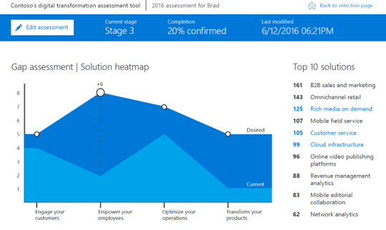
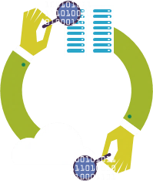
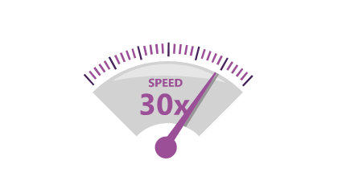
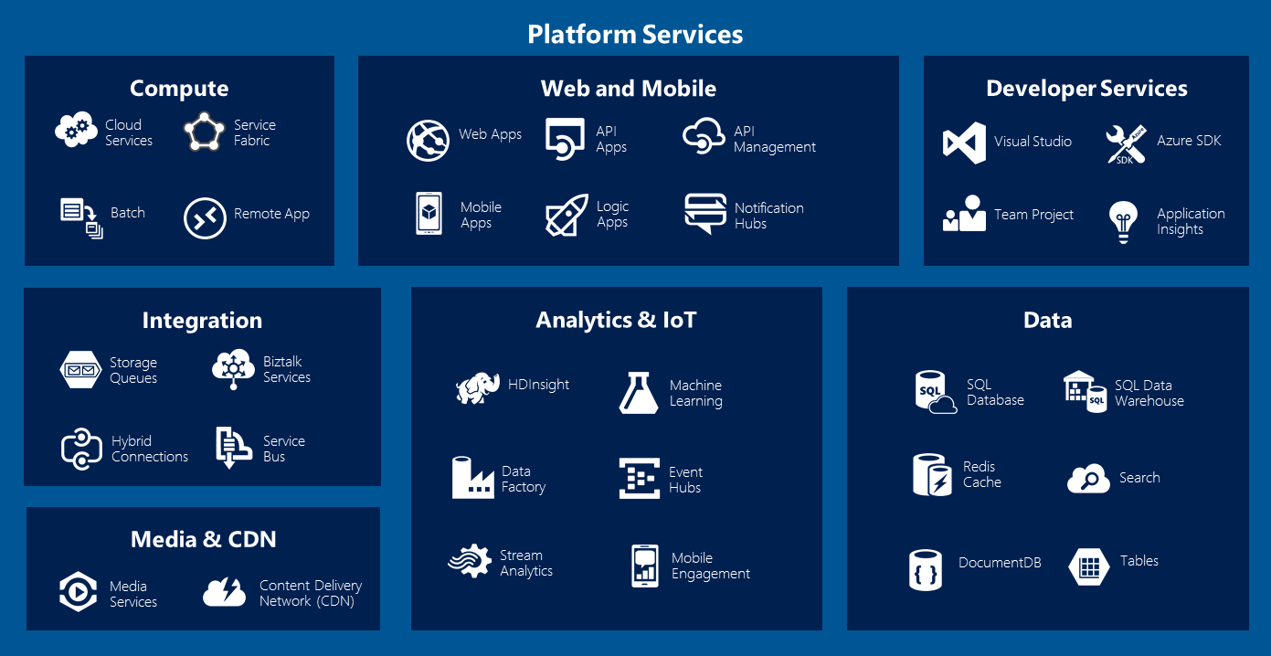
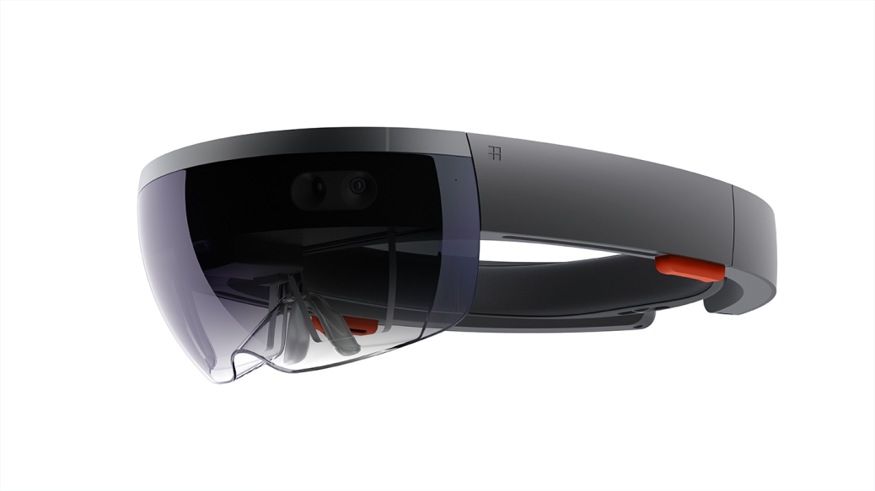


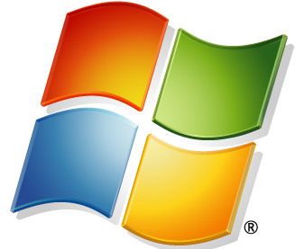




Enterprise in Transformation
Cloud Technology
SaaS adoption
Perimeter of a Modern Enterprise
Platform as a Service
Infrastructure as a Service
Internet of Things
1st class mobile experience
ENGAGE
YOUR CUSTOMERS
EMPOWER
YOUR EMPLOYEES
OPTIMIZE
YOUR OPERATIONS
TRANSFORM
YOUR PRODUCTS

Slide 5

The digital estate
Smart cities
Sensors
Vehicles
Energy systems
Cloud
Partners
Citizens
Marketplaces
Equipment
Customers
Mobile devices
On-premises
Supply chains
Manufacturers

Slide 6

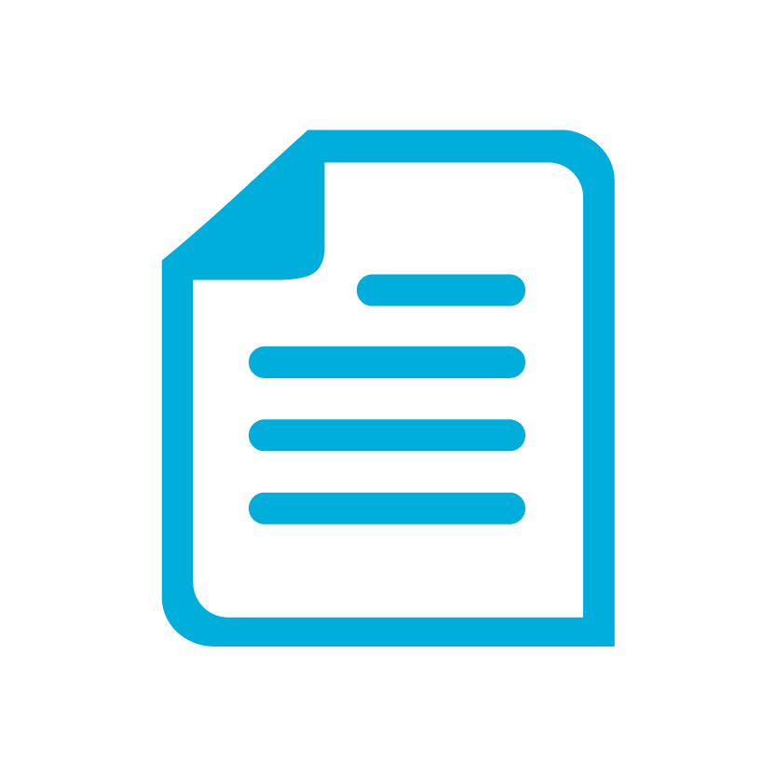
Imperatives and opportunity to reimagine security
Monitor and manage your hybrid cloud estate:
Visibility and Control over Blind spots
Identity security perimeter to protect cloud, mobile, and IoT assets
Automated policy monitoring and enforcement for modern estate
Agile and Efficient Threat Protection
Automated and integrated toolsets for response efficiency and effectiveness
Integrated telemetry to reduce noise and increase accuracy
Find and Protect Intellectual Property & Regulated data
Automate classification as documents are created
Persist data protection throughout it’s lifecyle

Slide 7
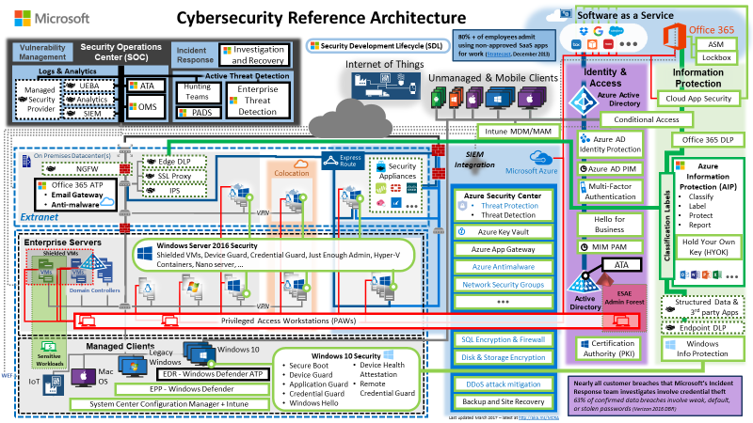

Securing the Modern Enterprise
Integrated Security Experience
Integrate trillions of diverse threat signals, TPM hardware isolation, machine learning, and human analysis into platform and tools
We Run on Cloud
7+ Years of Azure and Office 365
We manage attacks 24x7
Continuous attacks on Microsoft environments
Attacks on enterprise customers
Cybersecurity Reference Architecture
Recommended Strategies & capabilities
Security Management
Threat Protection
Information Protection
Identity & Access Management
…and more
We Run Cloud Services
22 years of Online Experience
Security is in our DNA
15 years of investment into trustworthy and secure computing
More than $1 billion per year in security research and development

Slide 8
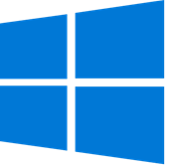

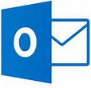





Building an Integrated Security Experience
INTELLIGENT SECURITY GRAPH
Industry Partners
Antivirus Network
CERTs
Cyber Defense
Operations Center
Malware Protection Center
Cyber Hunting Teams
Security Response Center
Digital Crimes Unit
Conditional
Access
Cloud App
Security
Event Management
Information Protection
Key Vault
Security Center
Office 365 Advanced Threat Protection
Windows
Update
Active
Protection Service
SmartScreen
Identity
Apps and Data
Infrastructure
Device
PaaS
IaaS
Advanced Threat
Analytics
Active
Directory
Azure Active Directory
SaaS

Slide 9

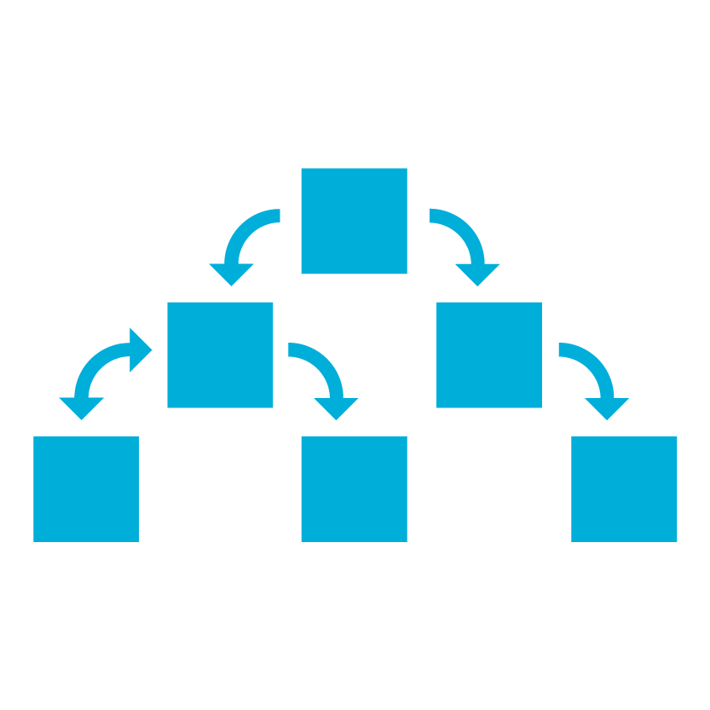
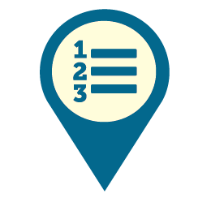
Cloud Security is a partnership
Sharing security, privacy, and compliance responsibility with cloud provider(s)
Access & Usage
Always your responsibility
Device & Browser Security
Information and Document Security
User and Account Security
Service
Responsibility varies
by service type
Policy & Compliance Accountability
Software (SaaS)
Platform (PaaS)
Compliant Platform and Controls
Infrastructure (IaaS)
Fabric
Your or your cloud provider’s responsibility
Cloud Provider Secures the Fabric
On Premises
Physical, Network, & Software Security

Slide 10
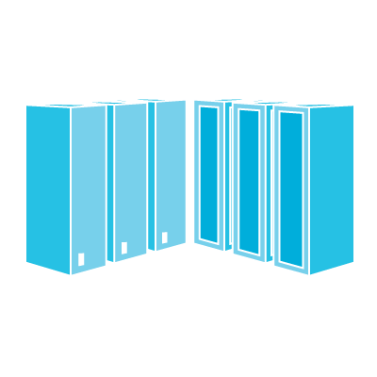
Security Advantages of Cloud Era
TRADITIONAL APPROACH
CLOUD-ENABLED SECURITY
Cloud Technology enables security to:
Shift commodity responsibilities to provider and re-allocate your resources
Leverage cloud-based security capabilities for more effectiveness
Use Cloud intelligence improve detection/response/time
  Greater Business Value
  Commodity Resources
Security is a challenging and under-resourced function
  Unmet responsibility
  Cloud Provider responsibility (Trust but verify)
  Satisfied responsibility
  Partially met responsibility

Slide 12
Identity & access management
Information protection
Built in
security
Platform
Threat
protection
Security management

Slide 13
Identity & access management
Information protection
Built in
security
Platform
Threat
protection
Security management

Slide 14

How much control do you have over access?
Can your access control policies
adapt to changing conditions?
Can you improve user experience
and strengthen access protection?
How do you protect user credentials?

Slide 15
Identity and access management
Prove users are authorized and secure before granting access to apps, data, and devices
Protect at the
front door
Improve user experience while maintaining security
Safeguard your credentials
Notes:
EMS Overview
© 2014 Microsoft Corporation. All rights reserved. Microsoft, Windows, Surface and other product names are or may be registered trademarks and/or trademarks in the U.S. and/or other countries. The information herein is for informational purposes only and represents the current view of Microsoft Corporation as of the date of this presentation. Because Microsoft must respond to changing market conditions, it should not be interpreted to be a commitment on the part of Microsoft, and Microsoft cannot guarantee the accuracy of any information provided after the date of this presentation. MICROSOFT MAKES NO WARRANTIES, EXPRESS, IMPLIED OR STATUTORY, AS TO THE INFORMATION IN THIS PRESENTATION.
5/8/2018
15

Slide 16

Protect at the front door with
Conditional Access
IF
THEN
10TB
Users
Allow access
Devices
Privileged user?
Credentials found in public?
Accessing sensitive app?
Unmanaged device?
Device compromised?
IP detected in Botnet?
Impossible travel?
Require MFA
Risk
High
Medium
******
Force password reset
Low
Location
Deny access
Apps
Limit access

Slide 17
Identity & access management
Information protection
Built in
security
Platform
Threat
protection
Security management

Slide 18
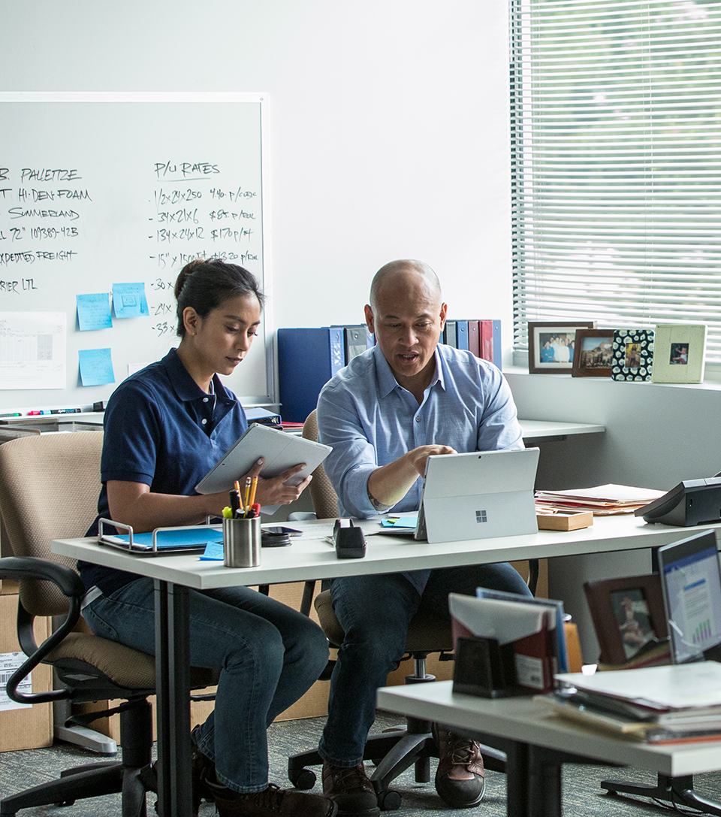
Do you have a strategy for protecting and managing sensitive information?
Do you know where your sensitive
data resides?
Do you have control of your data as it travels inside and outside of your organization?
Are you using multiple solutions to classify, label, and protect sensitive data?

Slide 19
Information protection
Comprehensive protection of sensitive data throughout the lifecycle—across devices, apps, cloud services, and on-premises
Detect & classify sensitive information
Apply protection
based on policy
Monitor &
remediate
Across
Devices
Apps
Cloud services
On-premises
Notes:
EMS Overview
© 2014 Microsoft Corporation. All rights reserved. Microsoft, Windows, Surface and other product names are or may be registered trademarks and/or trademarks in the U.S. and/or other countries. The information herein is for informational purposes only and represents the current view of Microsoft Corporation as of the date of this presentation. Because Microsoft must respond to changing market conditions, it should not be interpreted to be a commitment on the part of Microsoft, and Microsoft cannot guarantee the accuracy of any information provided after the date of this presentation. MICROSOFT MAKES NO WARRANTIES, EXPRESS, IMPLIED OR STATUTORY, AS TO THE INFORMATION IN THIS PRESENTATION.
5/8/2018
19

Slide 20
Identity & access management
Information protection
Built in
security
Platform
Threat
protection
Security management

Slide 21

How do you protect your organization from advanced threats?
How quickly can you detect suspicious activities on your network?
How do you know if credentials have
been compromised?
How quickly can you remediate
advanced threats?
How do you protect your users from
email threats?

Slide 22
Threat protection
Built in, cloud driven, automatic protection
Reduce attack surface
Detect attacks faster and block them
Respond automatically
to breaches where appropriate

Slide 23
Identity & access management
Information protection
Built in
security
Platform
Threat
protection
Security management

Slide 24

How do you manage security?
Do you know the security state
of your full estate in real time?
How easily can you configure and manage the security posture across your estate?
How do you proactively improve your security practices over time?

Slide 25
Security management
Provide visibility, control, and guidance, with shared intelligence across the digital estate
Visibility
Control
Guidance
Across
Devices
Apps & data
Infrastructure
Notes:
EMS Overview
© 2014 Microsoft Corporation. All rights reserved. Microsoft, Windows, Surface and other product names are or may be registered trademarks and/or trademarks in the U.S. and/or other countries. The information herein is for informational purposes only and represents the current view of Microsoft Corporation as of the date of this presentation. Because Microsoft must respond to changing market conditions, it should not be interpreted to be a commitment on the part of Microsoft, and Microsoft cannot guarantee the accuracy of any information provided after the date of this presentation. MICROSOFT MAKES NO WARRANTIES, EXPRESS, IMPLIED OR STATUTORY, AS TO THE INFORMATION IN THIS PRESENTATION.
5/8/2018
25

Slide 26

Microsoft Intelligent Security Graph
Unique insights, informed by trillions of signals
Shared threat data from partners, researchers, and law enforcement worldwide
OneDrive
930M
threats detected on devices every month
Outlook
400B
emails
analyzed
1.2B
devices scanned each month
200+
global cloud consumer
and commercial
services
Botnet data from Microsoft Digital Crimes Unit
Windows
Enterprise security for 90% of Fortune 500
Azure
Microsoft
accounts
18B+ Bing web pages scanned
Bing
450B
monthly
authentications
750M+ Azure user accounts
Xbox Live

Slide 27




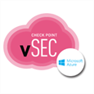

Integrating with your SIEM
Powered by the
Intelligent Security Graph
Azure AD
Identity Protection
EDR - Windows Defender ATP
Azure Active
Directory
Azure Security Center
Threat Protection
Threat Detection
Security Appliances
Connect to your existing SIEM tool and processes
Azure Log Integration
Azure SQL
Threat Detection
Office 365 ATP
Email Gateway
Anti-malware
Cloud App Security
Log Integration
Audit Logs
Alerts
Office
365
ROADMAP
SIEM
Maximize Visibility
  Internal
  External
Reduce manual steps (and errors)
  Automate
  Integrate (with SIEM)
Maximize human analyst impact
  Deep expertise and intelligence
  Continuous Learning
Office 365 Threat Intelligence
ATA

Slide 28
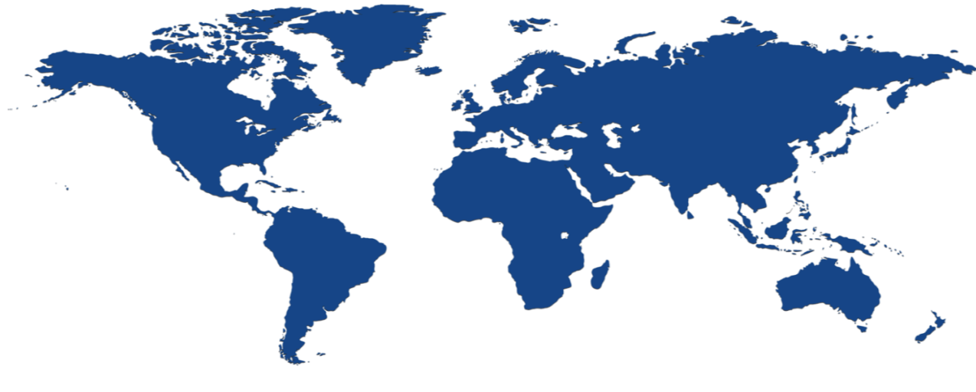
Microsoft Cloud Services infrastructure
Global, hyper-scale, enterprise-grade infrastructure offering data residency and business continuity in 14 worldwide geos
Enterprise reliability
via 100+ data centers and
Microsoft’s global network edge
Compliance leadership
with standards and commitments including ISO 27001, FISMA, and EU Model Clauses
Office 365:
No standing access to data,
transparent operational model, and
99.9% financial-backed uptime guarantee
Security by design
operationalized at the physical,
logical, and data layers

Slide 29
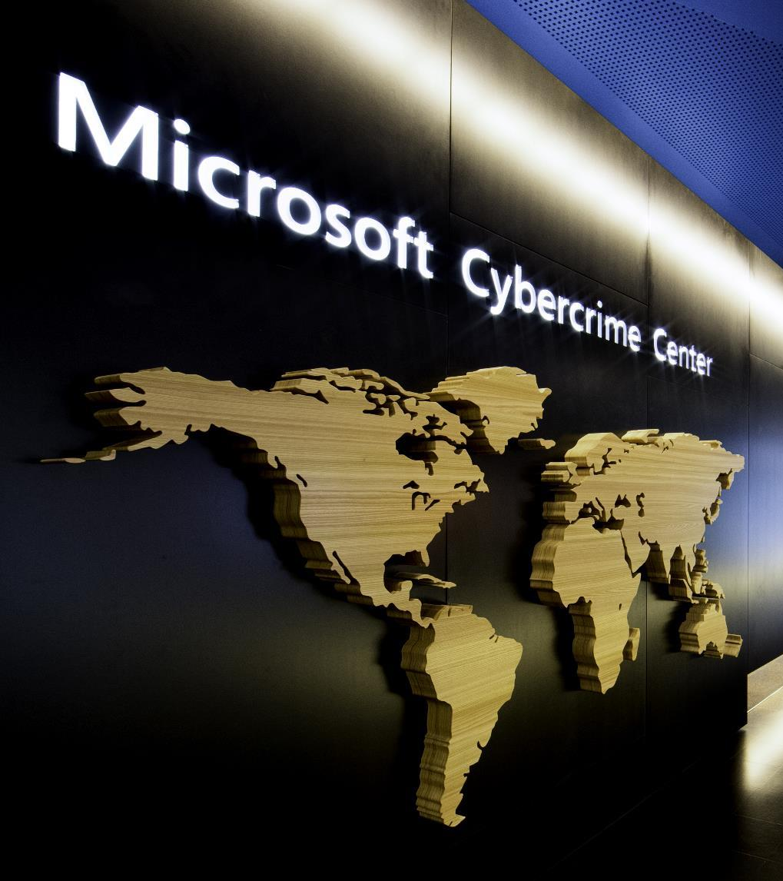
Digital Crimes Unit
Leading the fight against cybercrime
Protecting people, organizations and our cloud through global disruptions and enforcement actions against cybercriminals
Investigations, forensics, and analytics
Machine learning, AI, and data visualization
Public and private partnerships
Creative legal strategies

Slide 30
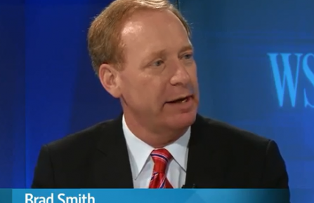

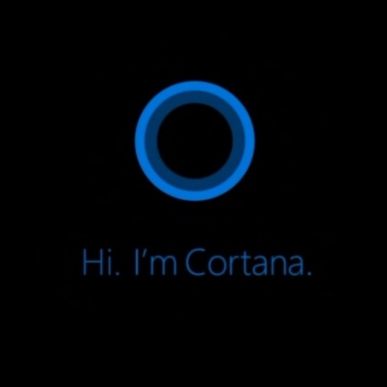
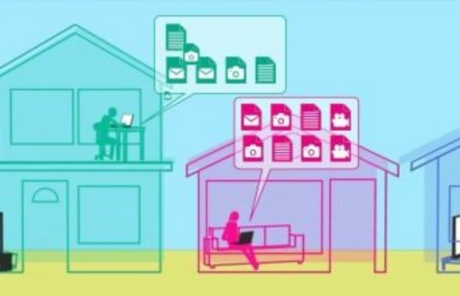

“We oppose government demands for customer and personal data”
Ethics and your Data
We have built a
culture of strong
privacy principles
and leading
security practices
“We do not provide anyone with direct, unfettered access to customer data.”
-Brad Smith, General Counsel
We provide governments with the ability to review source code and reassure themselves of its integrity at our Transparency Centers
Your data is only used to enhance your experiences
“Most trusted company
for privacy”
-Ponemon Institute’s Most Trusted Companies for Privacy Study
Microsoft
Trust Center
We put people first with
privacy by design

Slide 31
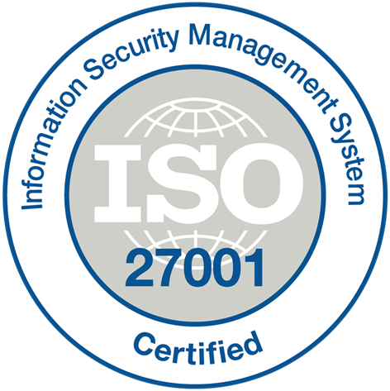
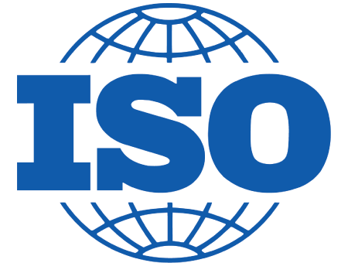
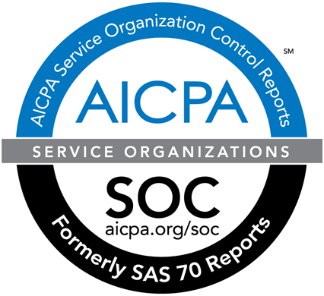
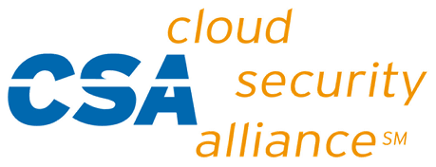













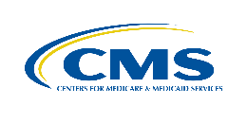


























TRUSTED CLOUD
March 2017
Azure has the deepest and most comprehensive compliance coverage in the industry
GLOBAL
ISO 27017
ISO 22301
ISO 9001
SOC 1
Type 2
SOC 2
Type 2
SOC 3
CSA STAR
Self-Assessment
CSA STAR
Certification
CSA STAR
Attestation
ISO 27001
ISO 27018
US GOV
Moderate
JAB P-ATO
High
JAB P-ATO
DoD DISA
SRG Level 2
DoD DISA
SRG Level 4
DoD DISA
SRG Level 5
SP 800-171
FIPS 140-2
Section 508 VPAT
ITAR
CJIS
IRS 1075
INDUSTRY
PCI DSS
Level 1
CDSA
MPAA
FACT UK
Shared
Assessments
FISC Japan
HIPAA / HITECH Act
HITRUST
GxP
21 CFR Part 11
MARS-E
IG Toolkit UK
FERPA
GLBA
FFIEC
REGIONAL
Argentina
PDPA
EU
Model Clauses
UK
G-Cloud
China
DJCP
China
GB 18030
China
TRUCS
Singapore
MTCS
Australia
IRAP/CCSL
New Zealand
GCIO
Japan My
Number Act
ENISA
IAF
Japan CS Mark Gold
Spain
ENS
Spain
DPA
India
MeitY
Canada
Privacy Laws
Privacy
Shield
Germany IT
Grundschutz
workbook

Slide 32

Our commitment to you
Security
Privacy & control
Compliance
Transparency
Reliability

Slide 33

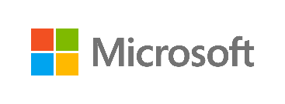
Microsoft Secure
Ensuring security to enable your
digital transformation through a comprehensive platform, unique intelligence, and broad partnerships

