Slide 1
No-Code Application Development
and the Citizen Developer
Presented by Cal Fuerst

Slide 2
Who is
CitizenDeveloper?
15 Years in Central PA
Makers of WorkXpress and CitizenDeveloper
Located in Strawberry Square, 2nd Floor
We empower NON-CODERS to
rapidly build APPLICATIONS that are:
Sophisticated
Highly Secure
Highly Performant
Highly Scalable
© 2018 CitizenDeveloper. All Rights Reserved

Slide 3
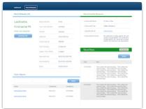
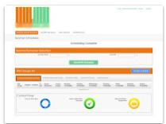
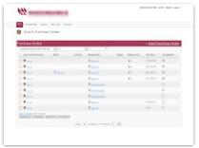
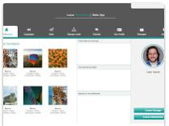
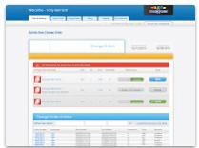
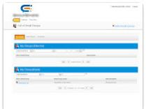
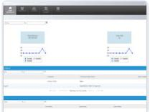
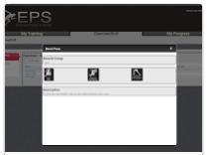
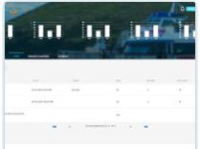
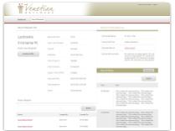
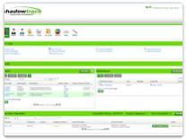
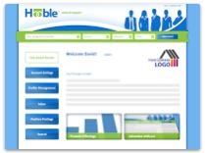
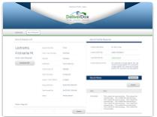
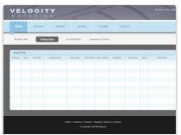
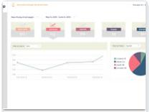
Citizen Developers with no coding experience have ALREADY BUILT nearly 1000 sophisticated, real-world applications…
THIS IS REAL, IT'S HAPPENING!
© 2018 CitizenDeveloper. All Rights Reserved

Slide 4
Airline
Apparel & Accessories
Architecture
Authors
Automotive
Advertising
Banking
Beverage & Tobacco
Biotechnology
Broadcasting
Brokerage
Business
Call Centers
Cargo Handling
Chemical
Computer
Construction
Consulting
Consumer Products
Cosmetics
Dating Platforms
Defense
Department Stores
Distribution
Education
Electronics
Energy
Engineering
Entertainment & Leisure
Executive Search
Financial Services
Food Production
Gambling
Government
Grocery
Health Care
Human Resources
Internet Publishing
Legal
Manufacturing
Marketing
Media
Military
Motion Picture & Video
Music
Newspaper Publishers
Online Auctions
Packaging
Parks and Recreation
Pension Funds
Pharmaceuticals
Politics
Private Equity
Publishing
Real Estate
Retail & Wholesale
Robotics
Sales
Science
Securities & Commodity
Service
Social Media
Social Services
Software
Sports
Technology
Telecommunications
Television
Transportation
Travel Services
Trucking
Utilities
Venture Capital
Web Development
And More!
Global Reach:
500,000 Users On
6 Continents
Serving Every
Major Industry
© 2018 CitizenDeveloper. All Rights Reserved

Slide 5
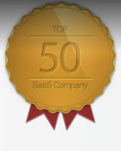
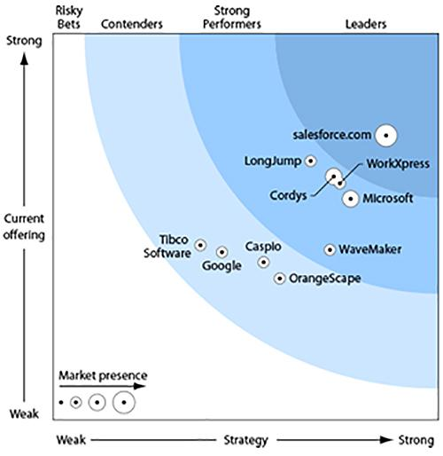
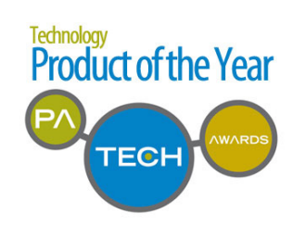
2012 Technology Product of the Year (TechQuest)
Top 50 SaaS company (SaaS Chronicles.net)
Top 150 Player Cloud Computing (Syscon)
“Strong Performer” (Forrester - 2011 Wave)
“Who’s who in PaaS” (Gartner)
“100 Cloud Vendors you should know” (Alsbridge)
“stands to disrupt an entire previous generation of technology” (IDC)
Winners of numerous awards and analyst accolades - AND WE’RE JUST GETTING STARTED!!
© 2018 CitizenDeveloper. All Rights Reserved

Slide 6
Back End Demo
A CitizenDeveloper wishes to Import ~10,000 Accounts, ~10,000 Contacts, and relate them together - all asynchronously (in parallel). Each record receives additional logic processing for e.g. duplicates, etc.
(**NOTE: System capacity was intentionally cut back to below-minimum conditions: hardware, database nodes, and 5 threads per service, in order to stretch out the demonstration time frame**)
© 2018 CitizenDeveloper. All Rights Reserved

Slide 7
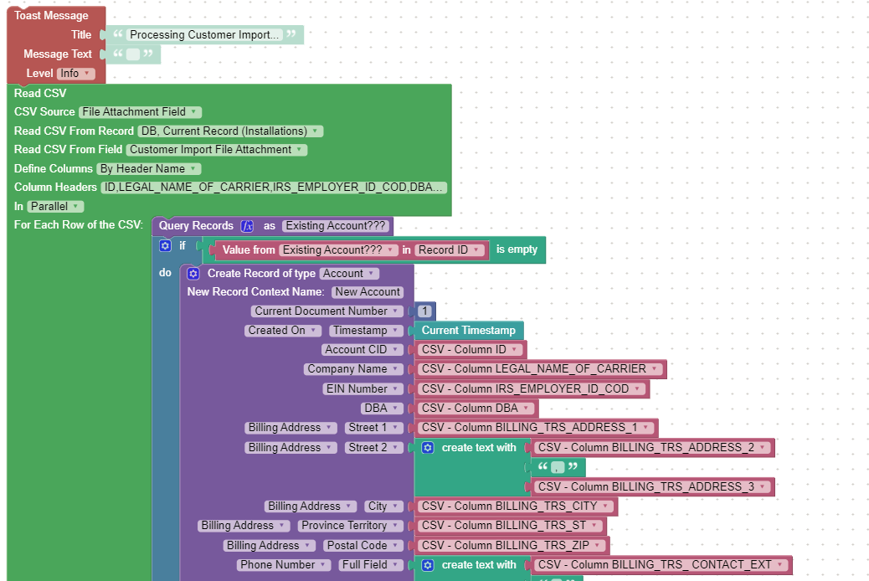
Import was setup without Code:
© 2018 CitizenDeveloper. All Rights Reserved

Slide 8
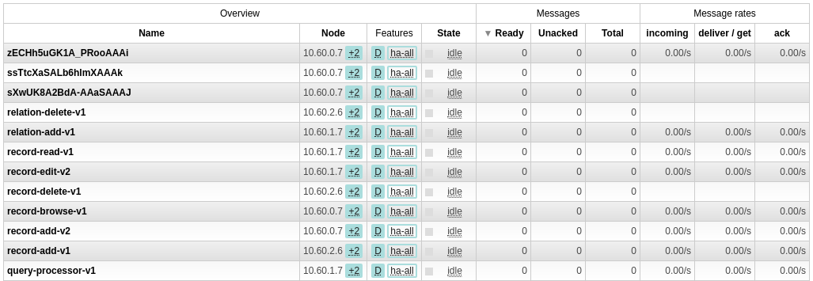
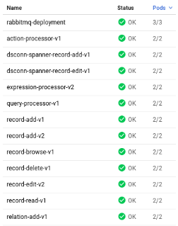
Time = 0: “systems at rest”
Service Requests:
MicroServices Count:
Record Counts:
Database Operations per Second:
Hardware Allocated:
© 2018 CitizenDeveloper. All Rights Reserved

Slide 9
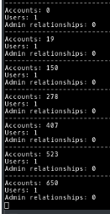
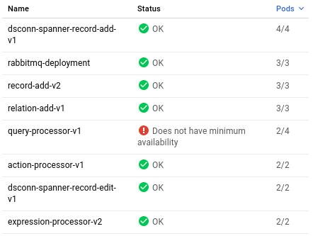
Time = 1: “asynchronous flood of query requests!”
Service Requests:
Record Counts:
MicroServices Count:
© 2018 CitizenDeveloper. All Rights Reserved

Slide 10
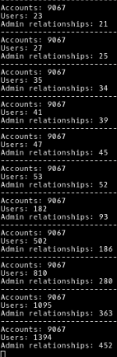
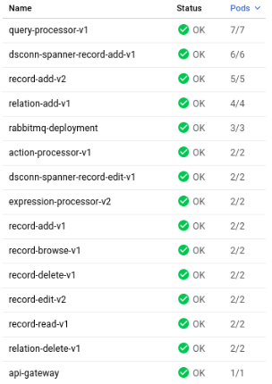
Time = 5: “add hardware, auto-shift to relationships”
Service Requests:
Record Counts:
MicroServices Count:
Database Operations per Second:
Hardware Allocated:
© 2018 CitizenDeveloper. All Rights Reserved

Slide 11
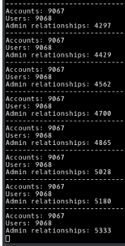
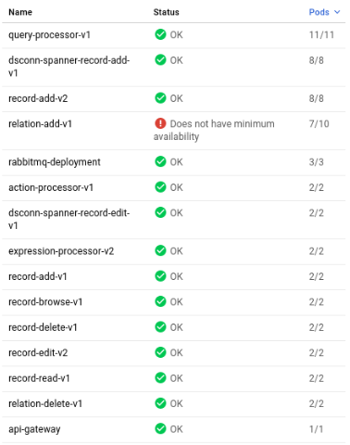
Time = 10: “queries auto-scale down, sudden demand for relation-add”
Service Requests:
Record Counts:
MicroServices Count:
Database Operations per Second:
Hardware Allocated:
© 2018 CitizenDeveloper. All Rights Reserved

Slide 12
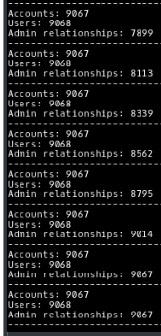
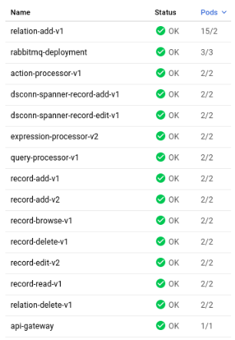
Time = 15: “no service requests: auto-scale down”
Service Requests:
Record Counts:
MicroServices Count:
Database Operations per Second:
Hardware Allocated:
© 2018 CitizenDeveloper. All Rights Reserved

