Slide 1


Internal Security Threats
Case Studies and Mitigation Methodologies
Peter Romness
Steve Caimi
May 2017

Slide 2
Abstract
Internal Security Threats
People are our most valuable assets, so we entrust them with legitimate access to critical systems and sensitive information to carry out their duties. But people can also become major internal threats by the actions they take – whether unintentionally risky or intentionally malicious.
This session explores real-world insider threat case studies and shows how a cybersecurity best-practices approach helps to mitigate the risk of insider threats.

Slide 3
Internal Security Threats

Slide 4
Effective Cybersecurity
Coordination is essential
People
Policy
Process
Technology

Slide 5
Cybersecurity Risks
The duality of human beings
People
Policy
Process
People are our greatest assets, but they can also be our biggest risks.
Technology

Slide 6
About Insiders
Attributes
1
Current or former employee, contractor, or business partner
2
Has or had authorized access to the network, system, or data
People
3
May have been vetted through background
or credit checks
4
Can be influenced by personal, behavioral, or financial issues
Individuals' behavior must be guided by policies, processes, and technologies

Slide 7
Internal Security Threats
Malicious vs. Unintentional
Malicious Insider Threats
Unintentional Insider Threats
People
Intentionally exceeds
or purposefully uses
authorized access to negatively affect the confidentiality, integrity, or availability of systems and data
Accidentally exceeds
or unintentionally uses
authorized access to negatively affect the confidentiality, integrity,
or availability of systems and data

Slide 8
Internal Security Threats
Some risky things people do
Malicious Insider Threats
Unintentional Insider Threats
People
Waste
Quick to Click
Duped
Fraud
Theft
Share
Credentials
Leaks
Carelessness
Sabotage
Abuse
Errors

Slide 9
Case Studies: Can you detect these?

Slide 10
Case Study #1
Detect an anomalous traffic pattern
Normal Activity:
The database usually communicates with insiders using these two endpoints
DB
Wi-Fi

Slide 11
Case Study #1
Detect an anomalous traffic pattern
Suspicious Activity:
The database begins sending high volumes of data outside of the network
011010110000101110110011011000110110011001100110101110000101001100110011001010100010100010100010100010010000000000011100110101001100100100110011
DB
011010110000101110110011011000110110011001100110101110000101001100110011001010100010100010100010100010010000000
Wi-Fi
001101010100011001001001
011010110000101110110011011000110110011001100110101110000101100110101001100100100001110110110011

Slide 12
Case Study #2
Detect evasive malicious code
Normal Activity:
Insiders use web and email in daily activities
Web Browsing
Email
Wi-Fi

Slide 13
Case Study #2
Detect evasive malicious code
Suspicious Activity:
Insider clicks a legitimate-looking email that actually contains advanced malware
Web Browsing
Spear-phishing Email
Wi-Fi

Slide 14
Case Study #3
Detect data leaks though cloud apps
Normal Activity:
Insiders access sensitive data with authorized devices
Wi-Fi

Slide 15
Case Study #3
Detect data leaks though cloud apps
Suspicious Activity:
Insider sends data to cloud app
And then: Outsider accesses data from cloud app
Wi-Fi

Slide 16
Mitigation Methodologies

Slide 17


The Cyber Question
Cybersecurity Risk Management
How can we efficiently
and
effectively
manage our
cyber risks?
Unacceptable Risk Level
Acceptable Risk Level

Slide 18




The Cyber Answer
Leverage Industry Best Practices
National Institute of Standards and Technology (NIST)
NIST Cybersecurity Framework, NIST Risk Management Framework
http://www.nist.gov/
1
Center for Internet Security (CIS)
CIS Critical Security Controls
http://www.cisecurity.org/
2
3
International Organization for Standardization (ISO)
ISO 27000-series publications
http://www.iso.org/
4
ISACA
COBIT 5 Framework
http://www.isaca.org/

Slide 19
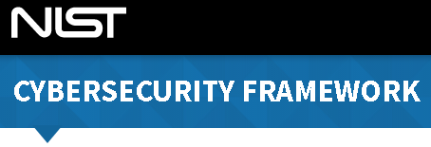
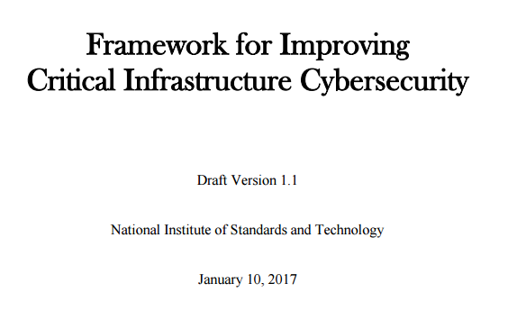

NIST Cybersecurity Framework
It’s gaining momentum
1
Common cybersecurity language
2
Risk-based investment decisions
3
Leverages existing best practices
4
Simple, flexible, and global
5
Freely available to everyone
6
Supply chain risk management

Slide 20

NIST Cybersecurity Framework
It’s for insider threats too
Identify
Protect
Detect
Respond
Recover
“The Framework provides a common language for understanding, managing, and expressing cybersecurity risk”

Slide 21
NIST Cybersecurity Framework
Insider threat detection
Detect
Identify
Protect
Respond
Recover
“Develop and implement the appropriate activities to identify the occurrence of a cybersecurity event.”

Slide 22
NIST CSF “Detect” Function
Insider threat detection
Anomalies and Events
“Anomalous activity is detected in a timely manner and the potential impact of events is understood.”
Detect
Security Continuous Monitoring
“The information system and assets are monitored at discrete intervals to identify cybersecurity events and verify the effectiveness of protective measures.”
Detection Processes
“Detection processes and procedures are maintained and tested to ensure timely and adequate awareness of anomalous events.”

Slide 23
Internal Security Threats
Highlighting effective detection
Suspicious Traffic Patterns
Malware in Disguise
Command and Control Activity
Encrypted Traffic
Detect
Exploited Vulnerabilities
Web Attack Vectors
Browser Infections
DNS Requests
Individuals' behavior must be guided by policies, processes, and technologies

Slide 24

Technology Highlight
Network as the Sensor
Network as the Enforcer
Network as the Sensor
Detect rich endpoint data
Detect anomalous data flows
Detect user access policy violations
Network as the Enforcer
Segment the network to contain attacks
Enforce policy to mitigate insider threats
Automate threat detection and respond faster
Notes:
So what is Cisco’s network as a sensor solution and how can it address the customer challenges of the new network and the new security challenges that the new network brings?
Cisco Network as a Sensor leverages a customer’s existing Cisco network investment to perform the network analysis and visibility that is the key element of network security today.
It enables customers to detect anomalous traffic flows and malware and see when malware gets in tries to propagate itself, gain granular visibility into applications and roles by user to see when they are violating access policy as well as detect rogue devices rapidly and quarantine them on the network.
Network as a Sensor reduces the complexity and fragmentation of networks by enabling visibility across the expanded attack surface to gain better control and help better secure the network.
So what is Cisco’s network as an enforcer solution and how can it address the customer challenges of the new network and the new security challenges that the new network brings?
Cisco Network as an Enforcer works hand in hand with Network as a Sensor.
Network as an Enforcer uses all the same elements in the Cisco Network as a Sensor solution but then augments that solution with CiscoTrustSec.
Once you have used Network as a Sensor solution to gain that deeper visibility and insight into traffic flows, user policy violations and malware, you can then leverage the network as an enforcer to take action.
Network as an Enforcer allows you to contain the scope of an attack in progress, quarantine threats and implement policy controls to secure your network resources.
It allows you to not only quarantine threats but also reduces your time to remediation.

Slide 25
Technology Highlight
What NaaS / NaaE Offers You
Unmatched Visibility
Global Intelligence With the Right Context
Advanced Threat Reduction
Detects and Stops Advanced Threats
Consistent Control
Consistent Policies Across the Network and Data Center
Complexity Reduction
Fits and Adapts
to Changing Business Models
Notes:
So let’s review these solutions one more time to remind you what Network as a Sensor and Network as an Enforcer can bring to your customers before I get to some specific use cases in the next section of the presentation.
First, unmatched visibility – the intelligence with the right context in your network applications, users and devices
Second, consistent control – bringing your customers consistent policies across the entire network all the way from the edge to the data center
Third, advanced threat protection – the ability to shrink the large attack surface that I mentioned at the beginning of this presentation as well as detecting and containing threats
Lastly, reduced complexity – the ability to adapt, scale and meet all of the challenges I spoke about at the beginning of this presentation -

Slide 26
Insider Threat Mitigation
Integrated threat defense strategy
1
Provides a richer network
and security architecture
4
Leverages Open Application Programming Interfaces (APIs)
2
Recognizes that best-in-class technology alone isn’t enough
5
Requires less gear and software to install and manage
3
Offers visibility into encrypted malicious activities
6
Speeds detection through automation and coordination

Slide 27


Recommended Approach
To summarize....
Simple
Open
Automated
Effective Cyber Risk Management

Slide 28





Learn more
Recommended reading
The Cybersecurity Landscape
http://www.talosintelligence.com
NIST Cybersecurity Best Practices
http://csrc.nist.gov
Cisco Security Reports
http://www.cisco.com/go/securityreport
Common Sense Guide to Mitigating Insider Threats
http://www.sei.cmu.edu
www.cisco.com/go/security

Slide 29
Effective Security Made Simple

